Slide 1

WELCOME

Slide 2
Introduction
M Quamrul Hassan
Assistant Teacher
Chandina model Govt. Primary School
Chandina, Comilla.
Gmail:qnoirit@gmail.com

Slide 3
Class- One
Subject-English
Time-40 minutes
Date-

Slide 4
Learning outcomes:
The students will be able-
L-1.1.1-become familiar with English sounds.
S-1.1.2-say simple words and phrases.
R-1.1.2-to recognize and read the alphabet both small and capital(non-cursive).
W-1.1.1-practise letter shapes.

Slide 5
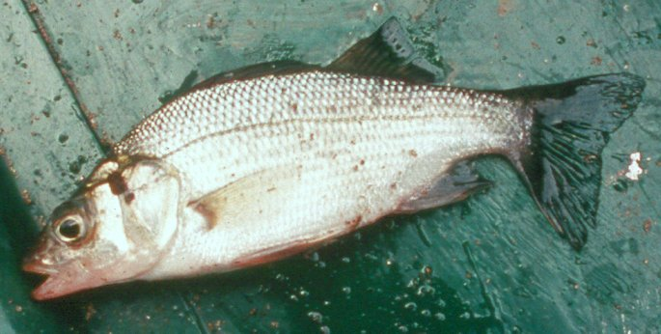
What do we see in the picture ?
Fish
fish
F
f

Slide 6
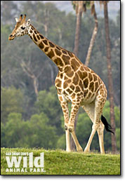
What do we see in the picture ?
Giraffe
giraffe
G
g

Slide 7
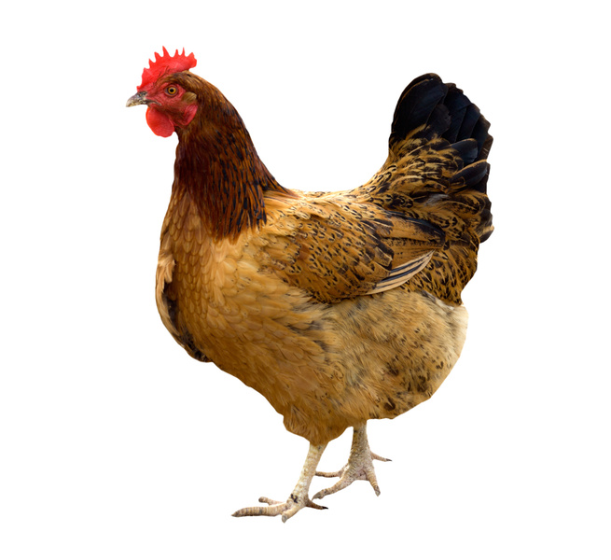
Hen
hen
H
h

Slide 8
Today we will learn -
Ff
Gg
Hh

Slide 9

Fan
F
f
fan

Slide 10
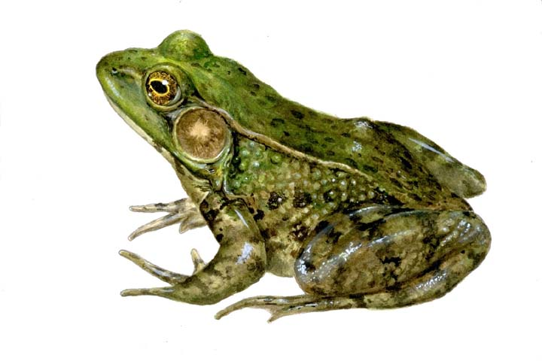
Frog
F
f
frog

Slide 11
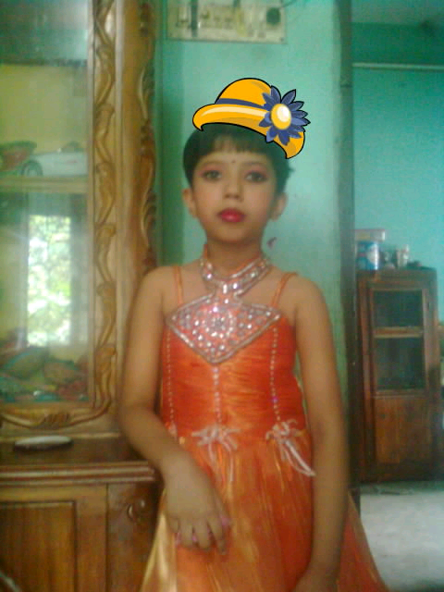
Girl
G
g
girl

Slide 12
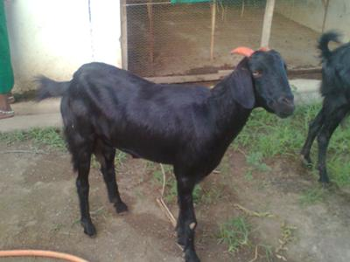
Goat
G
g
goat

Slide 13
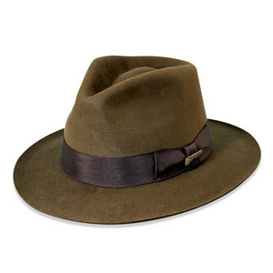
Hat
H
h
hat

Slide 14

Cap

Slide 15
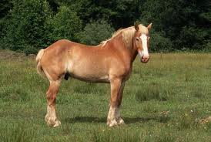
Horse
H
h
horse

Slide 17
H
F
G

Slide 18
F
g
G
h
H
f

Slide 19
Goodbye

