Slide 1

welcome

Slide 2
Teacher’s Interoduction
MD.Motiur Rahman
Asst.Teacher(English)
United High School Shakhahati
Sonatala ,Bogra

Slide 3
Topics Interoduction
Subject: English 1st Paper
Class : Eight
Unit: Eight
Lesson :One
Time : 50 Minute Date : 20/01/2014

Slide 4


Look at the picture

Slide 5
News! News! News!
To days topics

Slide 6
Objective Of the lesson
By the end of lesson student will be able…
Ask and answer the question.
Read and understand text.
Write short dialogue between two friends.
Write a short eassy.

Slide 7
Teacher reading the text and students listen attentively

Slide 8
Teacher’s Reading
Teacher will read the text and the student’s listen attentively …

Slide 9
Student’s Reading…
Student’s will read the text teacher will listen and also make correction their mistake.

Slide 10

Individual work
Look at the picture and answer the question
Question:Why do we read the newspaper?
Ans:
We read news paper to increse our knowledge.

Slide 11
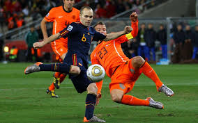
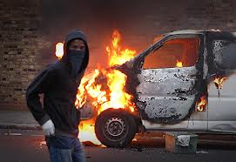
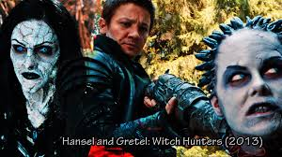
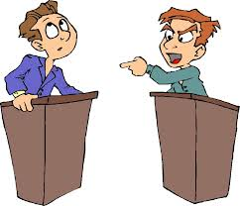
Pair works(5minits)
Identify the following pictures
খেলা
crime
sports
দূর্নিতি
movies
চলচিত্র
Debat
বিতর্ক

Slide 12
Question
What do you see in the picture?
Answer:we see inthepicture;sports
Crime;movi;debat.

Slide 13
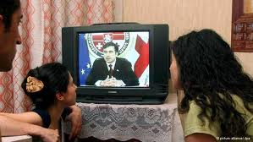
Group works:

Slide 14
Question:
Write a dialogue between two friends about the necessity of reading
Newspaper.

Slide 15
Evaluation:
1 who want’s to be a world youngest computer expert?
(a)a five years boy (b)a six years boy (c)a seven years boy (d)a eight years boy.
2What is the boy’s name?
(a)Asik (B)wahid (c)wasik (d)rakib
√
√

Slide 16
Home Work:
Write an easy on a newspaper.(Your easy must no more than250 words)

Slide 17

Thank you.

