Slide 1

WELCOME
DEAR STUDENTS

Slide 2
INTROINTDUCTION
MD.ABUL KALAM AZAD
ASST. HEAD MASTER
Dogachi High School And College,Pabna.

Slide 3
Class:-Eight
Sub:-Eng. 1st Paper
Time:- 50 minutes
Date- 21.01.2014

Slide 4

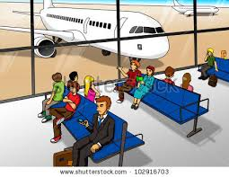
Dear students look bellow the pictures and guess
LOOK AT THE PICTURE.
1. What do you see in the picture?
2. Can you guess where it could be?
3. ho are the people in the picture?
4. What could be their relationship?
Waiting people at the airport

Slide 5
So, we will learn
‘AT THE AIRPORT’

Slide 6
AIMS AND OBJECTIVES
After finishing this lesson we will be able
Listen for information
After study they will be able to
Listen to and follow announcements
Read and understand texts
Ask and answer questions
Write answers to questions
Write the main ideas

Slide 7
Now read the passage and find out if your guesses are correct
Where does Zara live ?
Why does she come to Bangladesh?
Why was Mita very exciting?
Who sit at the lounge?
Who has a small lip gel in hand luggage?

Slide 8
Read the passage again and do pair work.
Guess the meaning of the following words-
1.Luggage-
baggage
2.Problem-
difficulty
3. Allow-
permit
4. Security-
safety
5. Announce-
proclaim

Slide 9
Evaluation
What are Zara and Mita planning?
Who are at Hazrat Shahjalal International Airport?
Where are they waiting?
What does Zara’s father bring?
When will Mita be ready to travel?

Slide 10
Home work
Write a short composition about your experience of traveling to another places. It could be going to your grandparents’/aunt’s/sister’s/brother’ house.
Notes:
1010

Slide 11

THANK YOU FOR EVERYBODY

Slide 12
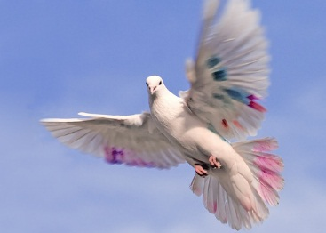
GOOD BYE

