Slide 1
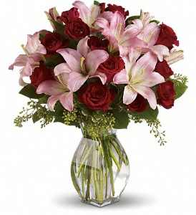
Good morning

Slide 2

INTRODUCE
MONTU KUMAR SORKER
ASSIST’ TEACHER
BIRISIRI MISSION GIRLS HIGH SCHOOL
DURGAPUR ,NETRAKONA.
Subject-English
Class-8
Unit-3,lesson-8.

Slide 3
The result of learning
a)Who is the class teacher?
b)Who is mrs.suborna saha?
c)How was the classroom?
d)Who is the class captain?

Slide 4
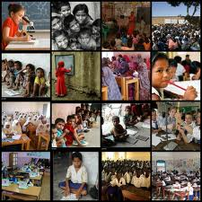
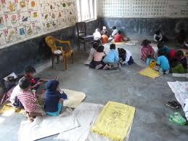
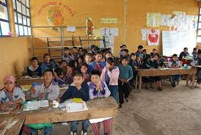
look at the pictures
Dirty class room’

Slide 5
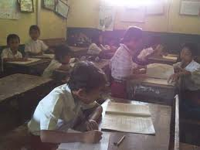
Title-Making a class
Room forum.

Slide 6
Vucabulary presentation
Enter-
Dirty--
Clean-
Tidy-
Select-

Slide 7
Evuluation
a)What is the responsibility of the student?
b)Who is the class teacher?
c)Why did the students form a forum?
(Group work)

Slide 8
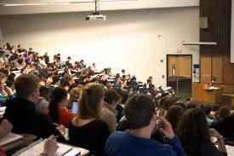
Home task
Why did the students form a
Forum?

Slide 9

thanked

