Slide 1

welcome

Slide 2
Teacher Introducing
Ranjit Chandra Paul
Assistant Teacher (English)
Bejora Dakkhin Para High School
Shajahanpur, Bogra.
ID No - 23

Slide 3
Lesson introducing
Class : Nine
Subject : English (1st paper)
Unit : Five
Lesson : 1
Duration : 50 minutes
Date :20/01/2014

Slide 4
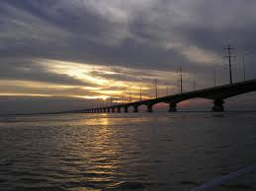
Previous knowledge justify
What do you see in the picture?

Slide 5
Learning outcomes
After we have studied the lesson, we will able to
Comprehend and summerise texts.
Ask and answer questions.
Take part in debates on given topics.

Slide 6
Todays Topic
The greed of the roaring rivers

Slide 7
vocabulary
Slum
Danger
Erosion
Whisper
Adapt
Demolish
Estimate
small cottage
peril
Lose of land
To talk of ear
Alter
destroy
Calculate

Slide 8
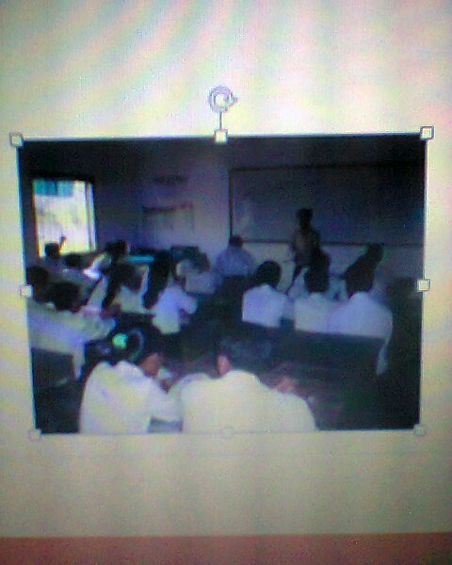
Teacher’s reading
Teacher will read the text frequently and students will listen.

Slide 9
Student’s reading
Students will read the text teacher will listen and also make correction their mistakes.

Slide 10
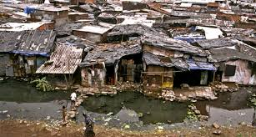
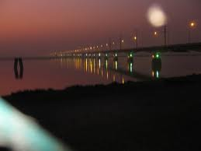
Individual work
(a)Where does Meherjan live?
(b) What is the name of river?

Slide 11
Answer
(a) Meherjan lives in a slum on the Shirajgonj Town Protection Embankment.
(b) The Jamuna.

Slide 12
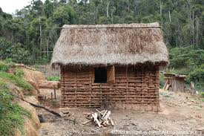
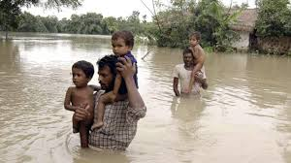
Pair work
(a) What does Meherjan use to make fire for cooking her meals?
(b) In which season does river erosion most likely occur?

Slide 13
Answer
(a) Meherjan uses some fallen leaves and straw to make fire for cooking her meals.
(b) In rainy season river erosion most likely occurs.

Slide 14
Group work
Make two groups and write support/oppose the statement given bellow then debate.

Slide 15
Evaluation
For each phrase below choose that is closest to the meaning used in the text above.
1.Roaring river
(a) rivers that flow strongly making wild sounds
(b) rivers having many rowing boats in them
(c) rivers that make people cry out
(d) rivers that have noisy fishes
2.landed property
(a) a rented piece of land
(b) apiece of land on the bank of a river
(c) property in the form a source of income to its owner
(d) property used only as an agricultural form

Slide 16
3.whispering wind
(a) wind that blows from across the river
( b) wind that blows with a hissing sound
(c) wind that helps someone make a fire
(d) wind that blows in summer
4.Dancing of the flame
(a) a traditional from of folk dance
(b) a flame that makes people dance around it
(c) a flame that is made unstable by the blast of air
(d) a flame made by people to remember their pasts
Ans: 1.(a) 2.(d) 3.(b) 4.(c)

Slide 17
Home work
Write a composition about “Flood in Bangladesh” about 200-220 words.

Slide 18
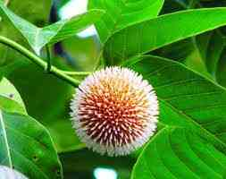
Thank you

