Slide 1

WELCOME
welcome

Slide 2
Presented by.
Md. Shafiqul Islam
Assit. Teacher
Shamsunnahar –Osman
Ghani Shikka Niketon.
Karimgonj, Kishoregonj.
Class- Nine .
Sub- English ( 1st paper)
Topic –Environment pollution.
Time - 40 minutes.

Slide 3
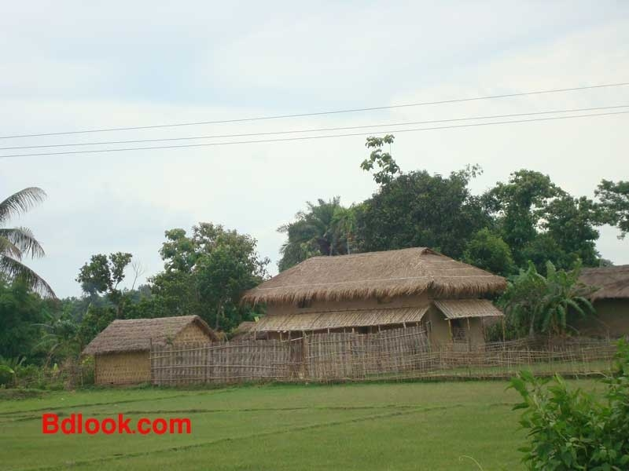
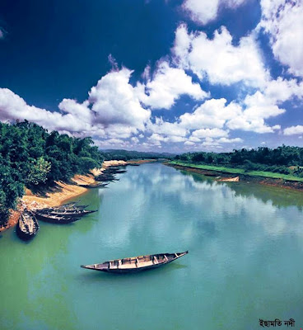


Slide 4
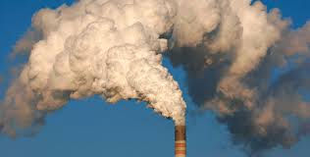
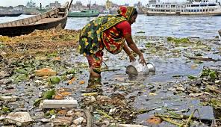

Slide 5
Environment pollution

Slide 6
At the end of the study students will be able to
tell about new words and enrich their vocabulary.
tell about different types of pollution.
write the effect of environment on us.
take some effective steps to prevent pollution .

Slide 7
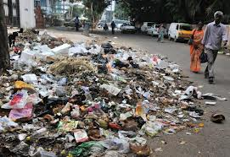
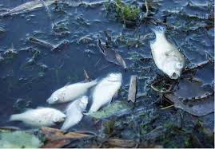
V0cabulary present
dirt, waste
Rubish=
Don’ t throw domestic rubbish here and there
Toxic=
poisonous
We should not drink poisonous water

Slide 8
Group work :
Findout five points about Environment pollution and write down .

Slide 9
Evaluation
1. What is Environment ?
2.Mention the causes of pollution ?
3. What sorts of diseases may be caused due to pollution ?
4 .How we can minimize pollution ?

Slide 10
Home work :
Make a list of 5 points about the way of keeping Environment free from pollution.

Slide 11

THANKS

