Slide 1
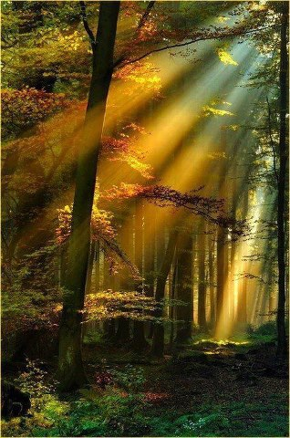
GOOD MORNING

Slide 2
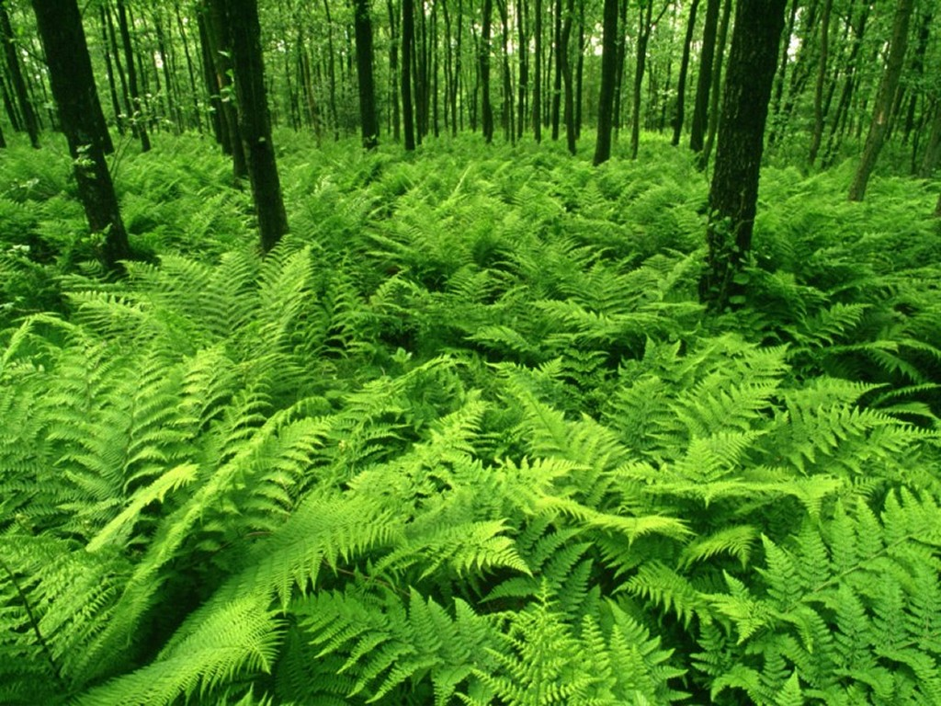
Class-2
Sub- English
Unit 5- The rainbow
Lesson 1- Colours (1)

Slide 3

Learning out comes
Student will be able to
1.Know some colours name then
2.Recite the rhyme with correct pronunciation

Slide 4


Creating emotion
“RAINBOW”

Slide 5
YELLOW
BLUE
ORANGE
VIOLET
INDIGO
RED
GREEN

Slide 6


Slide 7


Slide 8
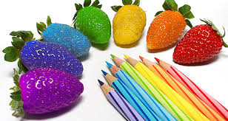

Slide 9

Do you want to hear a rainbow song?
Let’s see the video.

Slide 10

Now we read the rhyme.
“RAINBOW”

Slide 11
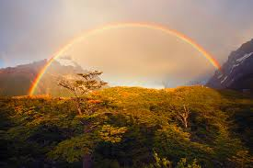
I see rainbows

Slide 12
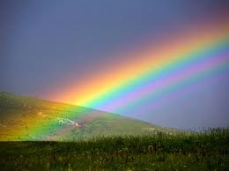
I see rainbows

Slide 13
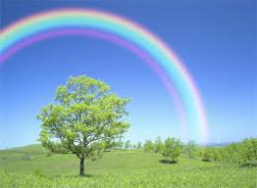
Way up high

Slide 14
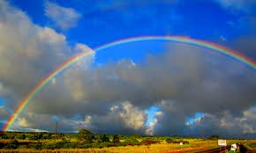
In the sky

Slide 15
I see red and
orange
RED
ORANGE

Slide 16
Yellow ,
green
and blue
BLUE
YELLOW
GREEN

Slide 17
Violet ,
indigo too
VIOLET
INDIGO

Slide 18

What a view !

Slide 19

Input
Students repeat the rhyme after teacher.

Slide 20
I see rainbows
I see rainbows

Slide 21
In the sky
Way up high

Slide 22
I see red and orange
RED
ORANGE
Yellow , green and blue
BLUE
YELLOW
GREEN
Violet , indigo too
VIOLET
INDIGO

Slide 23
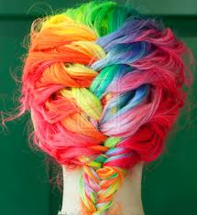
THANKS

