Slide 1

Welcome

Slide 2
Introducing
Bikash kanti Majumder
Rajarkathi High school
Udaykathi, pirojpur
ID No:215.
Date: 03 feb 2014
Class:Nine
Sub: English 1st
Time: 45 munite

Slide 3
Learning outcome
By the end of the lesson ss will be able to……..
Learn about pollution.
Talk about Air,Water and Soil pollution.
Talk about Environment pollution.
Ask and answer question.

Slide 4
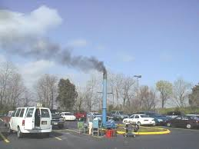
Picture-1

Slide 5
Today’s lesson
“Environmental Pollution”

Slide 6
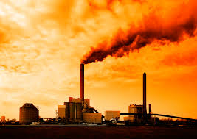
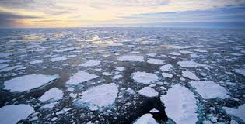
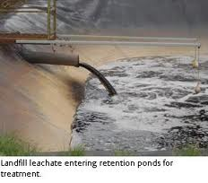
Dear student open your book , at the page no-(52),Unit-5,lesson-2.
Read through the passage.
“Bangladesh is now apparently in the grip of all sorts of pollution like air, water and soil.

Slide 7
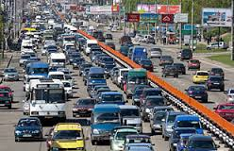
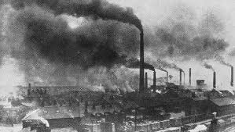
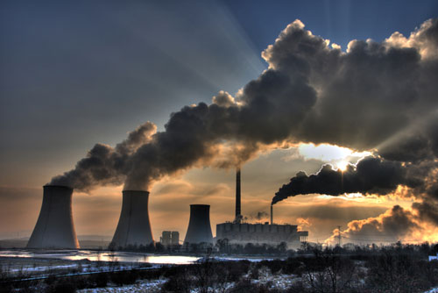
Air pollution

Slide 8
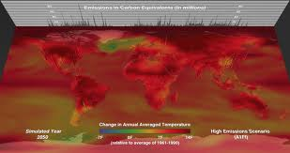
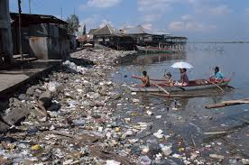
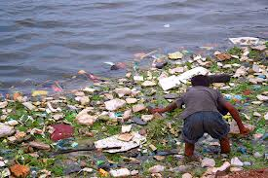
“Water pollution can occur in oceans,rivers,lakes,ponds and underground reservoirs.”

Slide 9
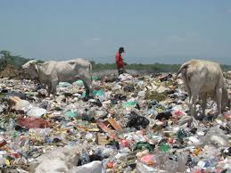
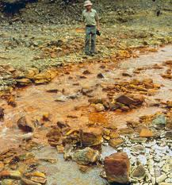
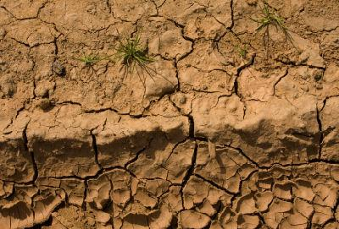
Soil are pollution in many way like as household wasts,polythene shopping bags,Agricultural pesticides fertilizers.

Slide 10
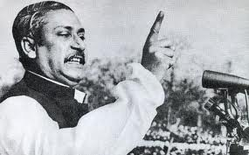
vocabulary
Indiscriminate
vehicles
Encourage

Slide 11
Group work
1.What is the main cause of air pollution?
2.What is the another cause of soil pollution?

Slide 12
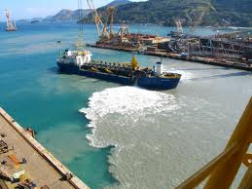
Evaluation
How can you save water pollution?
Why does air pollution happen?

Slide 13
Homework
Write the main idea of the passage about (TEN) sentences.

Slide 14
Departing
Thank a lot

