Slide 1

Welcome everybody to this lesson

Slide 2
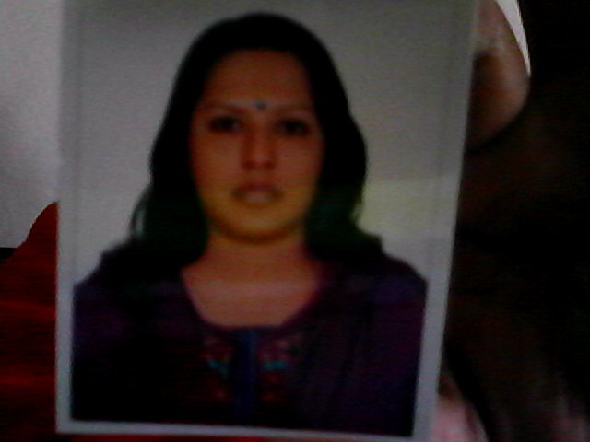
Tanjina Shirin
Assistant teacher [English]
Natore Govt. Girls High School
Natore.

Slide 3
Date
24 February’2014
Class : Eight
Subject : English
Paper : First
Unit : Three
Lesson :6
Time :50 Minutes.

Slide 4
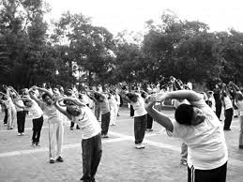
Look at the picture

Slide 5
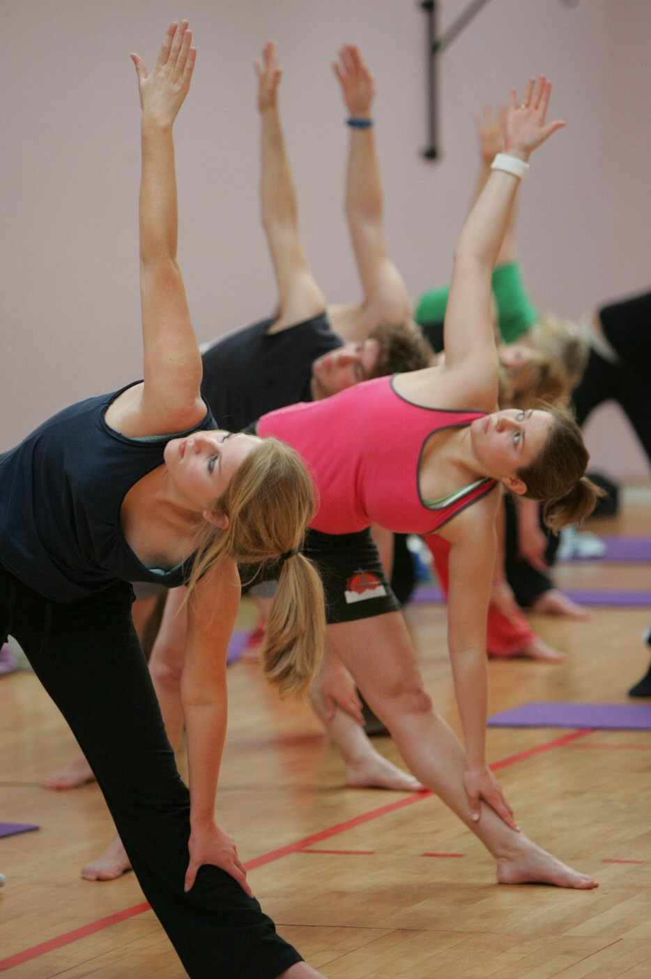
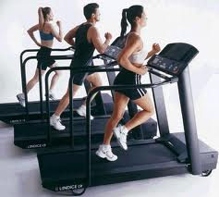
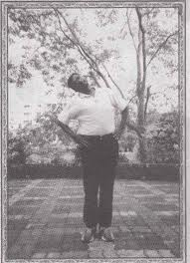
Let’s look at some more pictures.

Slide 6
Now, Let’s discuss about the pictures.

Slide 7
These are-
Different kinds of physical exercises.
To keep our body fit we need physical exercise.

Slide 8
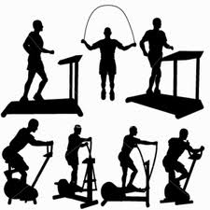
Title of today’s lesson
Physical exercise

Slide 9
Learning outcomes :
After reading this lesson the students
Will understand text through silent reading.
Will listen for information.
Will ask and answer questions.
Will write the answers to questions.

Slide 10
Presentation :
Loud reading by the teacher and the students will listen carefully.

Slide 11
Meaning of some new words.
Stretching
Expansion.
Benefit
Advantage.
Regularity
Conformity to rule.

Slide 12
Individual work :Time-08 Minutes
Now, Open at page 36 of your Text book and read the passage silently.

Slide 13
Pair work:Time:10 Minutes:
Discuss with your partner:
What’s your favourite sport ?
Do you take part in it ?
If so, where do you play it and who with ?

Slide 14
Students will discuss and teacher will monitor.

Slide 15
Group work:Time-10 Minutes
Group-1
Answer the question.
What things are necessary for good health ?

Slide 16
Group -2 Time-10 Minutes.
Answer the questions.
How many physical exercises are there ?
Why do we need physical exercise ?

Slide 17
Now , match your ideas with the following answers :
Key-1 Healthy food,proper rest and sleep are
necessary for good health.
Key-2 There are different kinds of physical exercises.
They are indoors as well as outdoors.In the
house we can do some free hand exercise.We
can also stretch different parts of our body.
Outside,we can play, swim or simply work.
Key-3 The benefits of physical exercise are many.The
greatest of them is that it keeps us fit for work. It
also

Slide 18
Evaluation :

Slide 19
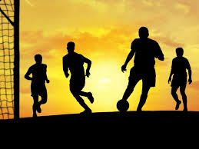
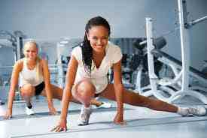
Let’s see the pictures and note how we take physical exercise regularly .

Slide 20
You will see a list of some physical exercises with pictures. Notice the pictures very carefully.And then say which ones are indoor exercises and which are outdoors, and which ones can be done both indoors and outdoors.

Slide 21
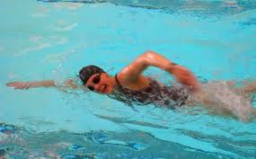
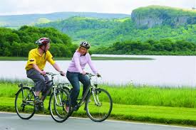
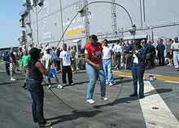

Let’s notice the pictures .
Physical exercise
Playing sport
Swimming
Cycling
z
Stretching
Skipping
Jogging

Slide 22
Home Task :
Imazine, you have a physical education teacher in your school . And s/he helps you to do physical exercise in many ways. Now write down in your own words how s/he helps you to do physical exercise.

Slide 23

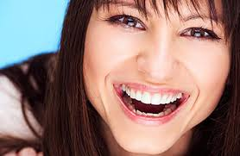
Thank you all
Take regular exercise and be healthy

