Slide 1

WELCOME

Slide 2
Introduction
A.WAHAB MIAH
Asst.Teacher
Barati High School
MIRZAPUR
TANGAIL
Class:Nine
Subject:English 1st Paper
U-3;L-5
Time:50 minutes
Date:17.02.2014

Slide 3
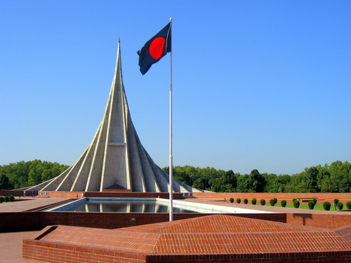
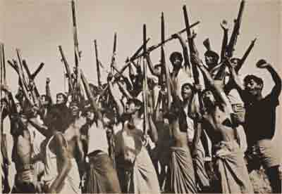
Introduction of lesson
Students look at the picture
Q-What can you see in the picture?
Q-Where is it?
Q-Why was it built?

Slide 4
Title of the lesson
Independence Day

Slide 5
Learning Outcome
By the end of the lesson students will be able to………..
Tell about the heroic struggle of the liberation war
Read the text
Match the word with their meanings
Choose the best answer

Slide 6

Presentation

Slide 7


Slide 8
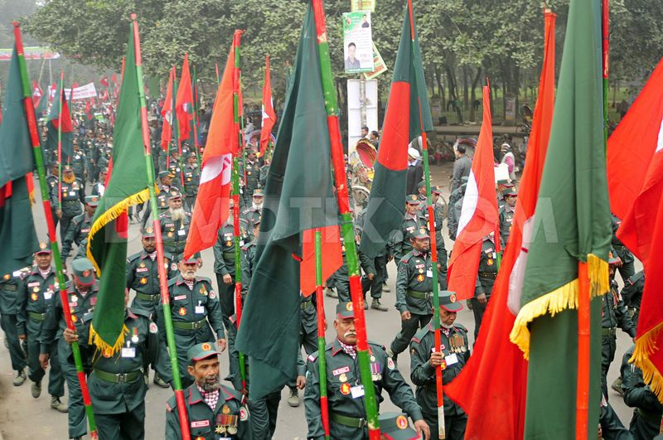

Slide 9
Write the activities of the Independence Day.

Slide 10
Silent reading practice
Post reading activity
Q-What do the President and thePrime Minister do on the Independence Day?

Slide 11
Match the words with their meanings
Words
Fervour
Alike
Spectator
Display
illuminate
Acts of performing skills
To decorate a building with bright lights
In a similar way
A strong feeling of excitement
A person who is watching an event

Slide 12
EVALUATION
Q-When is the Independence Day observed?
Q-Who sacrificed their livesin 1971?
Q-Why is the 26th March so important in our national history?

Slide 13
Home Work
Write briefly how you observed this years 26th March at your school.

Slide 14

THANK YOU

