Slide 1
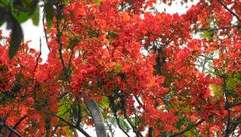
W
E
L
C
O
M
E

Slide 2
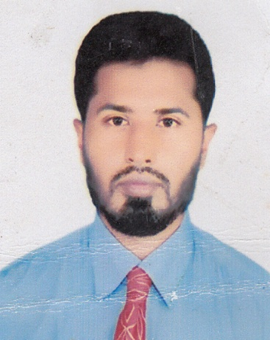

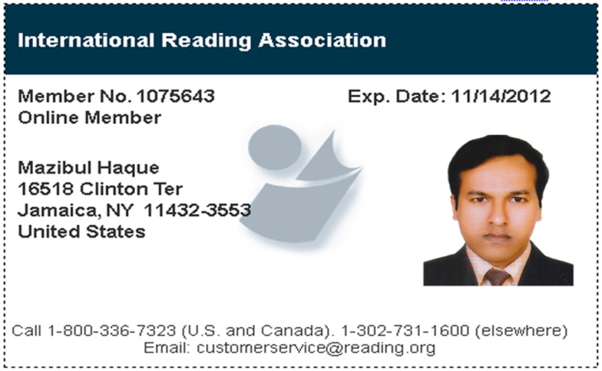
Md.Bachhir Ahammed
Asst. teacher
Dept. of Accounting
Email:bachhir1978@gmail.com
Cell No: 01823006515

Slide 3

Worried
Angry
Sad
Sleepy
Happy

Slide 4
Adjectives

Slide 5
Learning Outcomes
By the end of the lesson students will have…
explained what an adjective is.
identified adjectives from a text.
matched adjectives with pictures
made a list of adjectives
used adjectives to describe someone/ something

Slide 6
Adjective
Quality
Quantity
Number
Pronominal
Classes of Adjective

Slide 7
Adjective of number
Ordinal
Multiplicative
Cardinal
Three kinds of

Slide 8
He is a rich man
I want some rice
He has five pens
This is his toy
Example

Slide 9
Pair work
Time-05 minute
Give four example without before four example

Slide 10
Example
Cardinal :One,Two
Ordinal
:First,Second
Multiplicative:Single,double

Slide 11
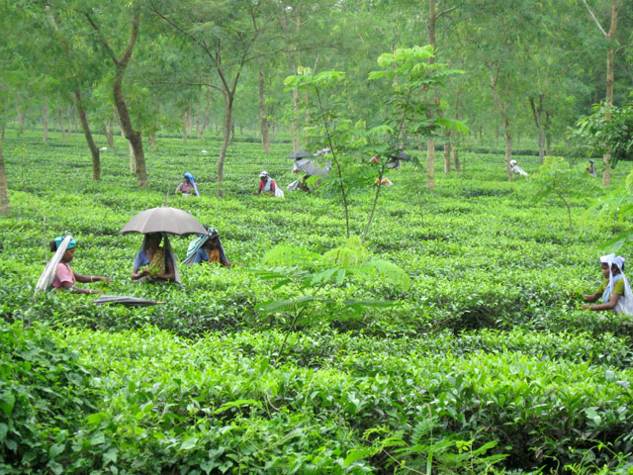
*Tea garden is a shady place.

Slide 12
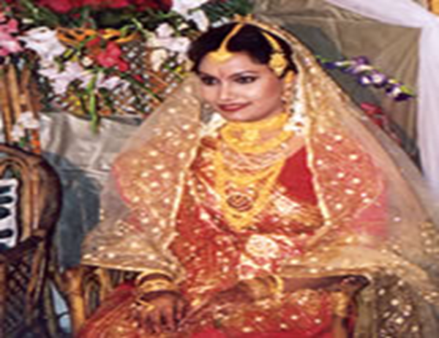


Slide 13

This place is sunny.

Slide 14

I saw a very clear rainbow.

Slide 15

Are you tired today?

Slide 16
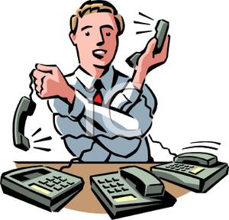
Rajib has to receive too many phone calls.

Slide 17

The gift was very surprising.

Slide 18
Group work . Time 1o munite
Work with your partner and write five sentences about your favourite person using some adjectives.

Slide 19
Home task
Make five sentences use some adjective

Slide 20


