Slide 1

Creating Safety Environment
Welcome

Slide 2
Lesson’s Introduction
Mahfuz Ara Sultana
Assistant Teacher
Carmichael College Government Primary School,
Rangpur City , Rangpur.

Slide 3
Lesson’s Introduction
Class-Two
Subject-English
Unit-8;Animals
Lesson-1, Use on/in/under.
Page- 50-51

Slide 4
Learning outcome
Student will be able-
1. to use preposition in / on / under.
2.to fill in the gaps by using on/in/under.
3. to use English sounds, stress and intonation appropriately .
4.to match the name with the picture.

Slide 5
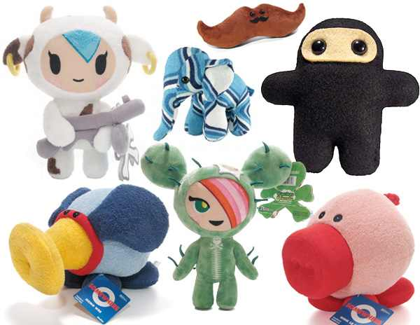
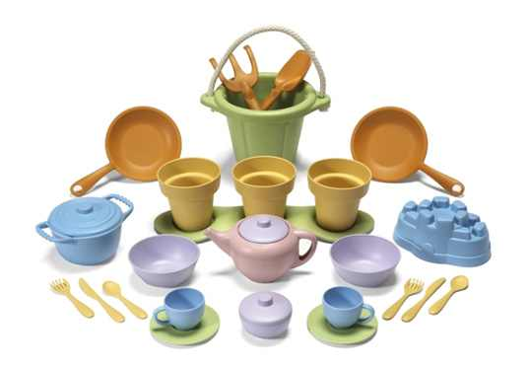
Creating emotion
Do you like to play with toys?

Slide 6
Today’s lesson
Where do you keep your toys?
on your bed/ under your table/ in your bag.
in
on
under

Slide 7

Presentation
20 minutes

Slide 8
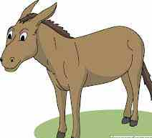
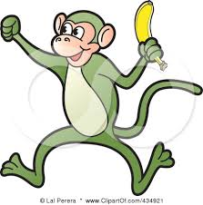

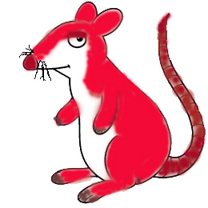
Checking previous knowledge
Say name of the animals?

Slide 9
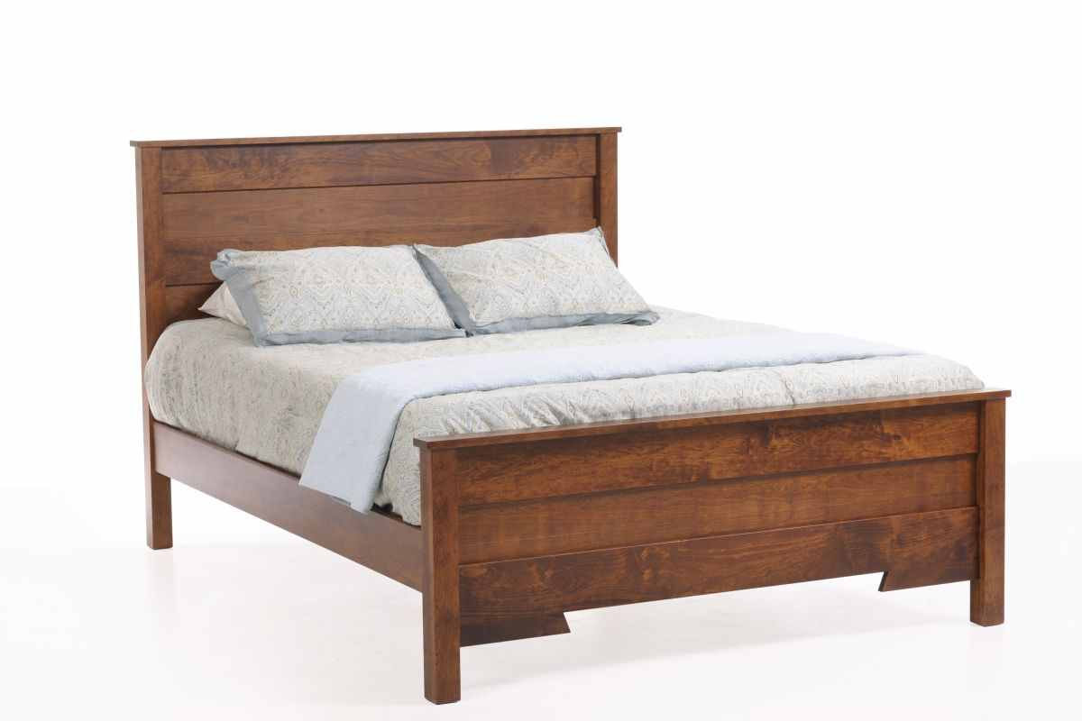
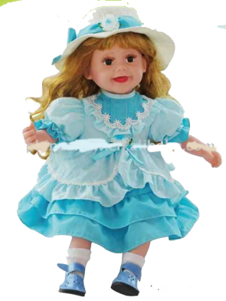
Use of in
A doll
in
the bed

Slide 10
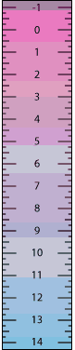
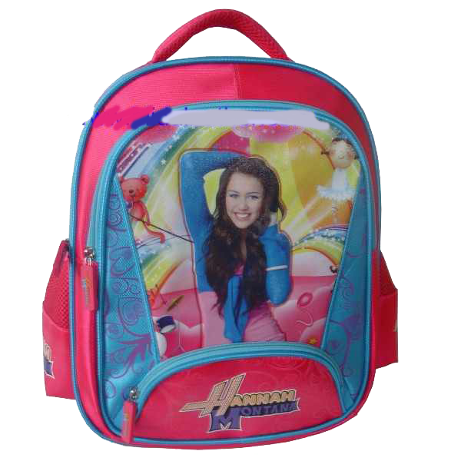
Use of in
A scale
in
the bag

Slide 11

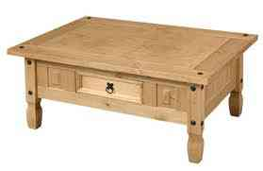
Use of on
A glass
on
the table

Slide 12
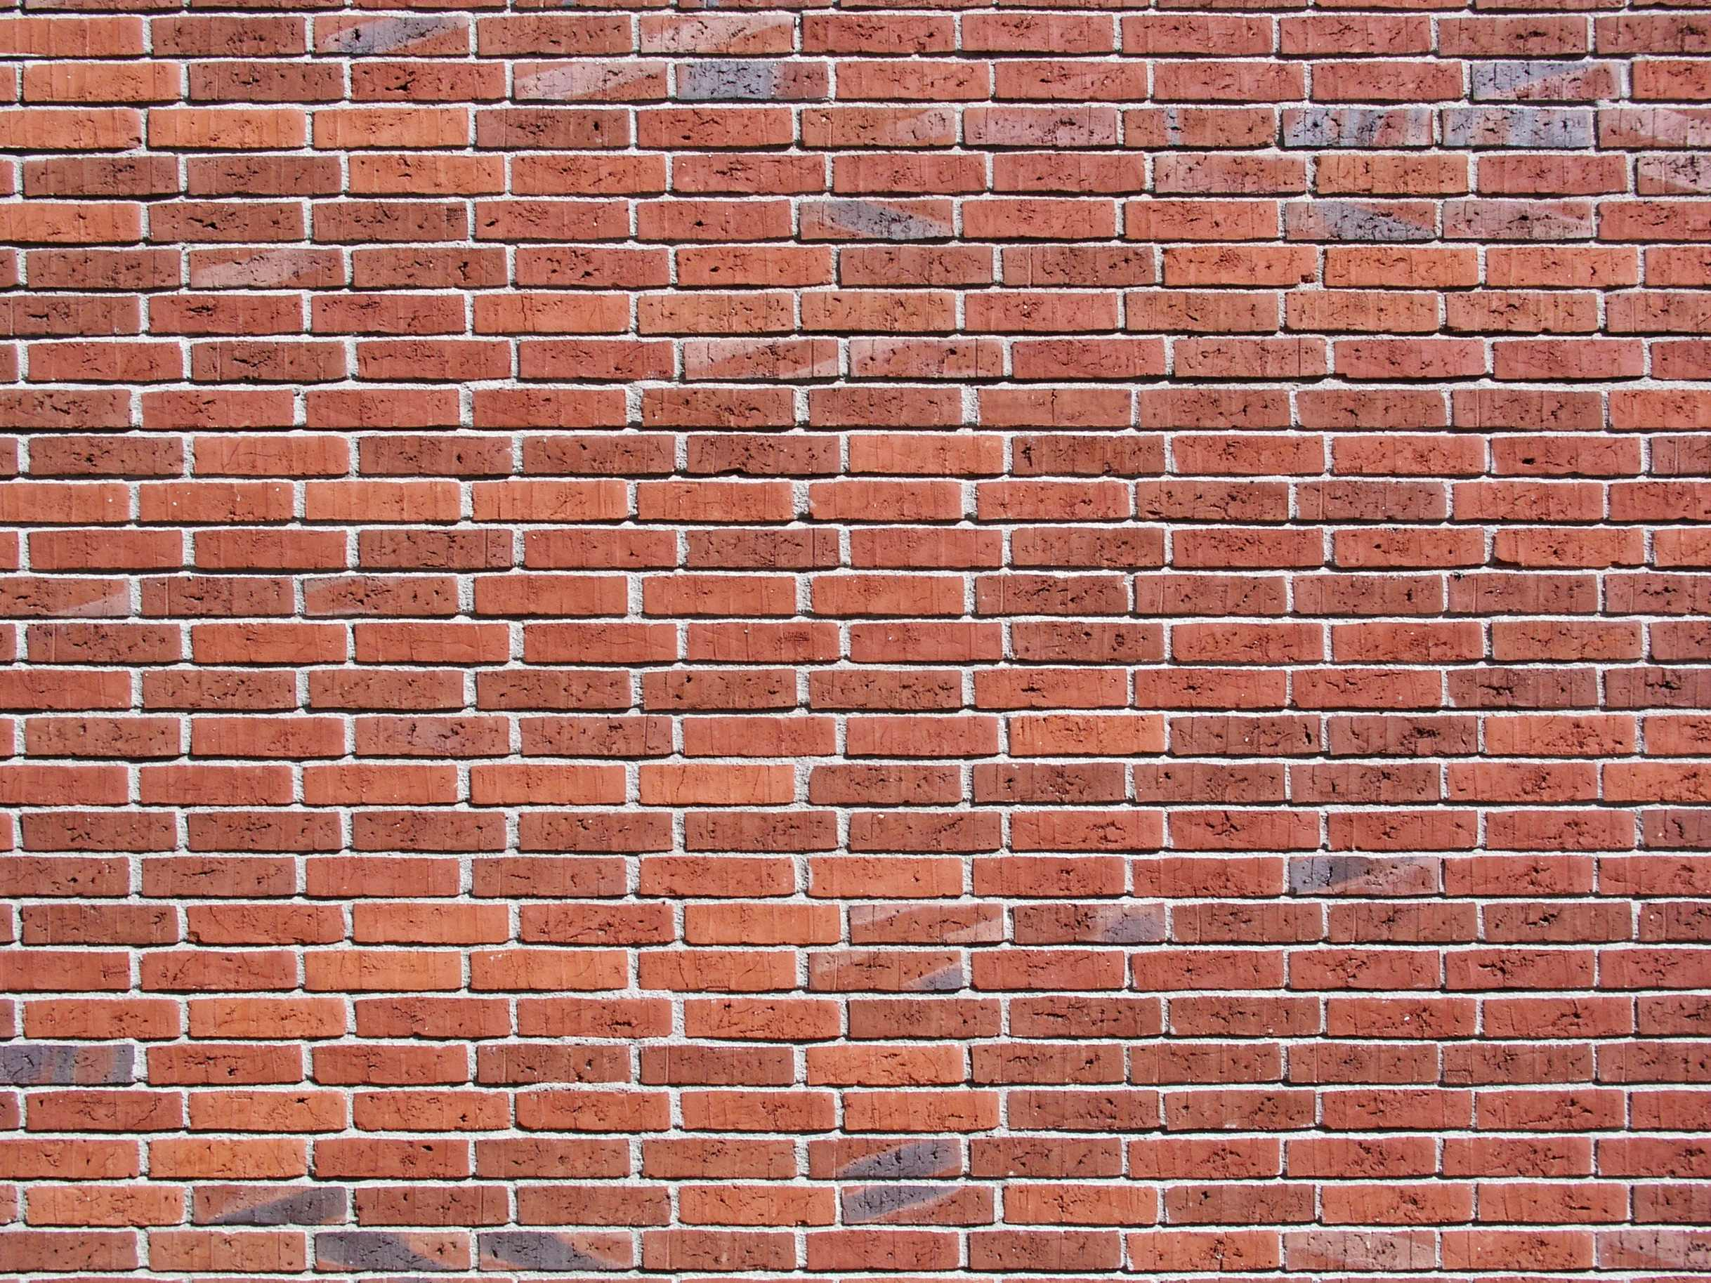

Use of on
A picture
on
the wall

Slide 13


Use of under
A pillow
under
the mat

Slide 14


Use of under
A television
under
a vase

Slide 15
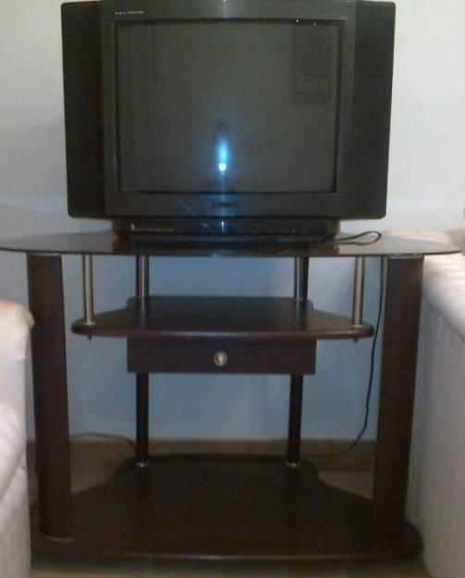

Use of under
A ball
under
the television

Slide 16
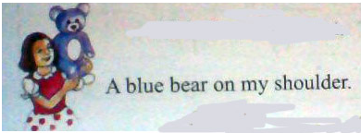
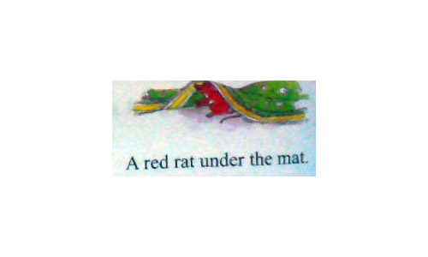
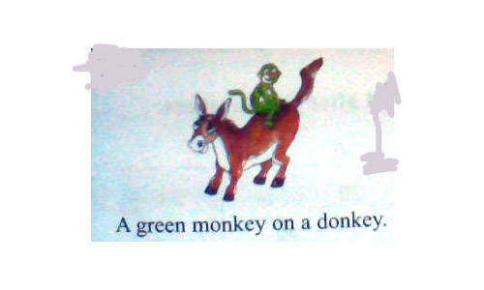
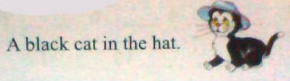
Let’s see the text to find out where are the animals?
Where is the red rat?
Where is the black cat?
Where is the blue bear?
Where is the green monkey?

Slide 17
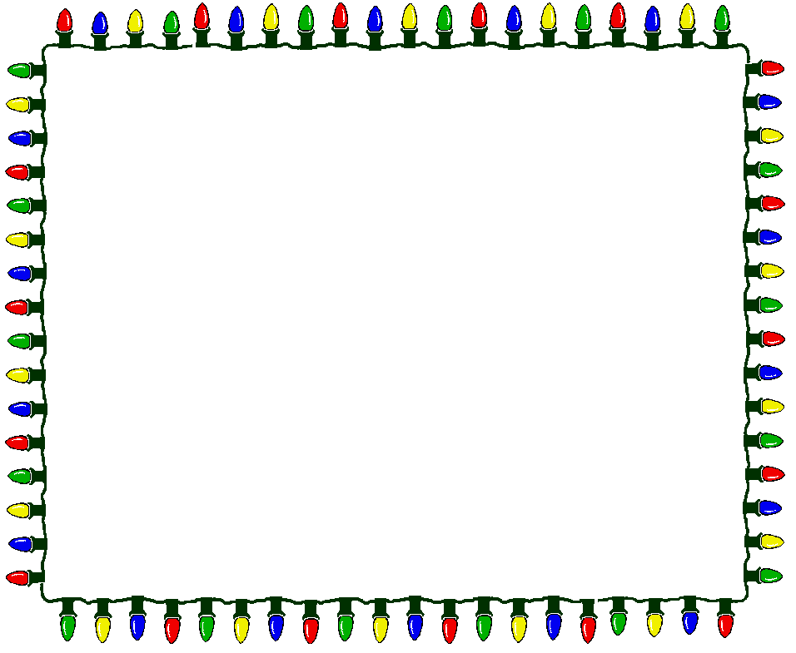
Practice

Slide 18
Listen and say in group.
Say these words with appropriate stress and intonation.
rat
donkey
ball
cat
monkey
hat
doll
mat

Slide 19

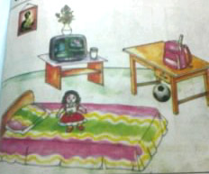
Look at the picture and ask and answer question in pair
Use in / on/ under
Q: What do you see?
A: I see a …………

Slide 20
Evaluation

Slide 21
Fill the blanks by using in/on /under
a picture …… the wall.
2. a scale …… the bag.
3.a doll …… the bed.
4.a vase …… the television.
5.a television …… a vase.
6.a pillow …… the bed.

Slide 22
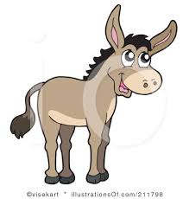


match the name with the picture
mat
picture
donkey
pillow

Slide 23


Declaration end of the lesson.

