Slide 1


Slide 2
Presented by
Dilruba Khanom
Assistant teacher
Oskhali Aliya Model Govt Primary School
Hatiya, Noakhali.

Slide 3
Class:- One
Subject:-English
Lesson 2 :- Letters A……H
Page:- 10,11,12
Date:- 23 /07 / 2013
Time:- 45munite.

Slide 4
Objectives:
By the end of the lesson students will be able to..
increase their speaking,listening & writing skill.
to learn new vocabulary with colourful pictures.

Slide 5
Safe learning environment

Slide 6

















Slide 7
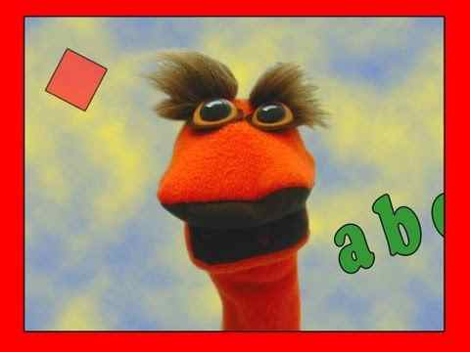

Slide 8
Declaration of the
title
Letters A….H

Slide 9
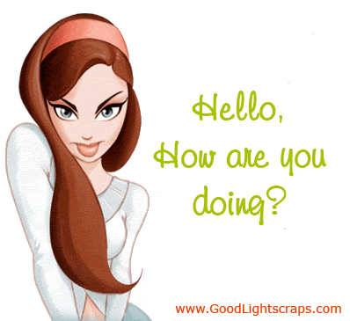
Prasentation
30minute

Slide 10

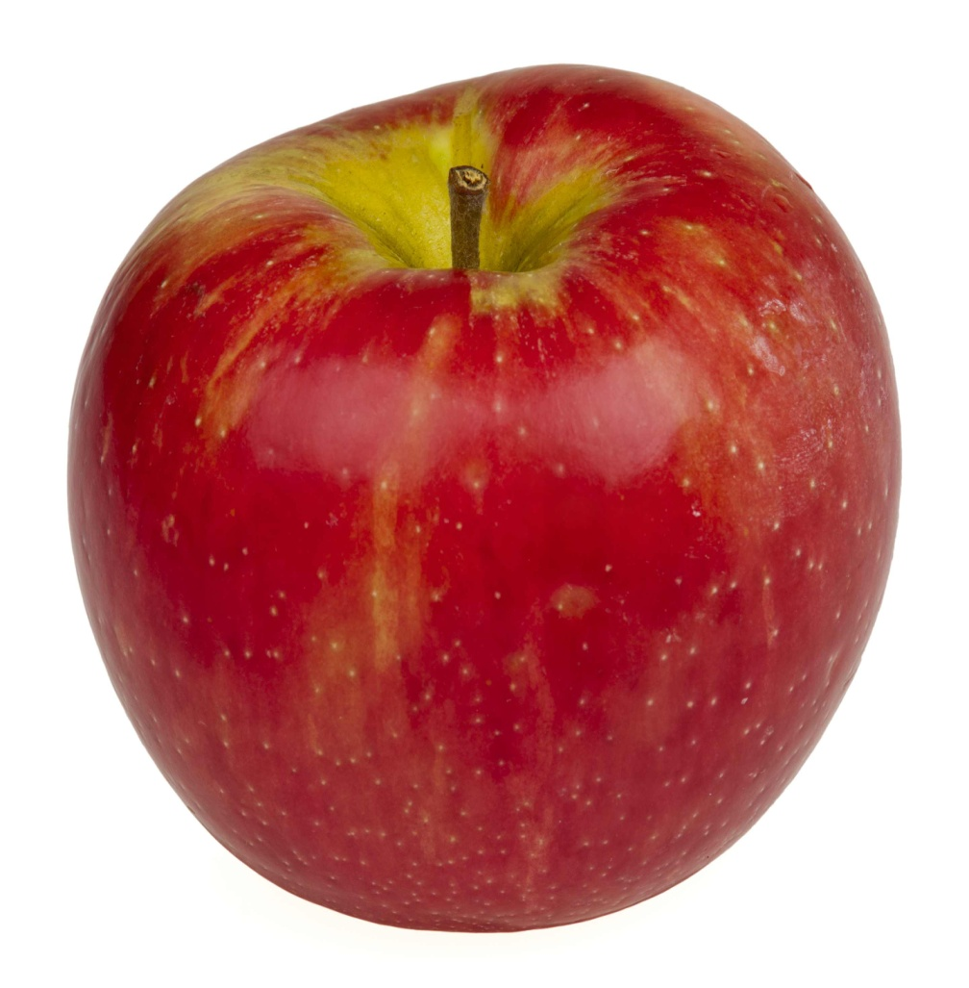

Do you know the pictures
What’s this ? Look,

Slide 11
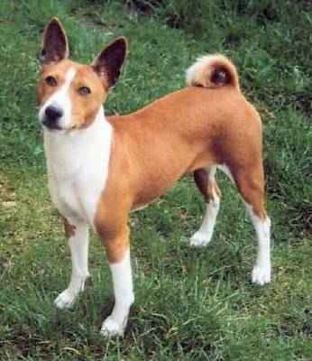
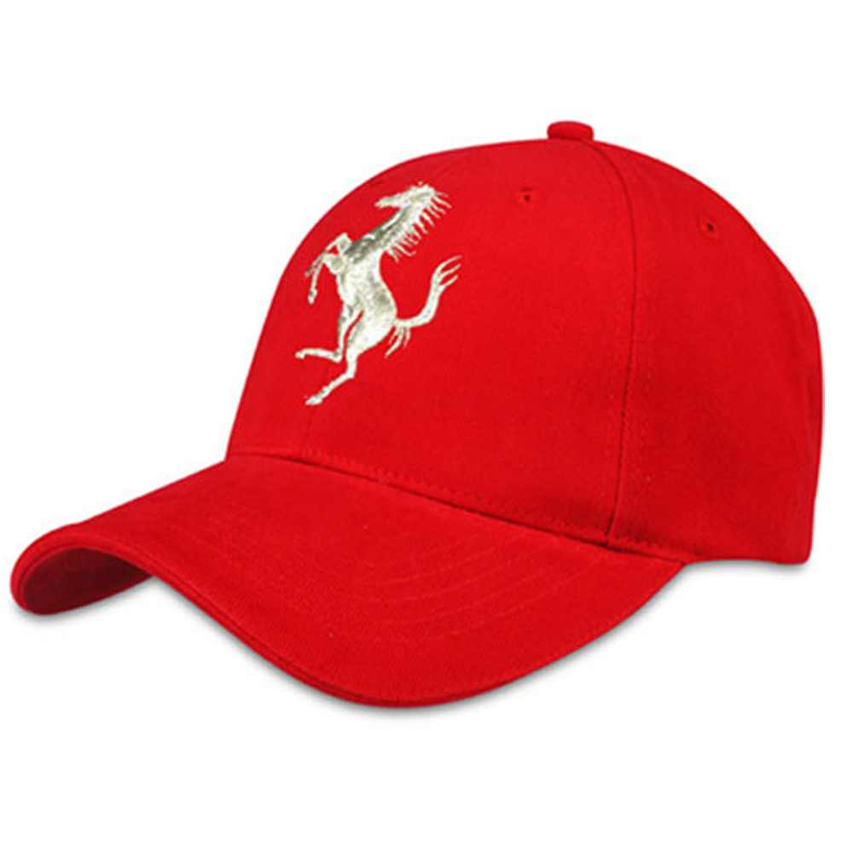

Slide 12
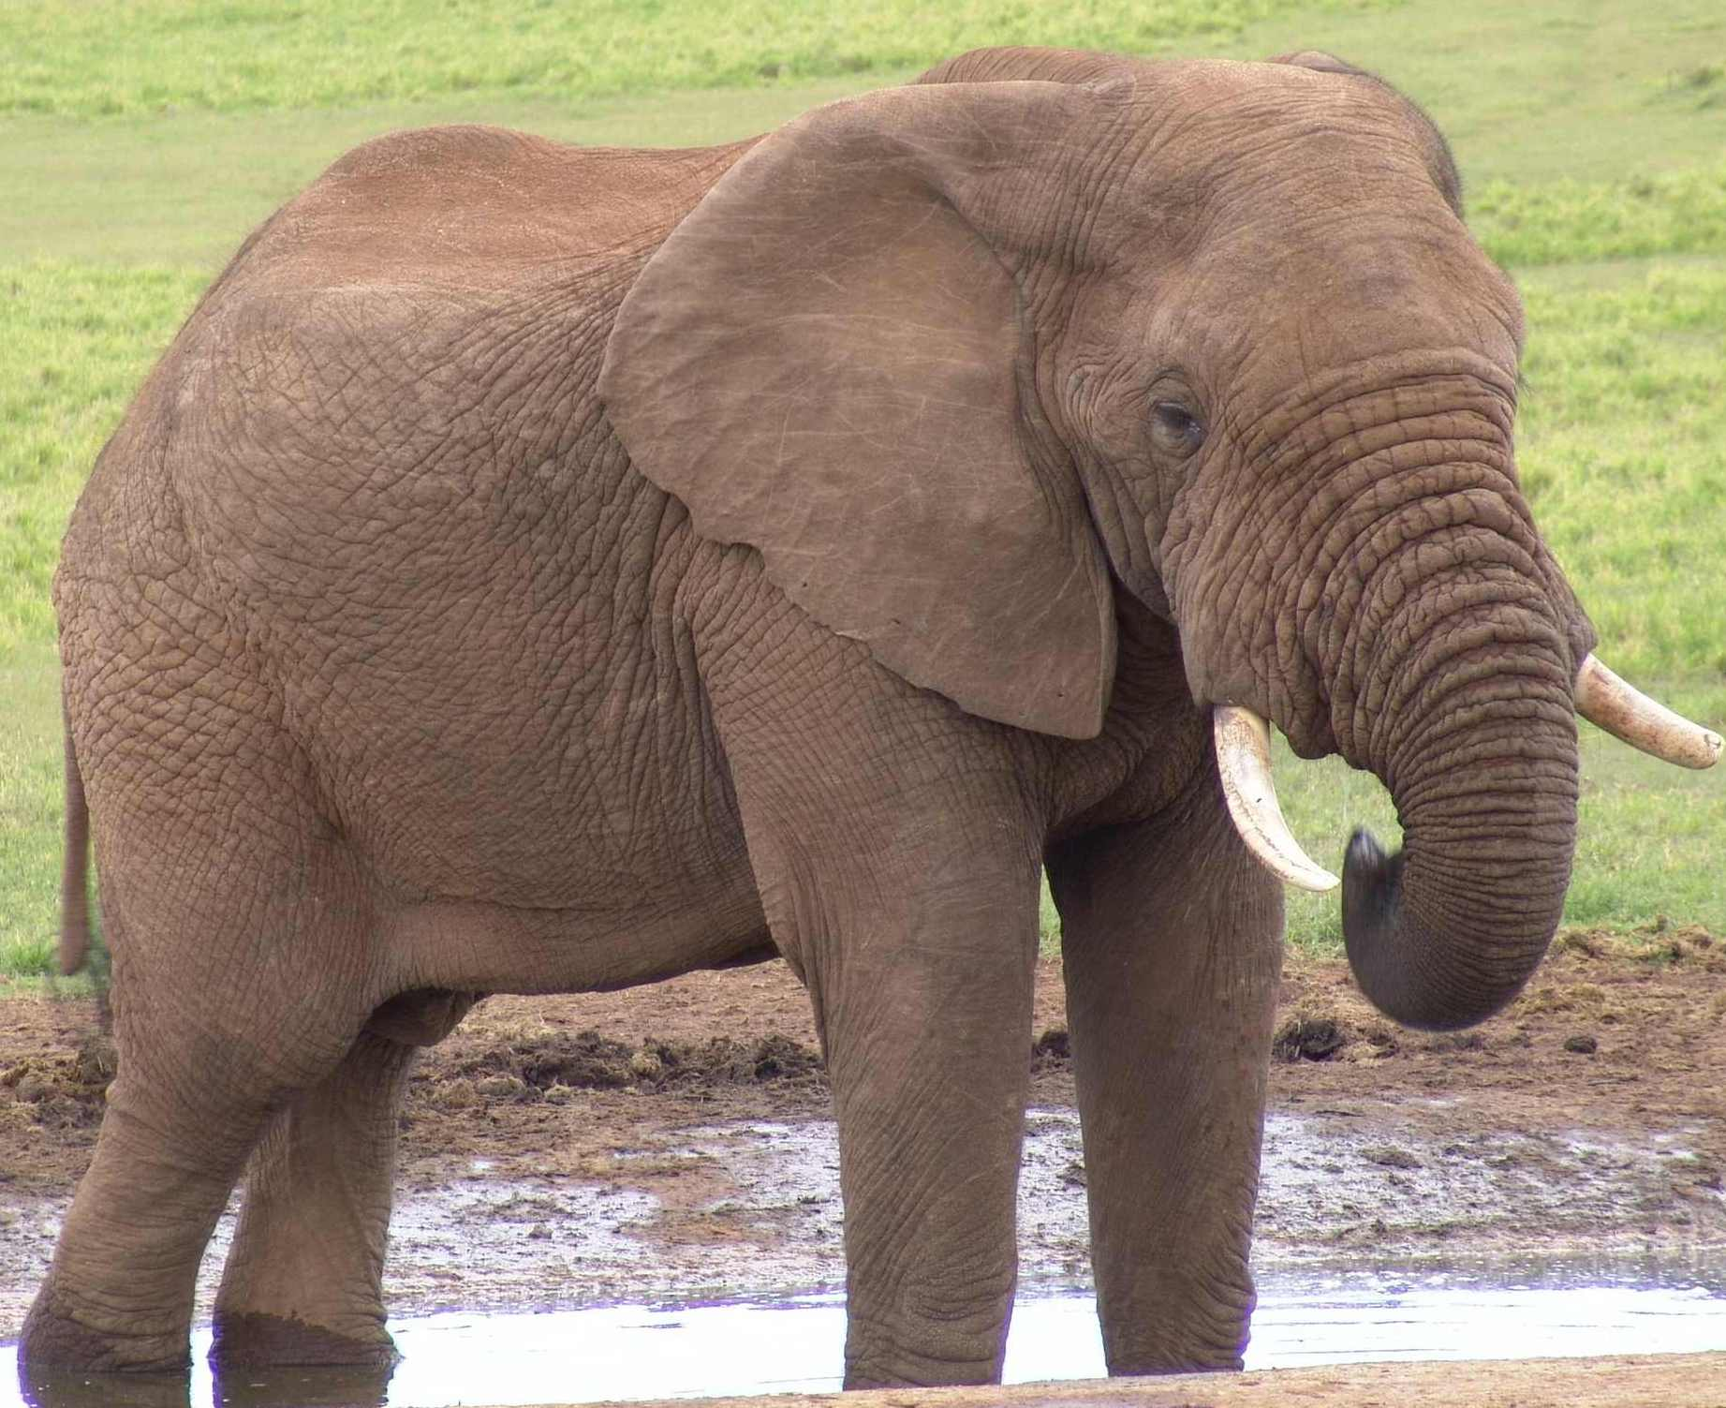
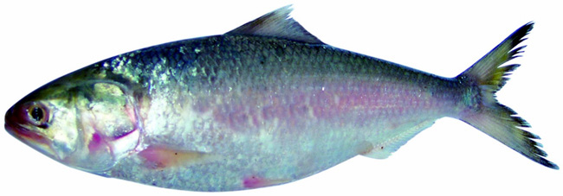

Slide 13
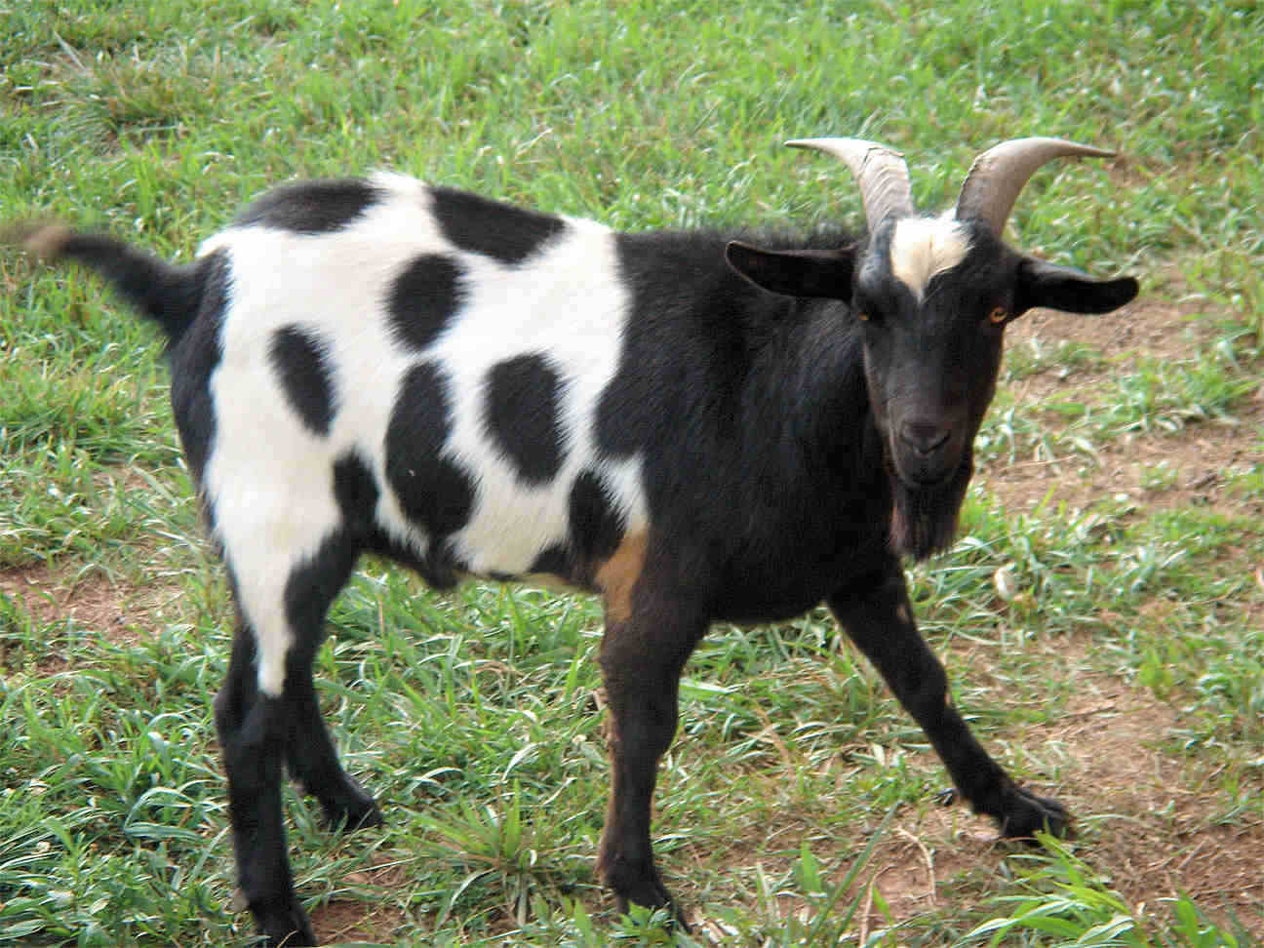
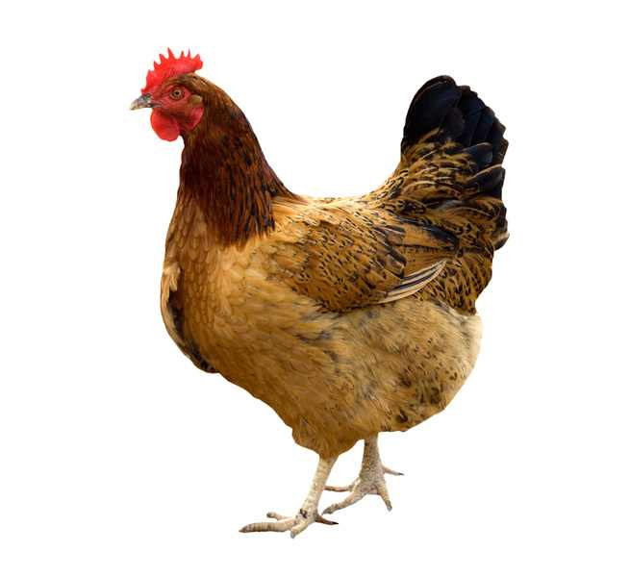

Slide 14
Open your book page no
10,11,12.
Look,listen then say.

Slide 15



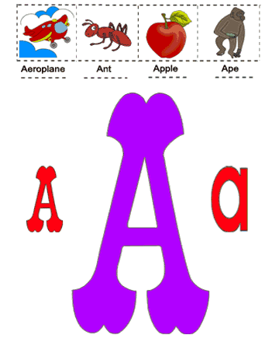
Apple

Slide 16



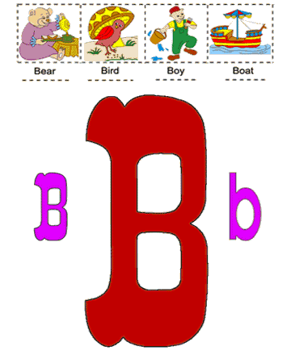
Ball

Slide 17


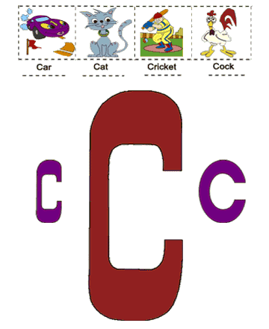
Cap

Slide 18



Dog

Slide 19


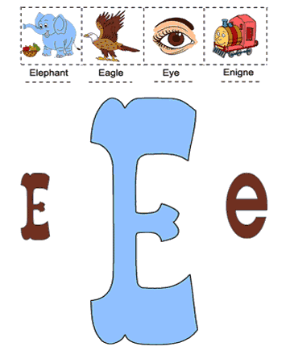
Elephant

Slide 20


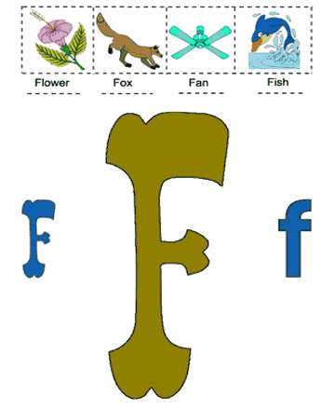
Fish

Slide 21



Goat

Slide 22


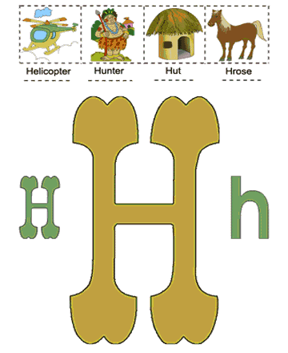
Hen

Slide 23

Find the animal whose name begings with.
Now you know then,
As easy as can be !
Once you know you letters,
Cross the letters
Play
Apple
Ball
Cap
Dog
Elephant
Fish
Goat
Hen

Slide 24




Match leatter with picture: pair work

Slide 25
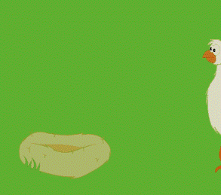
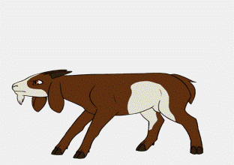
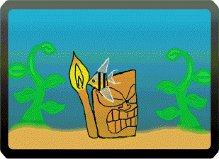
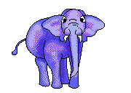
Match leatter with picture: pair work

Slide 26
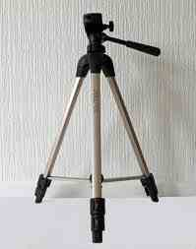
Look at the board:-G.W
A a
B b
C c
D d
E e
F f
G g
H h
Now write
5 munite

Slide 27


