Slide 1
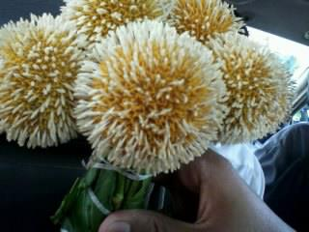
GOOD AFTERNOON
WELCOME TO GRAMMAR CLASS

Slide 2
Watch and listen to the video clip attentively so that you can answer my questions I’ll ask you after showing it.
http://www.youtube.com/watch?v=YyYDYoAOyWA Shakib Al Hasan 84(54)vs Pakistan
Note: this video clip is for the warm up session.

Slide 3

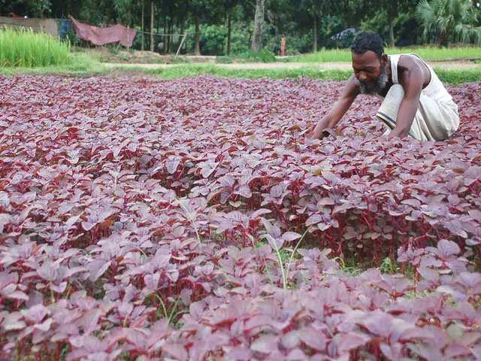
TODAY’S TOPIC
VERBS

Slide 4
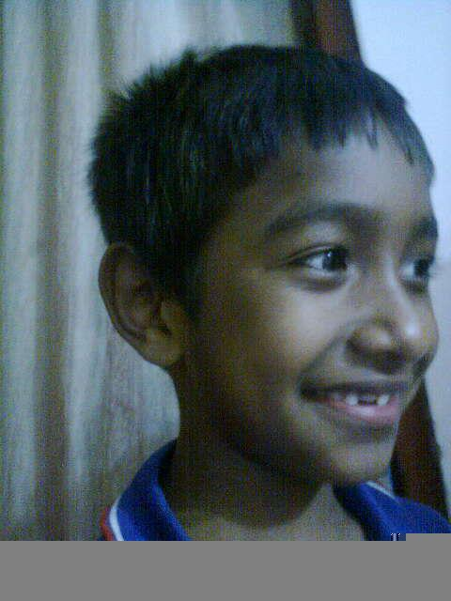
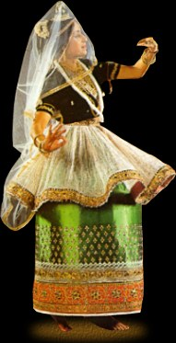
Sparshaw is laughing.
A girl is dancing

Slide 5
Lets enjoy a video on verbs,
http://www.youtube.com/watch?v=7MKmbyfhkkE fun action verb song

Slide 6
LEARNING OUTCOMES
By the end of the lesson the ss’ll be able to
define and identify verbs
make sensible sentences with the right form of verbs
fill in the gaps with them.

Slide 7
FOCUS:
WRITING
LISTENING
SPEAKING
READING

Slide 8
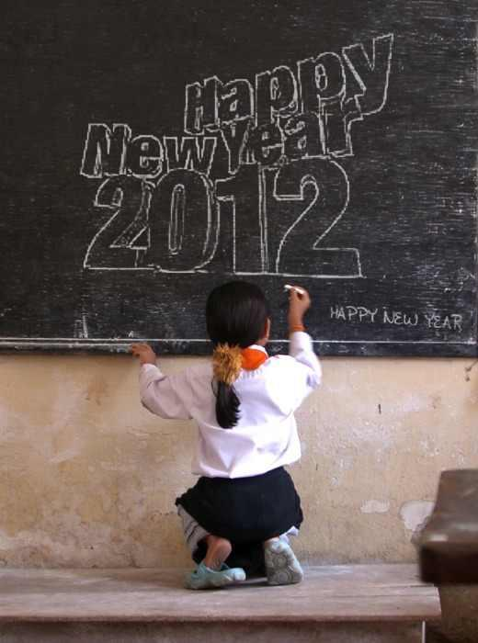
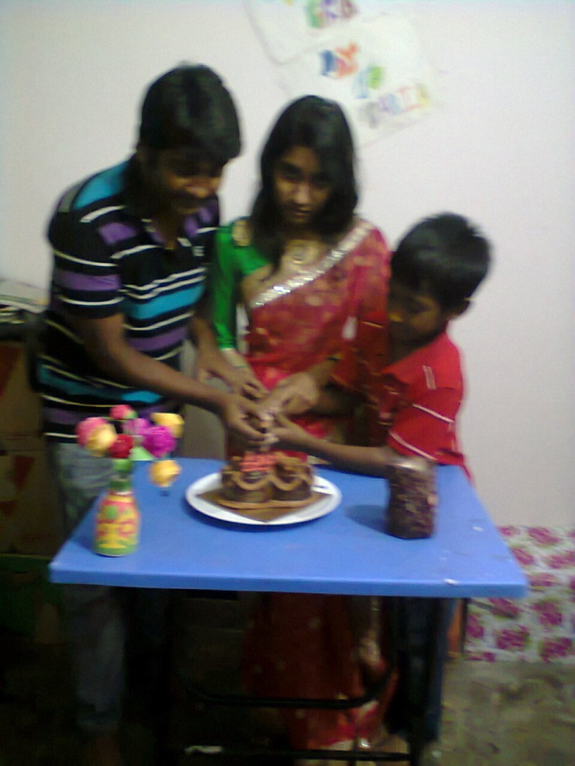
The girl writes on the blackboard.
Spriha is cutting a cake.
Principal verb
Auxiliary Verb

Slide 9
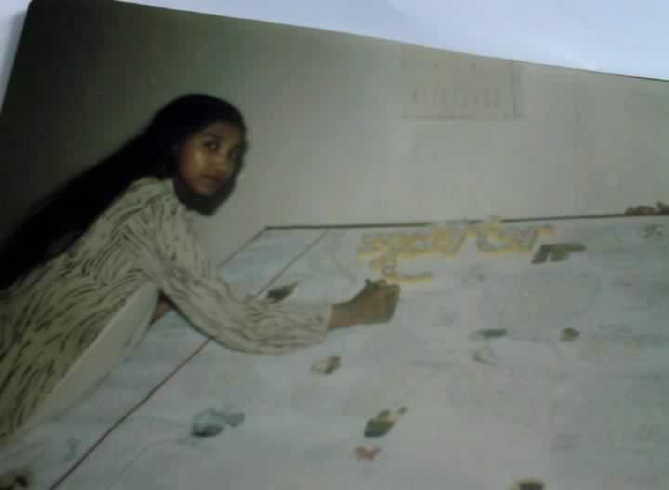
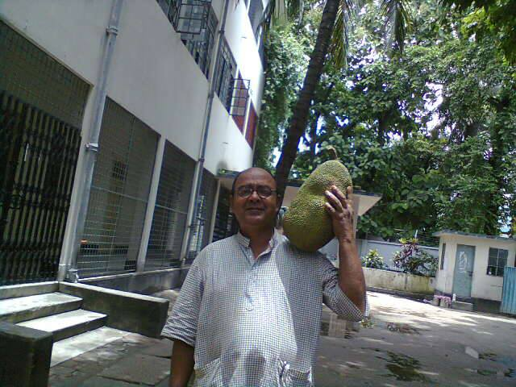
Jesmine writes an editorial.
Mr. Komol likes to eat jackfruits. .
Finite verb
Jesmine wrote an editorial.
Infinitive
Mr.Komol liked to eat jackfruits.
Finite verb
Infinitive

Slide 10
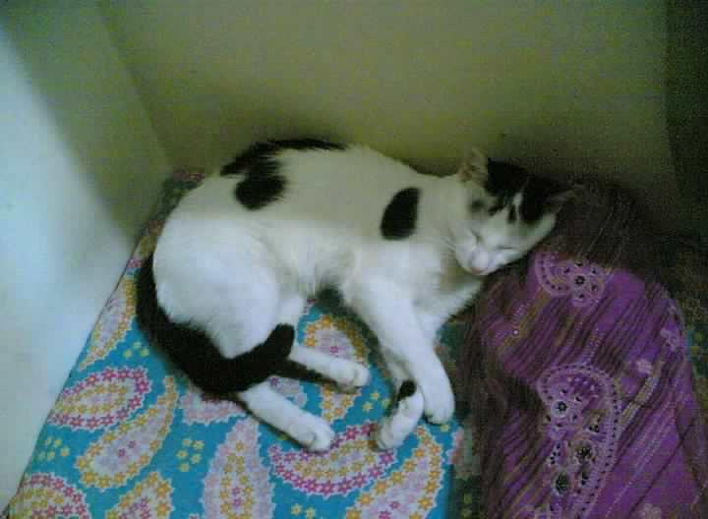
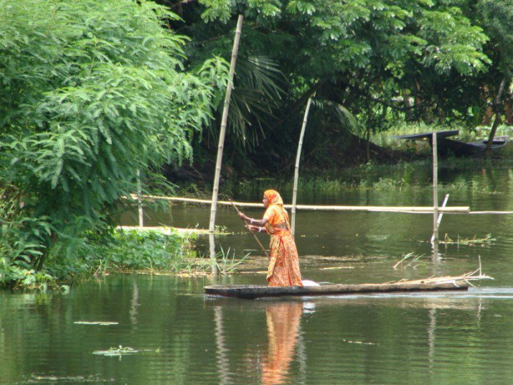
Pao now.
is crossing
is sleeping
The woman the cannel.
Intransitive verb
Transitive verb
Auxiliary Verb
Auxiliary Verb
A

Slide 11
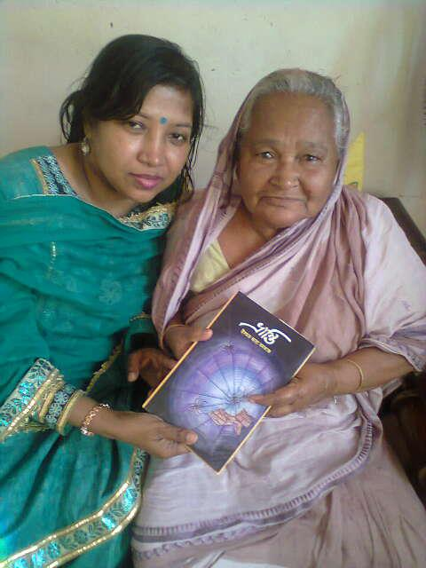
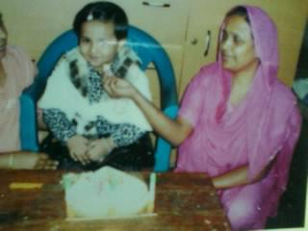
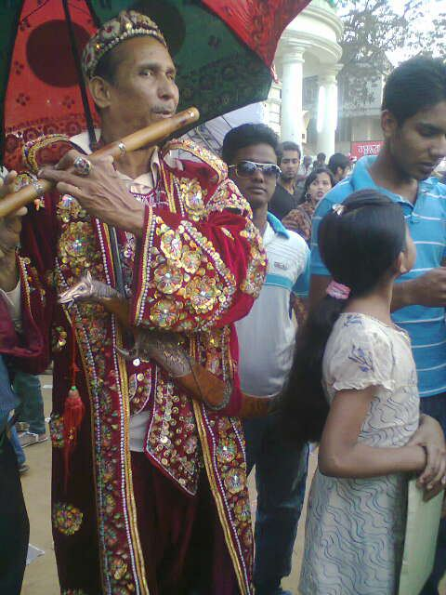
Mrs.Parveen feeds Mohona.
Cognate verb
The piper plays on a flute.
Jesmine gave a Bangla novel, Vranti,
To her aunt.
Group verb
Direct object
Indirect object
The verb ‘feed’ comes from the noun ‘food’.
Jesmine gave her aunt a Bangla novel, Vranti.

Slide 12
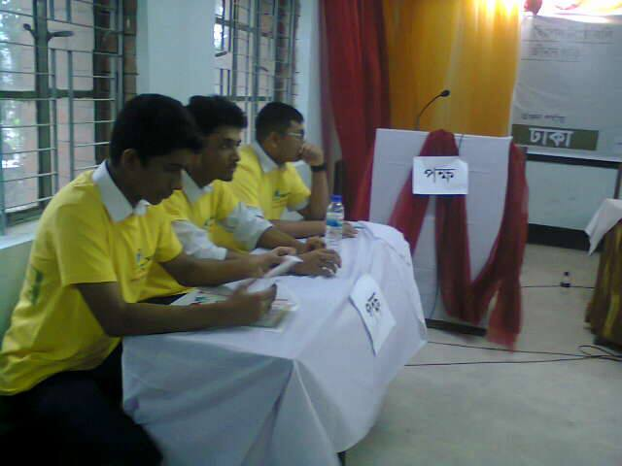
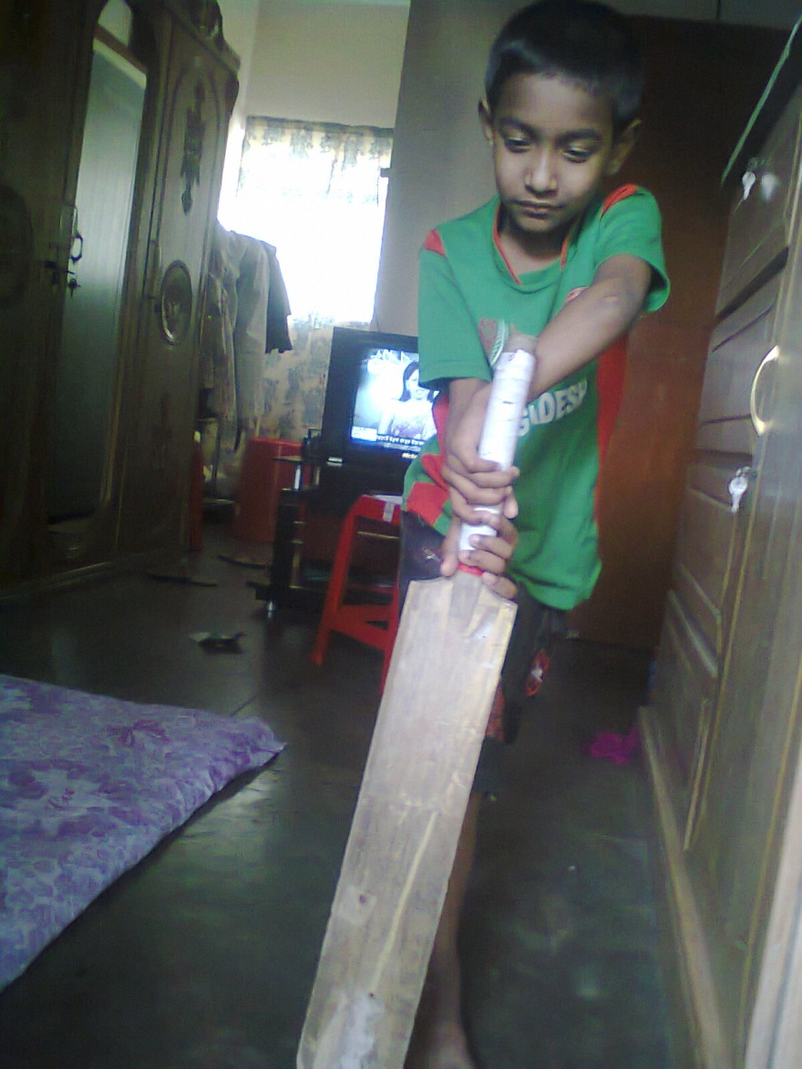
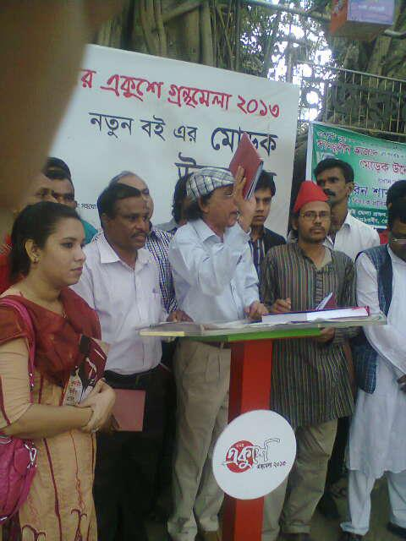
Group work
Describe the pictures and match the following verbs with given pictures and make sesible sentences using right form the verbs and write three paragraphs using them.
play, debate, unveil,

Slide 13
Verbs at a glance
A verb Is an action word.`
Verbs
Principal
Auxiliary
Finite
Non Finite
Transitive
Intransitive
More verbs: Cognate, Group Verbs etc.

Slide 14
Home Work
Write a paragraph on
“The life of a woman in Bangladesh”
using following verbs:
educate, lead ,lag tolerate, torture ,establish ,manage,

Slide 15
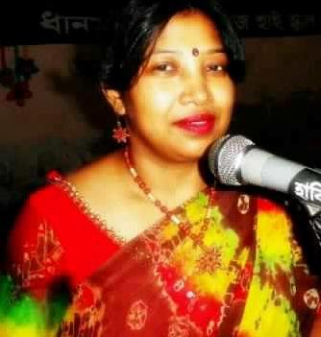
PREPARED &PRESENTED BY:
ISMAT ARA MAMATAZ
Assistant Teacher (English)
Dhanmondi Govt. Boys’ High School
Dhanmondi, Dhaka-1207

Slide 16

Thank You

