Slide 1


Good morning

Slide 2


Teacher Introduce
Afroza Akther
Assistant Teacher
Lakshmipur Govt Girls’ Primary School

Slide 3




Class Four
Subject-English
Lesson Unite-11
Sagar and His Family

Slide 4



Learning Outcomes
1-Student will be able to read the lesson with correct pronunction.
2-Know new word,and answer to question.
.
4-Able to write their own family.

Slide 5
Video

Slide 6
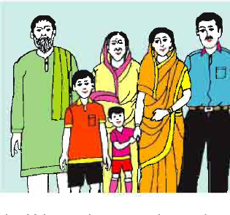
Sagar and His Family
Grandmother
Mother
Grandfather
Father
Sagar
Keya

Slide 7
New word
Grandfather,Grandmother,Parents,Sister,
Brother,Lawyer,Housewife,Garden,Proud etc.

Slide 8
Teacher’s Reading
Student ‘s Reading

Slide 9

Pair work
TO make five sentence
1-Student
2-Teacher
r
3-Lawyer
4-Housewife
5-Garden

Slide 10
Make sentence
Student-I am a student.
Teacher-He is a teacher.
Lawyer-My father is a lawyer.
Housewife-She is a housewife.
Garden-He works in the garden.

Slide 11
Answer to question
1-What is Sagar?
2-What does his father do?
3-What does his mother do?
4-How old is Keya?

Slide 12
Home Task
Write five sentence about your own family.

Slide 13

Thanks

