Slide 1

Good morning students

Slide 2
Introduction:
Abu kayes
Assistant Teacher
Gauranagar Government Primary school
Nabinagar, Brahmanbaria.

Slide 3
Class :Three
Subject:English
Lesson:2
Lesson Unit:A(My Mother)
Today’s lesson:I am…very much

Slide 4
Learning outcomes:Students will be able 1.to read the text(A read) with understandable pronunciation.
2.to recognize new words(Housewife, Vegetables, Garden, Cook, Shopping).
3.to make sentences using the word.

Slide 5
Warm up activities
My mother
I know a face
A lovely face
So full of beauty,
as of grace.
Thay face can be
Compared to no other
That lovely lady
Is my beloved mother.

Slide 6
Input

Slide 7
1.Showing picture for…….

Slide 8
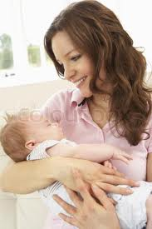
Mother

Slide 9
(a) Tittle
My mother

Slide 10
New word

Slide 11
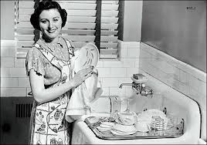
Housewife

Slide 12
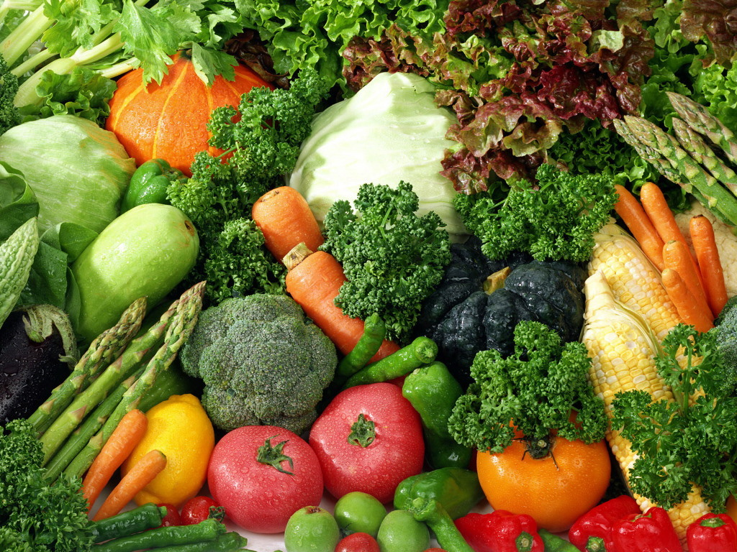
Vegetables

Slide 13

Garden

Slide 14
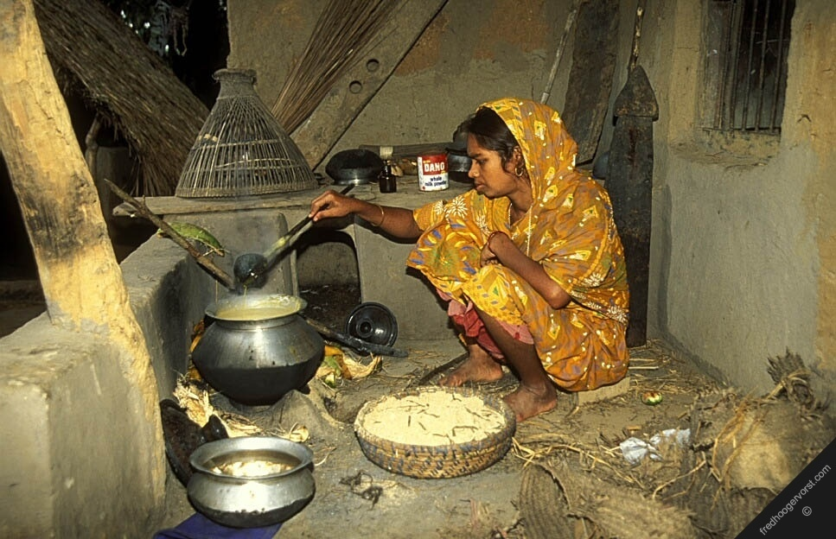
Cook

Slide 15
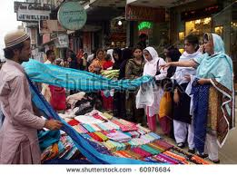
Shopping

Slide 16
2.Teachers loud reading

Slide 17
practice

Slide 18
1.Studtents loud reading

Slide 19
Pronunciation:

Slide 20
Housewife

Slide 21
Vegetables

Slide 22
Garden

Slide 23
Cook

Slide 24
Shopping

Slide 25
Housewife
Vegetables
Garden
Cook
Shopping

Slide 26
Group work:
Make sentences use of word(Housewife,Cook,Shopping,Work)

Slide 27
1.My mother is a housewife.
2.She cooks food for us.
3.She works at home.
4.She goes for shopping.

Slide 28
Task

Slide 29
Write five sentences about your mother.

Slide 30

Thanks
Good bye

