Slide 1

Good morning

Slide 2
Introduction:
Sharifa Begum.
Assistant teacher.
Deora west government primary school.
Sarail, Brahmanbaria.

Slide 3
Unit 4:Let’s count.
Lesson:2
Lesson’s name: number (1)

Slide 4
Class:one
Subject:english
Unit 4:Let’s count.
Lesson’s name:
Number(1)

Slide 5
Learning outcomes:
Students will be able-
(1) To say the word to see the picture.
(2)To say the number to see the picture.
.(3)To Identify the number (1-5).
(4)To write the number.

Slide 6
Learning outcomes:
Students will be able to
To say the word to see the picture.
(2) To say the number to the picture.
(3) To Identify the numbers(1-5).
(4) To write the number.

Slide 7
Greetings : Good morning students.
How are you ?
Warm up: Activities recite a rhyme.

Slide 8

1
Ball

Slide 9
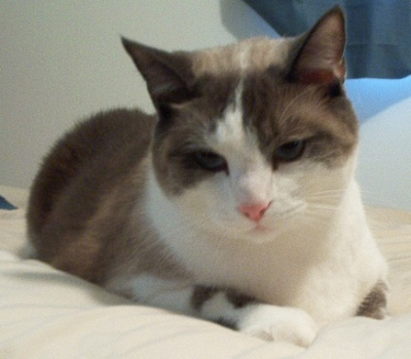
Cats
2

Slide 10
Eggs
3

Slide 11

4
Fishes

Slide 12
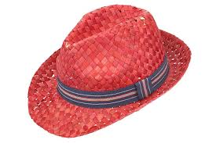
Hats
5

Slide 13



Group work
How Much
 | 1
 | 2
 | 3
 | 4
 | 5

Slide 14
1
2
3
5
4

Slide 15
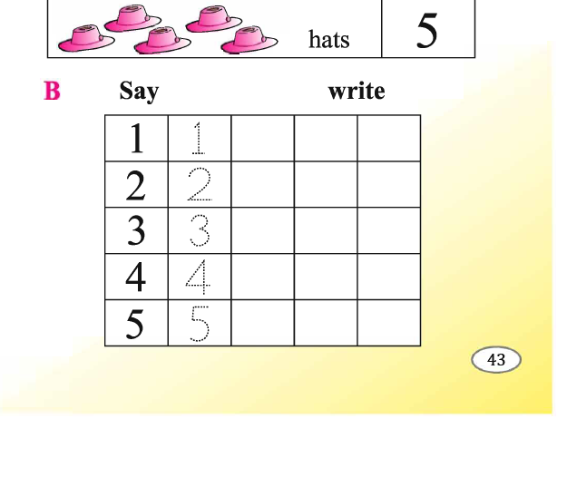

Slide 16

Thank you

