Slide 1

Good Morning Students

Slide 2
Teacher: Abdul Mazid Bhuiyan.
Head Teacher.
Maijkhar Govt. Primary School
Kasba Brahmanbaria.

Slide 3
Lesson Introduction
Class: One,Subject:English
Lesson:2,Letters:A_ _ _D
A Look, listen and say.

Slide 4
Learning outcomes:Students will be able
a.) to listening and says correct sound showing thepicture.
b) to follow Simple common introduction. c). to Matches: a ,b,c,d with the picture.

Slide 5
Warmup Activities :
Standup , Sitdown,standup ,sitdown

Slide 6
Presentation:

Slide 7
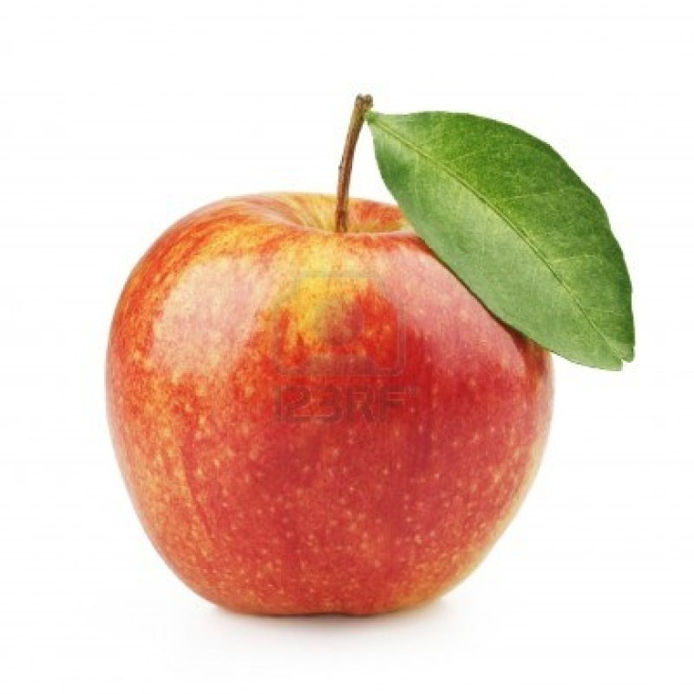
A
a
Apple apple

Slide 8

b
B
Ball ball

Slide 9

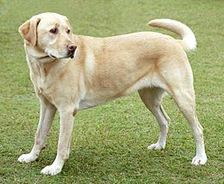
C
c
Cap
cap

Slide 10
d
D
Dog
dog

Slide 11
Evaluation:

Slide 12
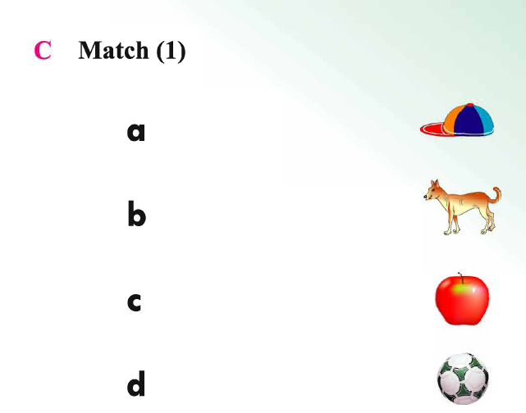

Slide 13
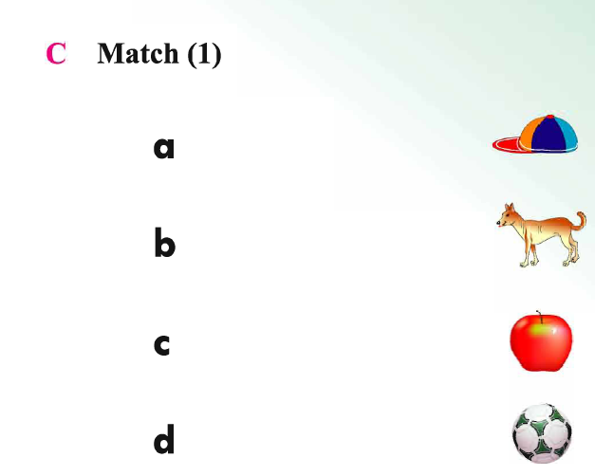

Slide 14
Thank you.Goodbye.

