Slide 1
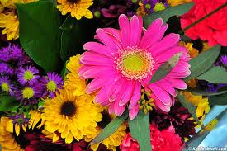
Good morning

Slide 2
Teacher’s Identity
Shanaj Sultana
Assistant Teacher

Slide 3
Class .One
Subject . English
Lesson .5
Look and say

Slide 4
Learning Outcomes
Students will be able to
1.recognige and read the capital letters

Slide 5
Now, we enjoy a video.

Slide 6
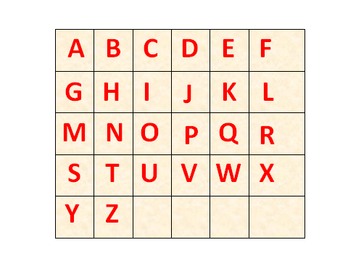

Slide 7
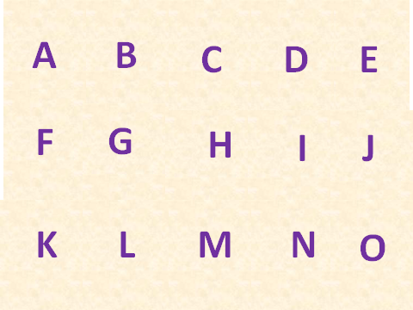

Slide 8
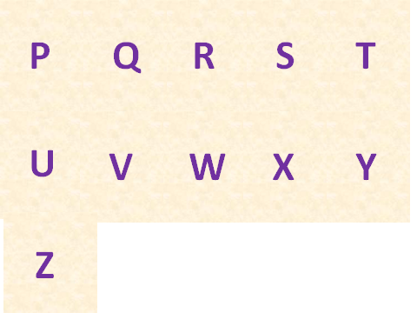

Slide 9


Slide 10

B
C
H
D
E
F
G
I
J
K
A
L
Z
M
Y
N
X
W
O
V
U
T
S
R
P
Q

Slide 11

Thanks

