Slide 1
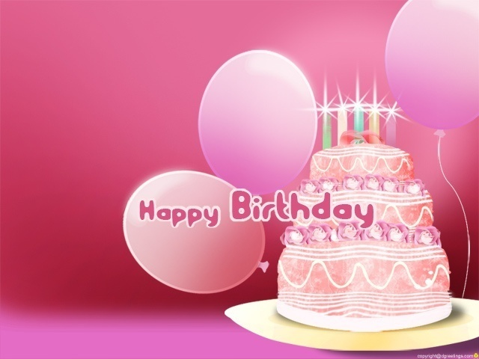


to
my
Class

Slide 2

Presented by:
Masuma Akter
Assistant Teacher
Oshkhali Aliya Model Govt. Primary School.
Hatiya.

Slide 3

Today’s lesson:
Class-Five
Lesson: 19-Happy Birthday!
Lesson unit: A (A birthday……………to you.)
Time: 45 minutes
Date: 26-1-2013

Slide 4


Objectives:
Students will be able to……………………..
know about a birthday.
know and singing wishing song-Happy birthday to you…………..
Enrich their vocabulary, reading & writing skill.
.

Slide 5
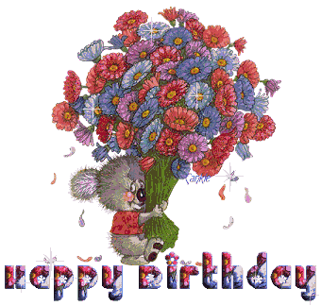
Create emotion:
Poem & picture

Slide 6
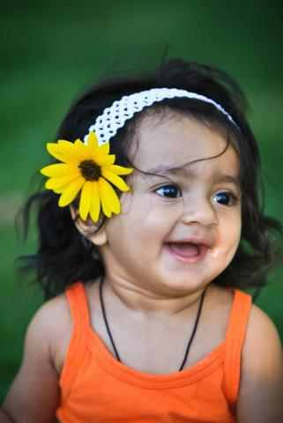

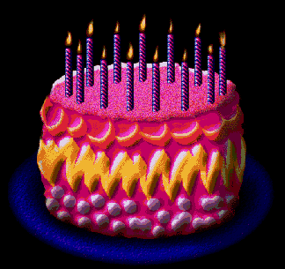


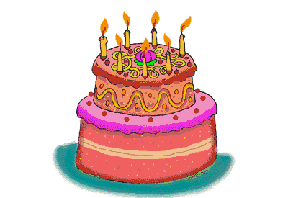
Momo
Our cute little girl
is 1 today
So sweet and lovely
in every way.
Momo you have
reached a milestone
But not one minute
on your own.
Our love for you
lasts everyday
Especially now on
your 1st birthday.

Slide 7
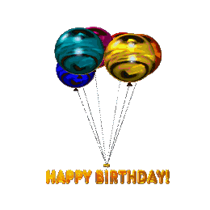
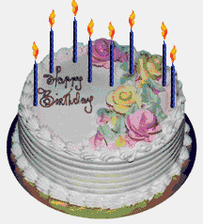
What type of pictures are these and which song of music is it?

Slide 8
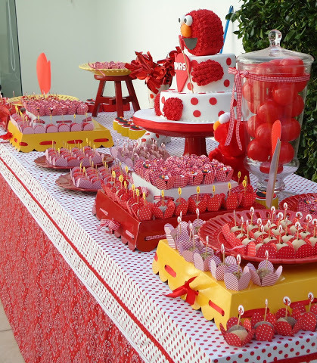
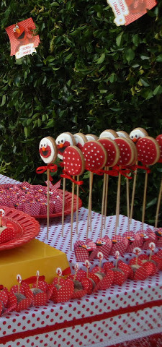
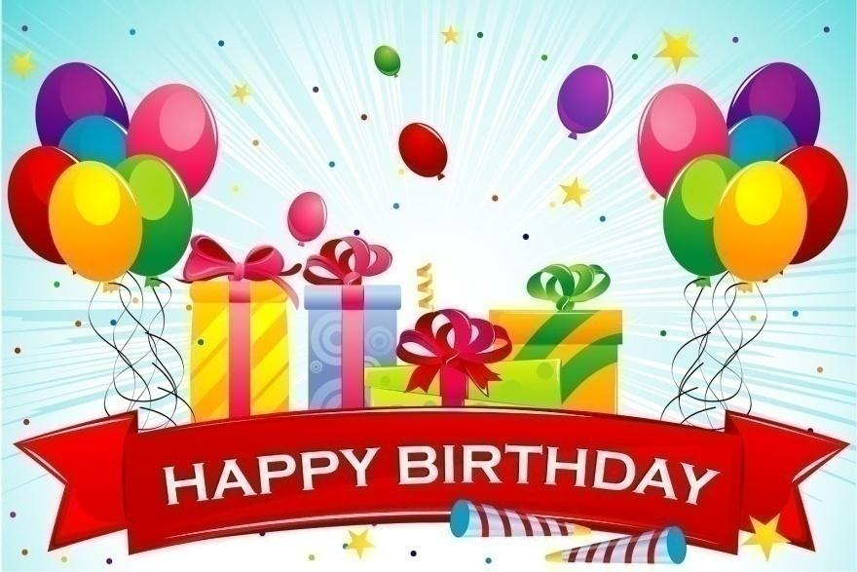
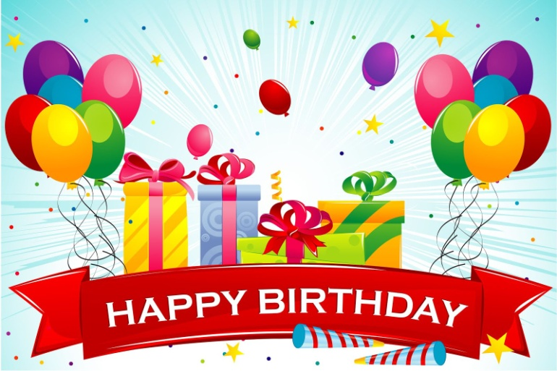
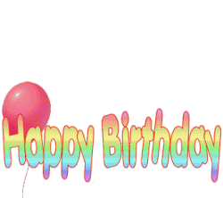
Declaration of the Title

Slide 9
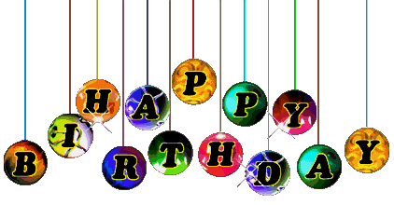
Presentation
20 minutes

Slide 10
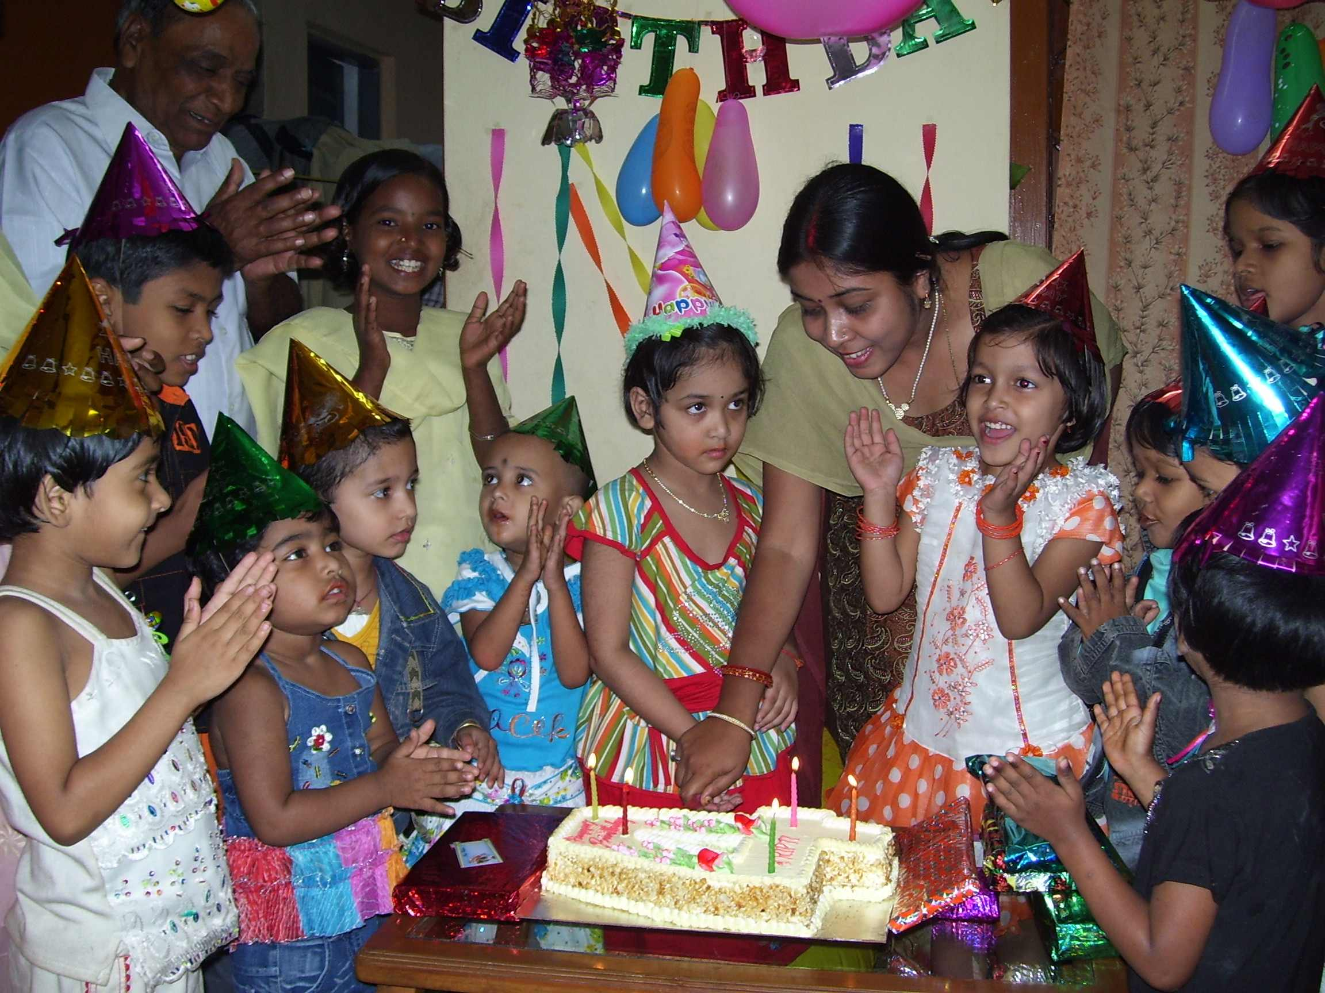
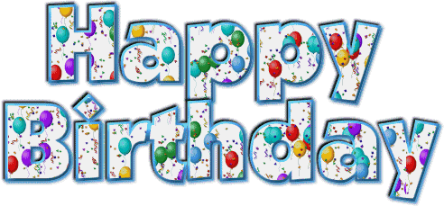
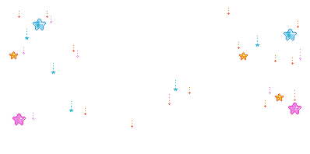

What can you see in the picture?

Slide 11

Teacher’s loud reading & discuss the lesson

Slide 12
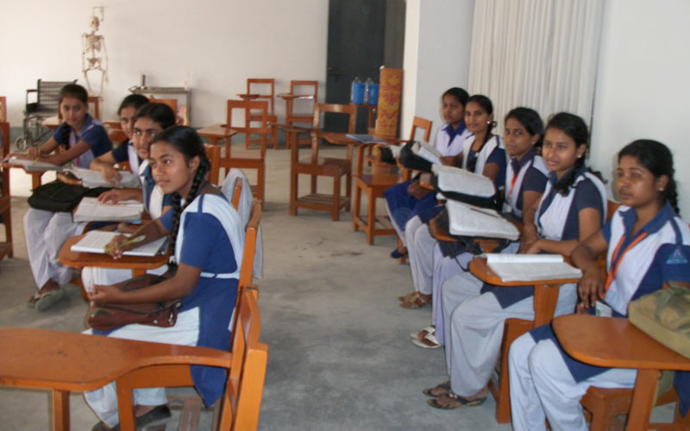
Students
Loud reading
help by
Teacher

Slide 13
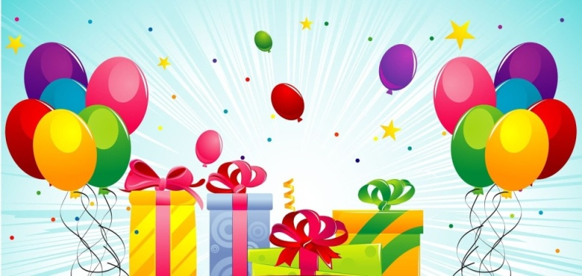
New words with sentences (using by picture)
This is the day when you were born.
Birthday
Today is your happy birthday.

Slide 14

New words with sentences (using by picture)
It’s not similar to another things.
Children enjoy the birthday in different ways.
Different

Slide 15
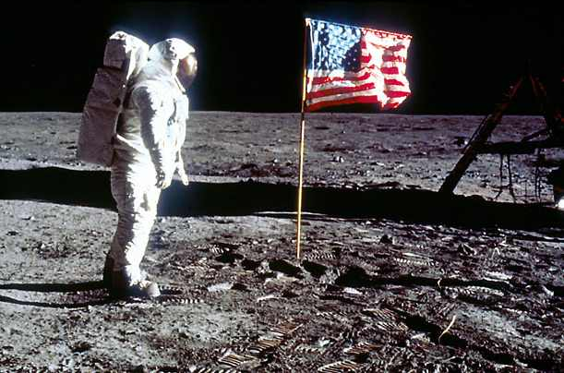
New words with sentences (using by picture)
It’s means recollections of joyfull or sady moments in a special day.
My first at school was a memorable day in my life.
Memorable

Slide 16
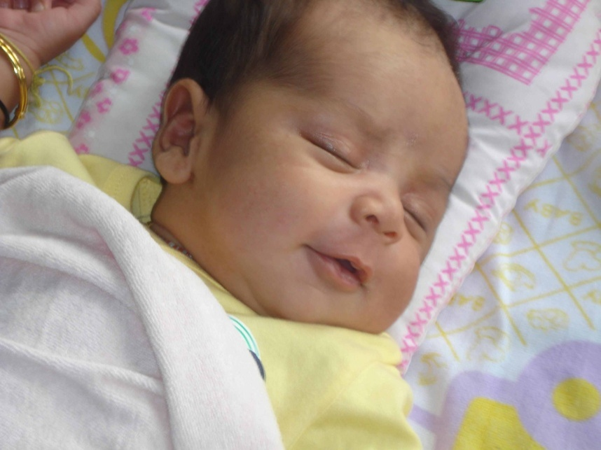
New words with sentences (using by picture)
This is the moment when you have come to the world.
Borsan was born in 17 April, 2008.
Born

Slide 17
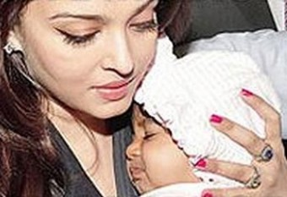

New words with sentences (using by picture)
It’s means hangs down to another person or another object.
Depend
Good health depends on good food.

Slide 18
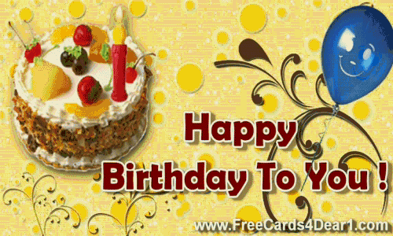
Lets sing a song……………………..

Slide 19
Answer the following questions:(gw)
What is birthday?
How do children celebrate
the day?
Which song everybody sings on birthday?

Slide 20
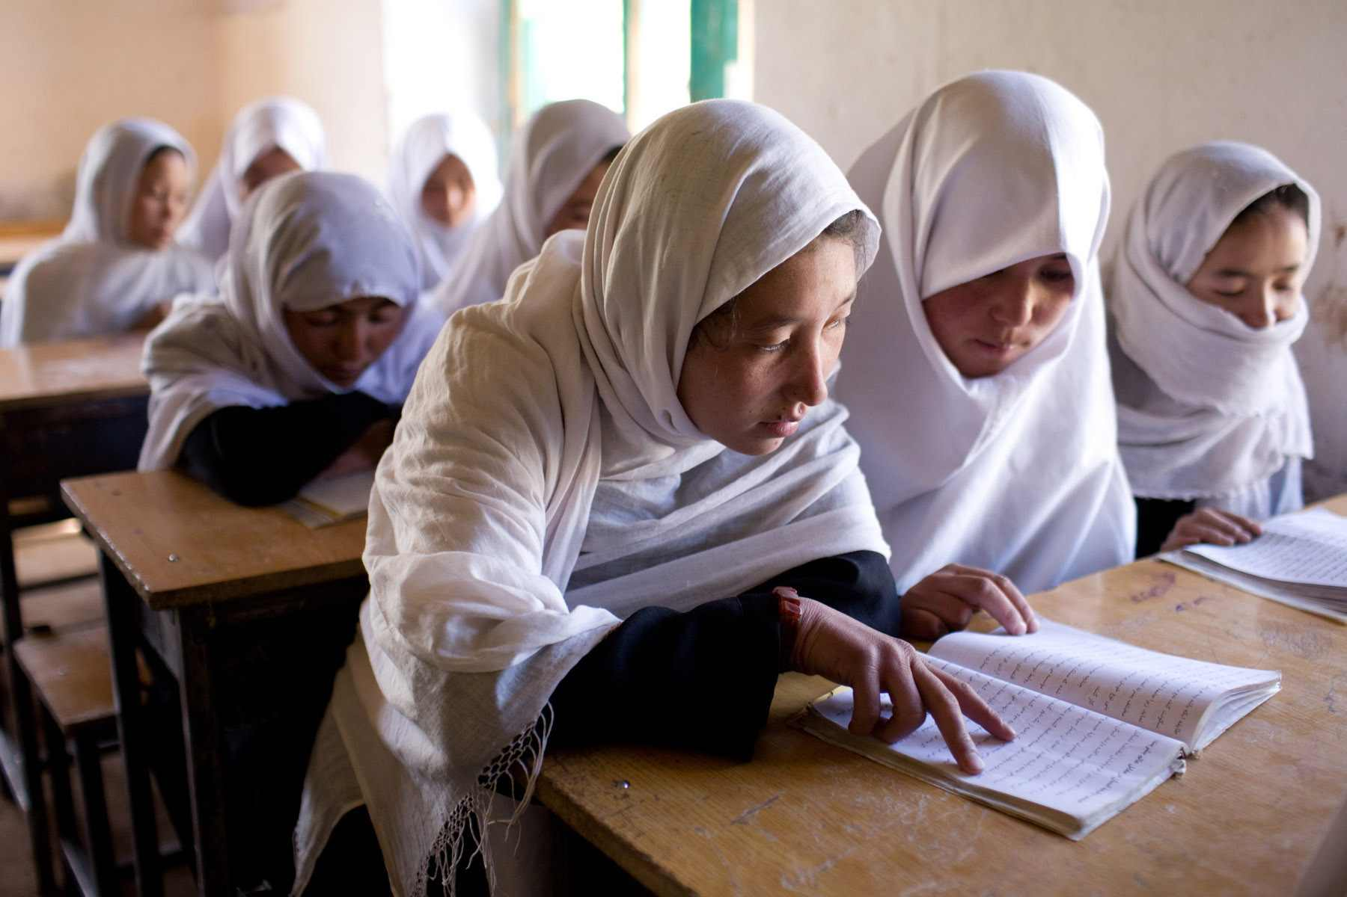
Silent reading

Slide 21
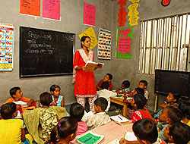

Evolution
Time: 15 minutes

Slide 22
Choose the best answer: (i.w)
(a) Who are particularly happy on a birthday?
1.Parents
2.Children
3.Guest
4.Realitives
(b) ‘Happy birthday to you’-It’s a……………….
1.New year wish or greeting
2.Birthday wish or greeting
3.Birthday fairwell
4.None of the avobe
(c) Memorable day/ one’s life/ a/ in/ a birthday/is.
Now find out the correct sentence-
1.A birthday is a memorable day in one’s life.
2.A birthday a memorable day is in.
3.A memorable day is a birthday in one’s life.
4.None of the above.

Slide 23
Match the words in column ‘A’ with their similar meanings in column ‘B’ (pw)
Column-A
Column-B
Memorable
Both father and mother
Children
Birth
Parents
Trust
Born
brother and sister
Depend
worthy of being
Boys and girls

Slide 24

Match the words in column ‘A’ with their similar meanings in column ‘B’ (pw)
Column-A
Column-B
Memorable
worthy of being
Children
Boys and girls
Parents
Both father and mother
Born
Birth
Depend
Trust

Slide 25
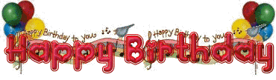
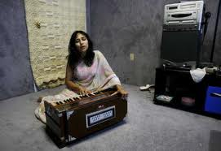
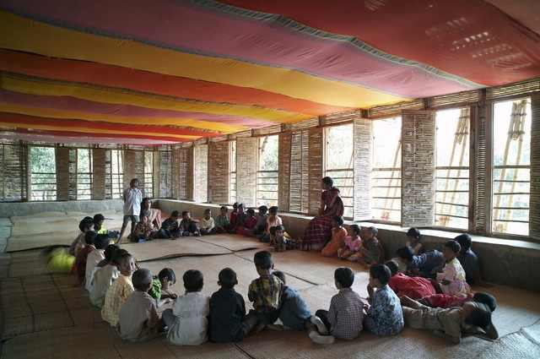
Now sing the birthday song one after another

Slide 26

Write down the following questions:(g.w)
a.How is a birthday celebrated?
b.How can the age of a child be counted?
c.Where the candles lit?

Slide 27

How will you celebrate your coming birthday party?
Explain it with in 10 lines.

Slide 28
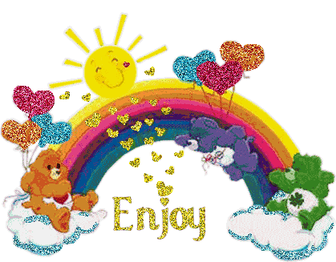
Message
“Enjoy yourself”

Slide 29


See you.
Bye.

