Slide 1


Slide 2
Introduction
Class-xi
Subject-English 1st paper
Unit-01, Lesson-01
Time-60 minutes
Md. Shahabuddin Mahmud
Assistant Professor
Birganj Women’s College
Birganj, Dinajpur

Slide 3
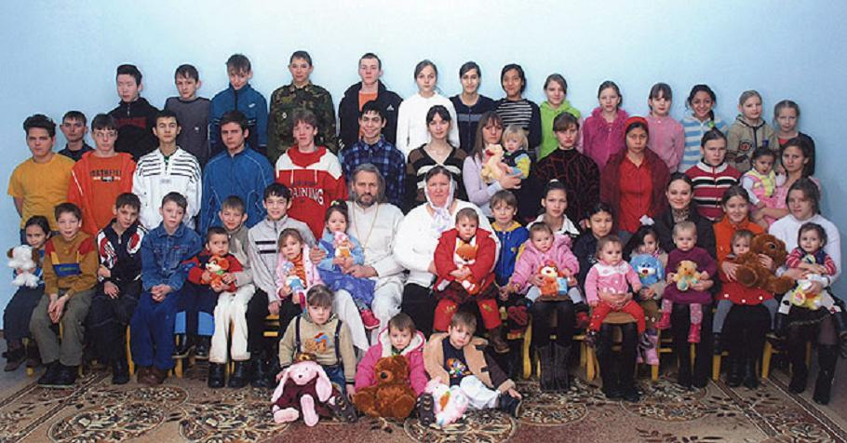
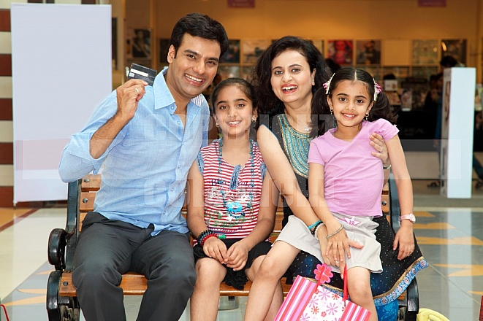
Extended family
Nuclear family

Slide 4
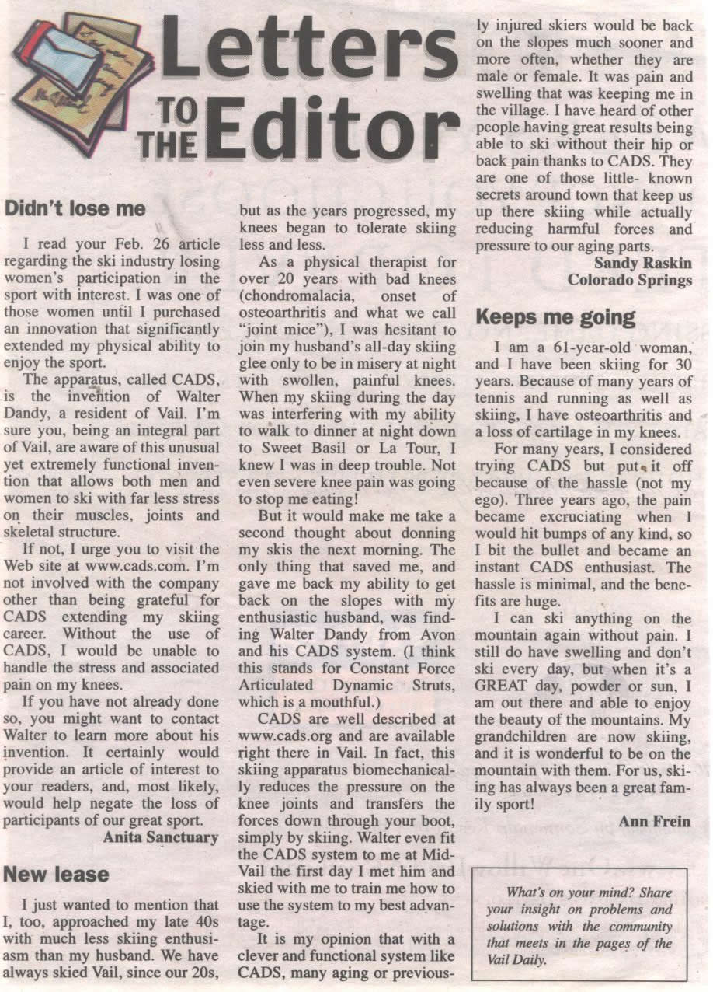

Slide 5
Our Family

Slide 6
Learning outcomes:
By the end of the lesson students will be…….
*able to read two letters.
*discus the contents of the letters.
* Write a short letter to a newspaper.

Slide 7
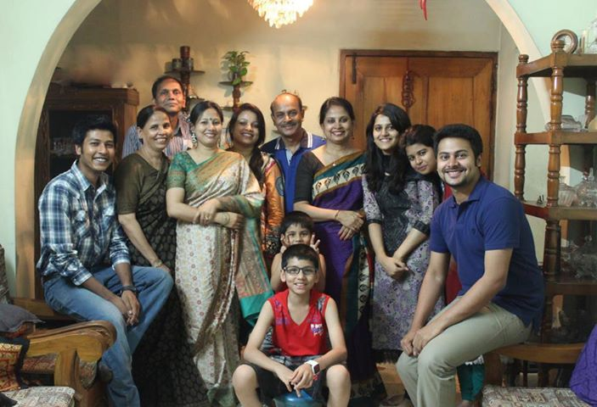
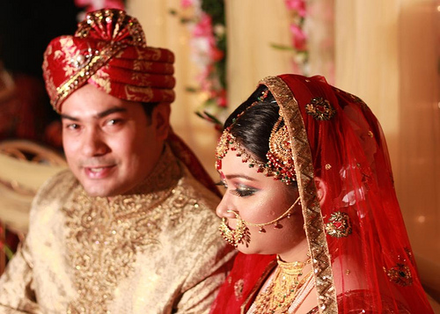

Nazneen’ family
Marriage of Nazneen’s sister
Household chores

Slide 8
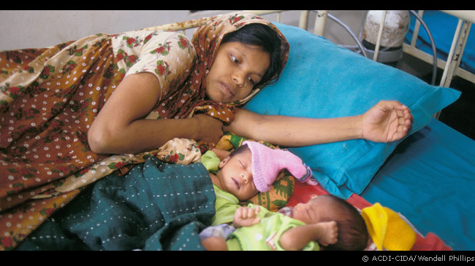
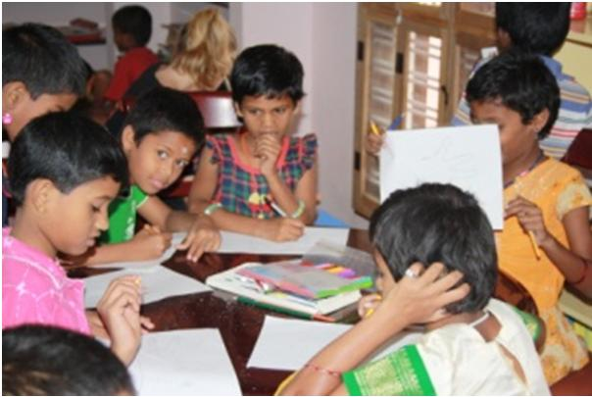
newborn baby
study

Slide 9

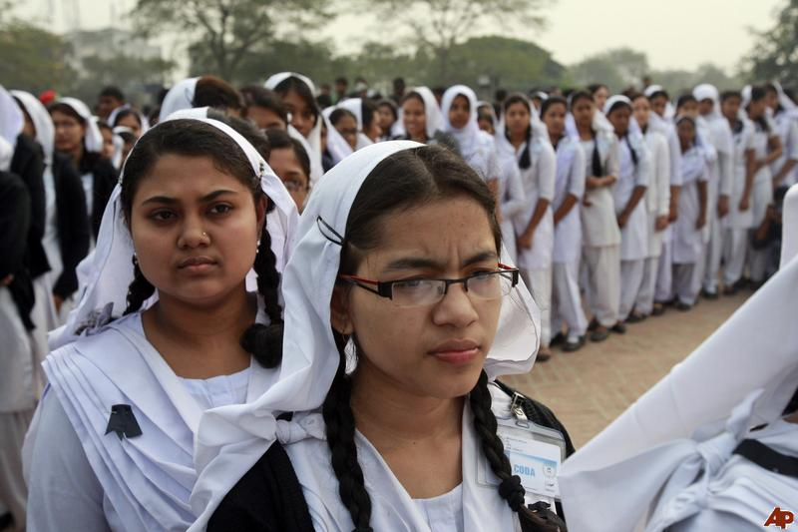
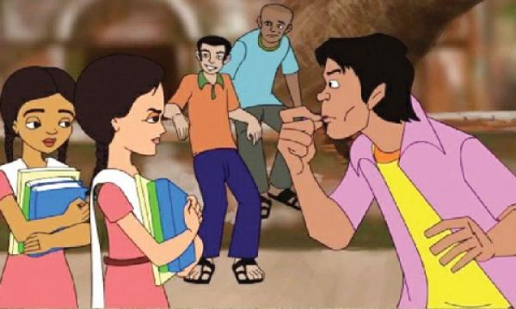

Small family
At college
eveteasing
boring

Slide 10
(1) The Rising Sun
Wednesday, 5 January
(2) Dear Mita apa,
(3) I’m a first year college student and my annual exams are closing at hand. I need to study a lot but the condition of my house is not ………………………………………………………………………………………………………………………………………………………………………………….
(4)Tell me what should I do.
(5) Nazneen
(1) The Rising Sun
Wednesday, 12 January
(2) Dear Mita apa,
(3) I read Nazneen’s letter published on in your column on 5 January. I can understand Nazneen’s Peoblems ab…………………out living in a large family, But things are not alwys rosy in a small family either as …………………………………………………………
(4) So having a small family necessarily does not make one happy.
(5) Zinia
Parts of a letter

Slide 11
Vocabulary
Festive—bright and cheerful

Slide 12
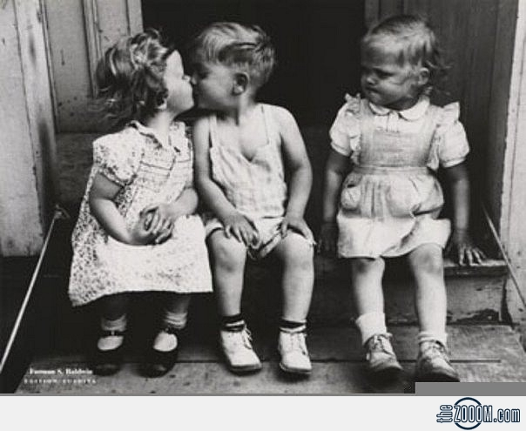
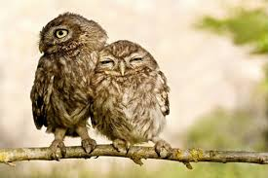
envy
Wish that you had someone else’s possessions
Zinia envy Nazneen for her having too many family members.
depend
Rely
Babies rely on their mothers.

Slide 13
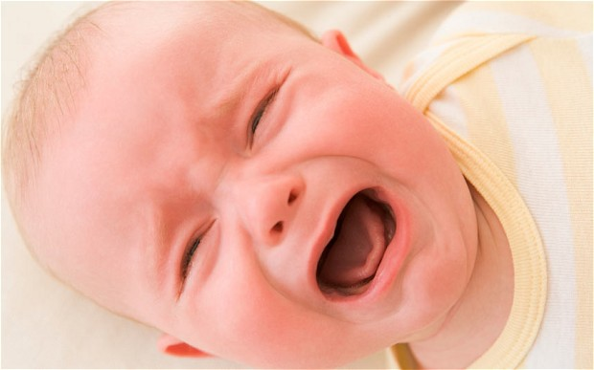
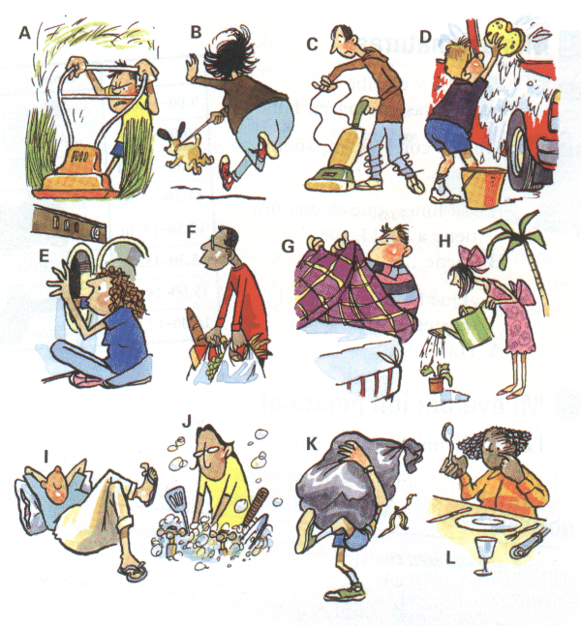
Scream
Crying loudly
Some babies scream all the time
Chores
Small household tasks
Many of the students have to do household chores.

Slide 14

Concentrate
Attention
Students should concentrate on their studies.

Slide 15
Group Work
Think about your own family. In pairs, ask and answer questions about your families.

Slide 16
Evaluation
1. What do you understand by extended and
nuclear family?
2. What are the disadvantages of an extended
family?
3. Does a nuclear family always makes a man
happy?

Slide 17
Assignment
Write a short letter to The Rising Sun describing the types of family you like and why.

Slide 18


