Slide 1



Slide 2
Lesson Identity:
Class: Four
Subject: English
Lesson: 21
Lesson Unit: A, B and C
Time: 50 minutes

Slide 3
Presented By:
Md. Jahangir Reza
Head Teacher
Kanarhat Model Govt. Primary School

Slide 4

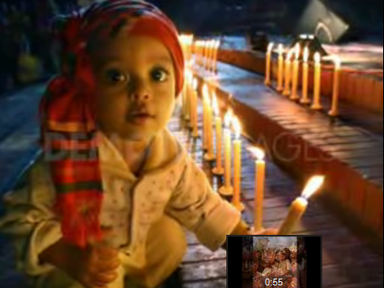
Create Emotion:
http://www.youtube.com/watch?v=drH3_Flt85g

Slide 5
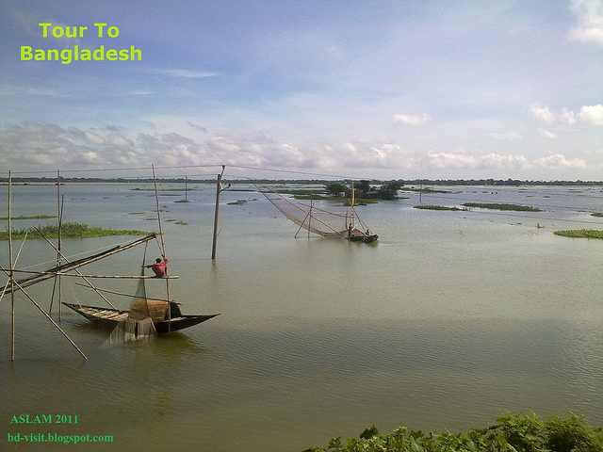
What month does the calendar show?
2013
January-2013
Sunday | Monday | Tuesday | Wednesday | Thursday | Friday | Saturday
 |  | 1 | 2 | 3 | 4 | 5
6 | 7 | 8 | 9 | 10 | 11 | 12
13 | 14 | 15 | 16 | 17 | 18 | 19
20 | 21 | 22 | 23 | 24 | 25 | 26
27 | 28 | 29 | 30 | 31
It’s the month of January 2013

Slide 6
Today’s Lesson
Reading the Calendar
January 2013
Sun | Mon | Tue | Wed | Thu | Fri | Sat
 |  | 1 | 2 | 3 | 4 | 5
6 | 7 | 8 | 9 | 10 | 11 | 12
13 | 14 | 15 | 16 | 17 | 18 | 19
20 | 21 | 22 | 23 | 24 | 25 | 26
27 | 28 | 29 | 30 | 31

Slide 7
Learning Outcomes:
By the end of the lesson students will be able to-
- tell meaning of the new words;
read the text with correct pronunciation;
- identify the date and day from the calendar.

Slide 8
Input
Time: 20 minutes

Slide 9
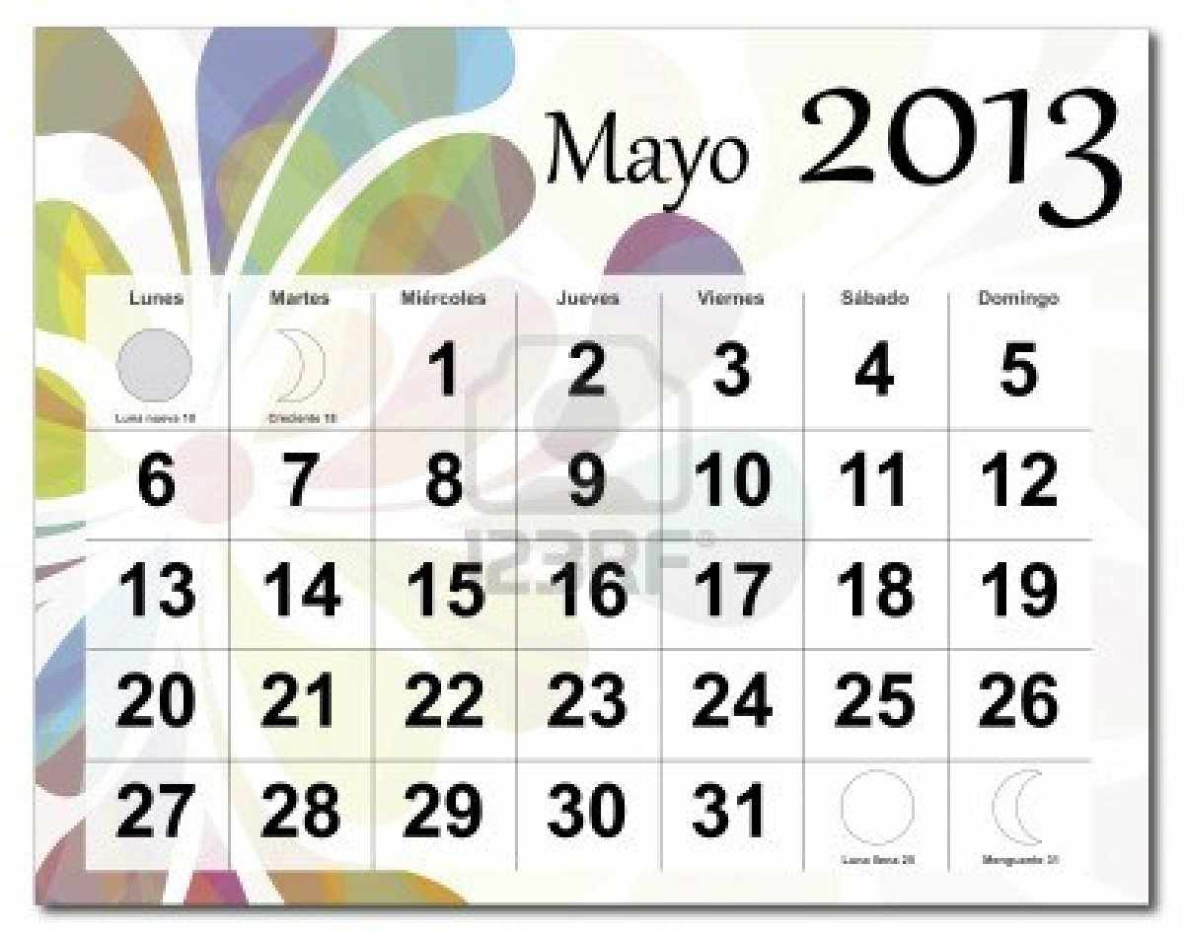
New words with sentences: (by using picture)
It is a record of the days, dates and months of a year..
Calendar
This calendar is so beautiful.

Slide 10

New words with sentences: (by using picture)
Record means illustrating past history.
Record
He got a record mark the Primary Completion Examination.

Slide 11
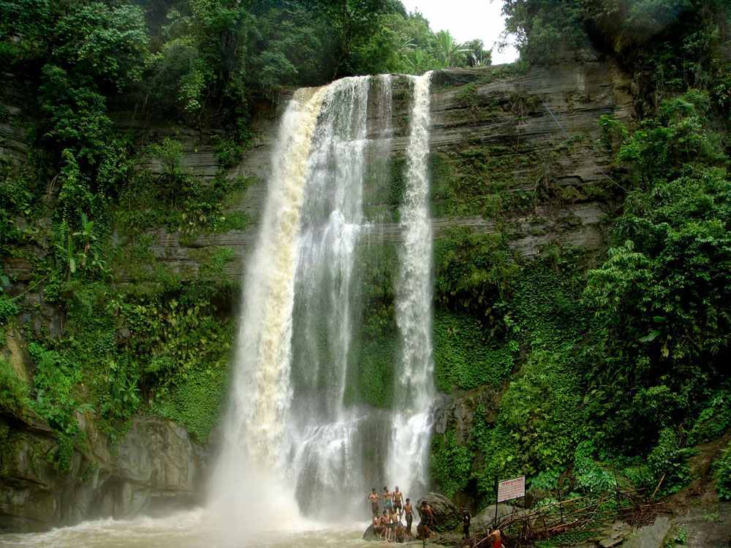
New words with sentences: (by using picture)
Below means into a lower place.
Below
The boy is standing below the hill.

Slide 12

Loud Reading
Open your book at page 69.
Text Audio

Slide 13
January-2013
Sunday | Monday | Tuesday | Wednesday | Thursday | Friday | Saturday
 |  | 1 | 2 | 3 | 4 | 5
6 | 7 | 8 | 9 | 10 | 11 | 12
13 | 14 | 15 | 16 | 17 | 18 | 19
20 | 21 | 22 | 23 | 24 | 25 | 26
27 | 28 | 29 | 30 | 31
January
Tuesday
1
The first day of the month is the first of January.
It is a Tuesday.

Slide 14
January-2013
Sunday | Monday | Tuesday | Wednesday | Thursday | Friday | Saturday
 |  | 1 | 2 | 3 | 4 | 5
6 | 7 | 8 | 9 | 10 | 11 | 12
13 | 14 | 15 | 16 | 17 | 18 | 19
20 | 21 | 22 | 23 | 24 | 25 | 26
27 | 28 | 29 | 30 | 31
January
Wednesday
2
The next day is the second of January.
It is a Wednesday.

Slide 15
January-2013
Sunday | Monday | Tuesday | Wednesday | Thursday | Friday | Saturday
 |  | 1 | 2 | 3 | 4 | 5
6 | 7 | 8 | 9 | 10 | 11 | 12
13 | 14 | 15 | 16 | 17 | 18 | 19
20 | 21 | 22 | 23 | 24 | 25 | 26
27 | 28 | 29 | 30 | 31
January
Thursday
31
The last day of the month is the thirty first of January.
It is a Thursday.

Slide 16
January-2013
Sunday | Monday | Tuesday | Wednesday | Thursday | Friday | Saturday
 |  | 1 | 2 | 3 | 4 | 5
6 | 7 | 8 | 9 | 10 | 11 | 12
13 | 14 | 15 | 16 | 17 | 18 | 19
20 | 21 | 22 | 23 | 24 | 25 | 26
27 | 28 | 29 | 30 | 31
January
Wednesday
30
The day before it is the thirtieth of January.
It is a Wednesday.

Slide 17
Practice
Time: 15 minutes

Slide 18
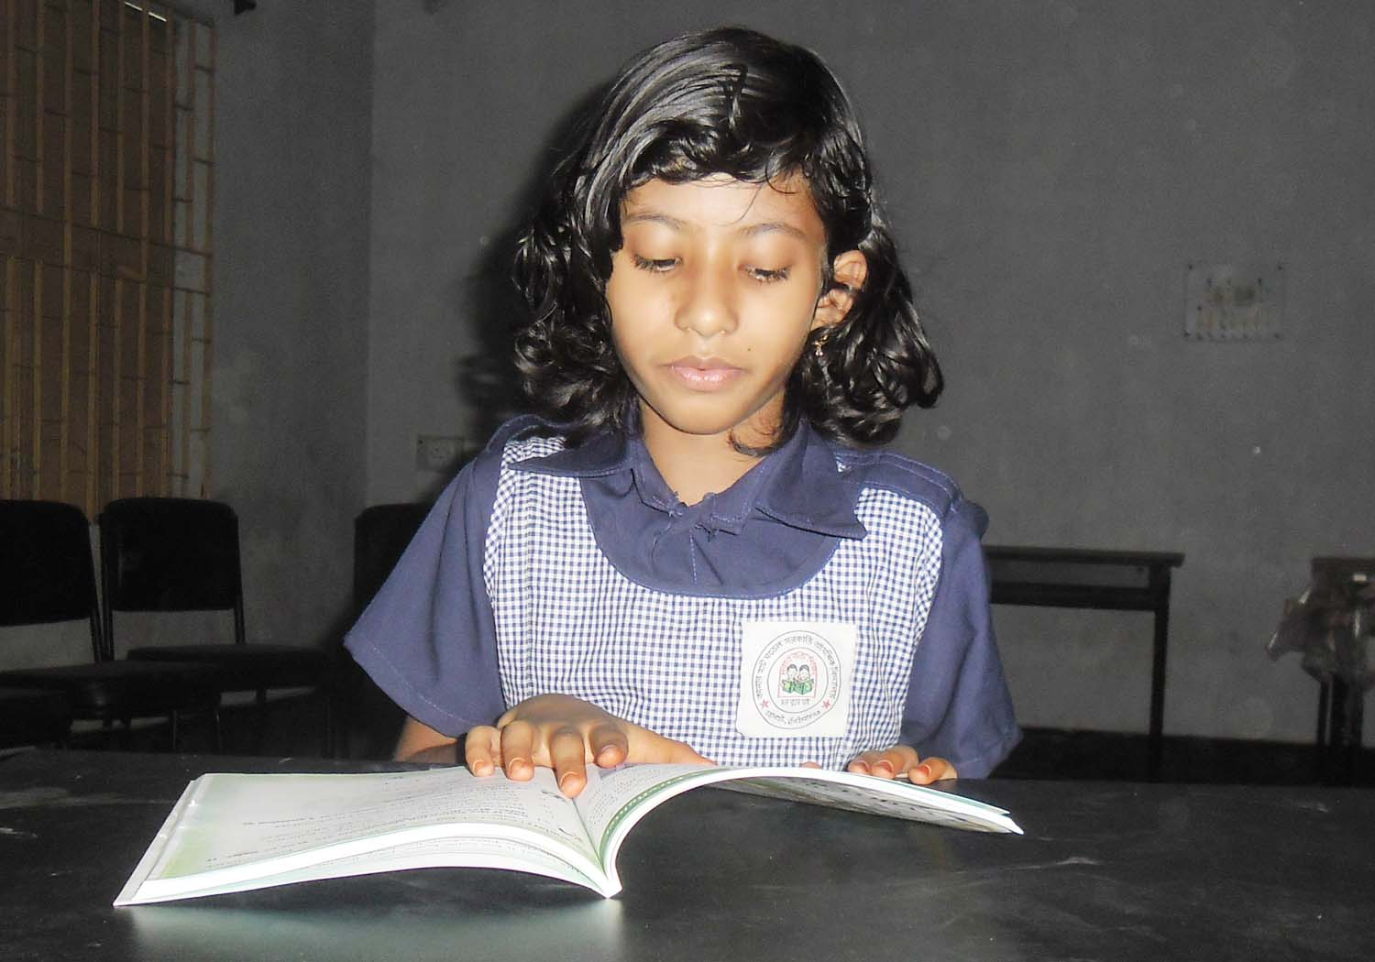
Silent Reading
Time: 5 minutes

Slide 19
Group Work# Time: 5 minutes
2013
January-2013
Sunday | Monday | Tuesday | Wednesday | Thursday | Friday | Saturday
 |  | 1 | 2 | 3 | 4 | 5
6 | 7 | 8 | 9 | 10 | 11 | 12
13 | 14 | 15 | 16 | 17 | 18 | 19
20 | 21 | 22 | 23 | 24 | 25 | 26
27 | 28 | 29 | 30 | 31
Look at the calendar and answer the questions:
(a) What day is the 8th of the month?
(b) What day is the 10th of the month?
(c) What day is the 25th of the month?

Slide 20

Pair Work# Time: 5 minutes
2013
April-2013
Sunday | Monday | Tuesday | Wednesday | Thursday | Friday | Saturday
 | 1 | 2 | 3 | 4 | 5 | 6
7 | 8 | 9 | 10 | 11 | 12 | 13
14 | 15 | 16 | 17 | 18 | 19 | 20
21 | 22 | 23 | 24 | 25 | 26 | 27
28 | 29 | 30
Look at the calendar and answer the questions:
(a) How many Saturdays are there in the month?
(b) How many Mondays are there in the month?
(c) How many Wednesdays are there in the month?

Slide 21

Supplementary Activities
http://www.softschools.com/math/calendar/activities/calendar_game/

Slide 22
Checking Learning
Time: 5 minutes

Slide 23
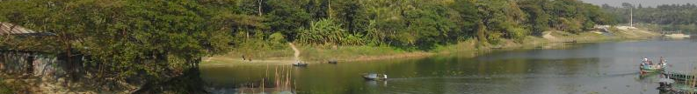
Individual Work# Time: 5 minutes
2013
May-2013
Sunday | Monday | Tuesday | Wednesday | Thursday | Friday | Saturday
 |  |  | 1 | 2 | 3 | 4
5 | 6 | 7 | 8 | 9 | 10 | 11
12 | 13 | 14 | 15 | 16 | 17 | 18
19 | 20 | 21 | 22 | 23 | 24 | 25
26 | 27 | 28 | 29 | 30 | 31
Look at the calendar and answer the questions:
(a) What date is the 2nd Friday in the month?
(b) What date is the 3rd Sunday in the month?
(c) What date is the 4th Tuesday in the month?

Slide 24
Home work
2013
January-2014
Sunday | Monday | Tuesday | Wednesday | Thursday | Friday | Saturday
 |  |  | 1
 |  |  |  |  | 31
 Draw a page for the month of January 2014.

Slide 25



