Slide 1

Welcome to All

Slide 2
Introduction
Name:
  Mohammod Munjurul Haque
Lecturer of English
Sonar Bangla Degree College
I.D. NO: 18
Subject: English
Class; Eleven
Unit: 10 Less: 02
Time: 60 minutes

Slide 3
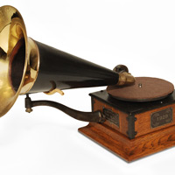
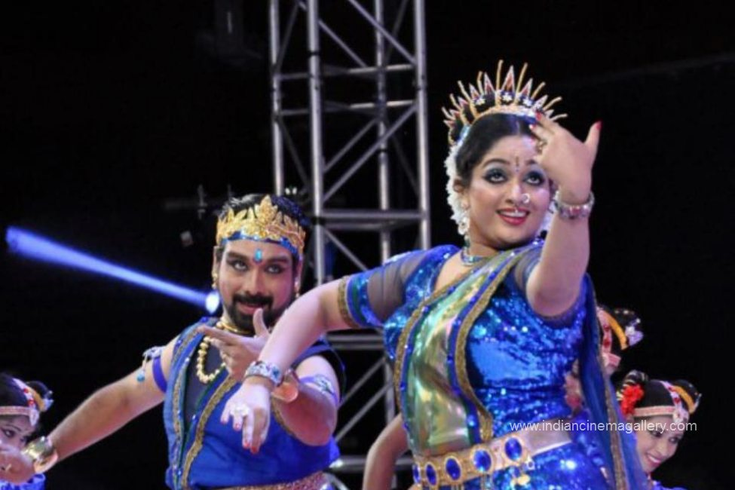

Slide 4
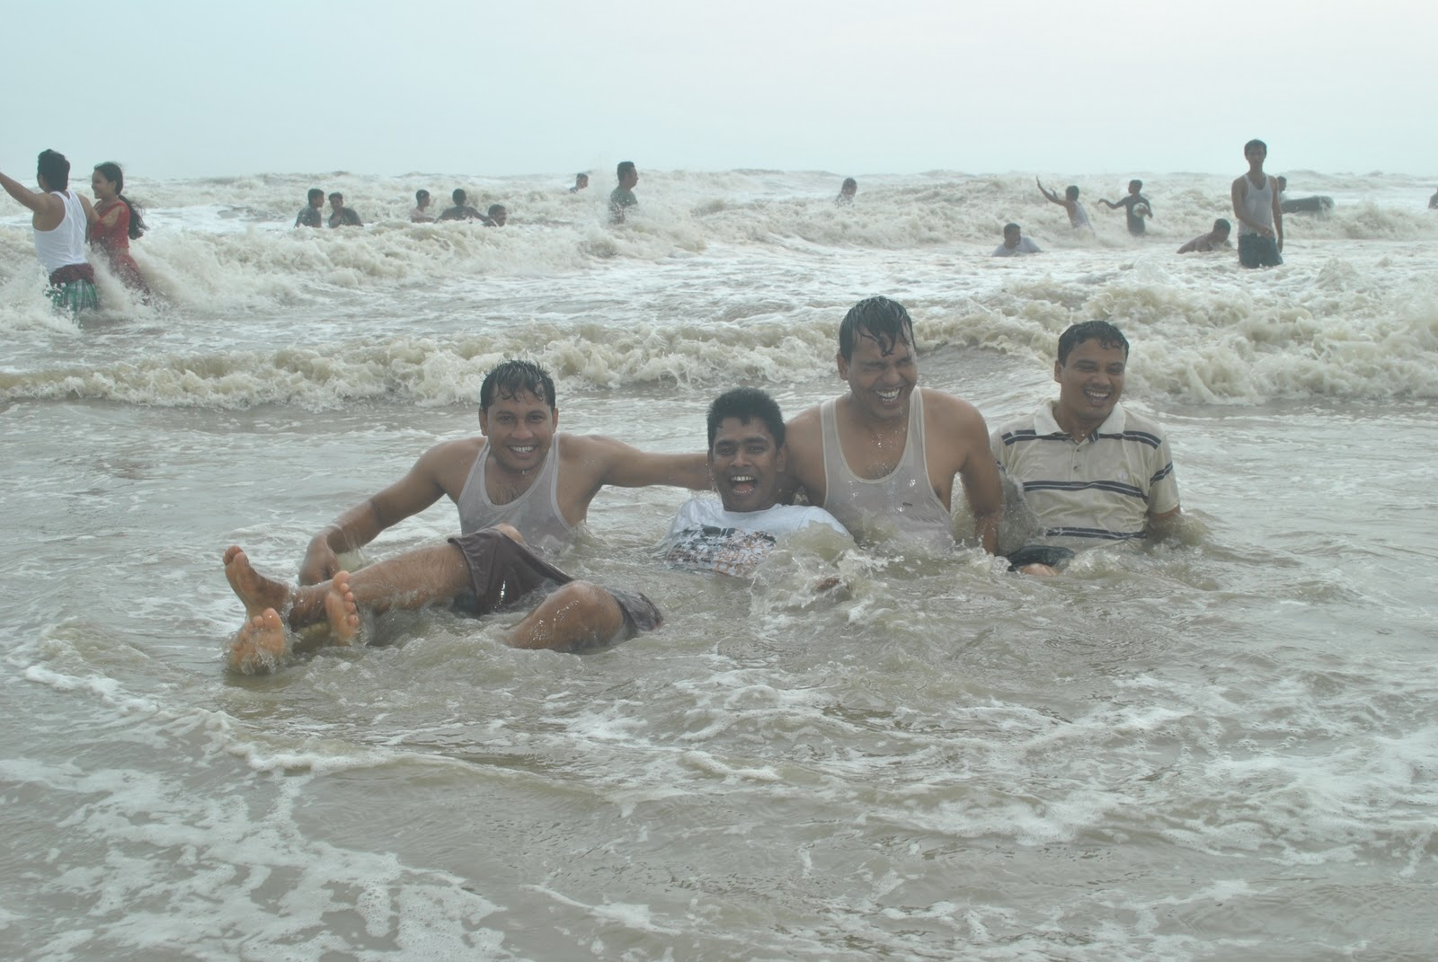

Slide 5
Learning outcome
A) They can say about the entertainment
B)They can describe the ways of entertainment
C)They can tell the effect of entertainments

Slide 6
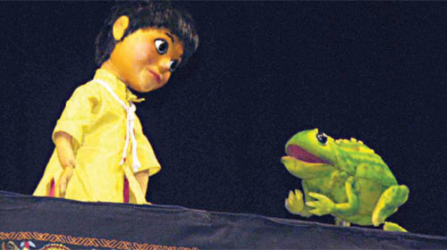
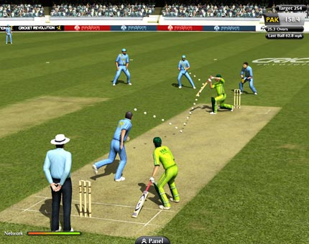
Entertainments

Slide 7
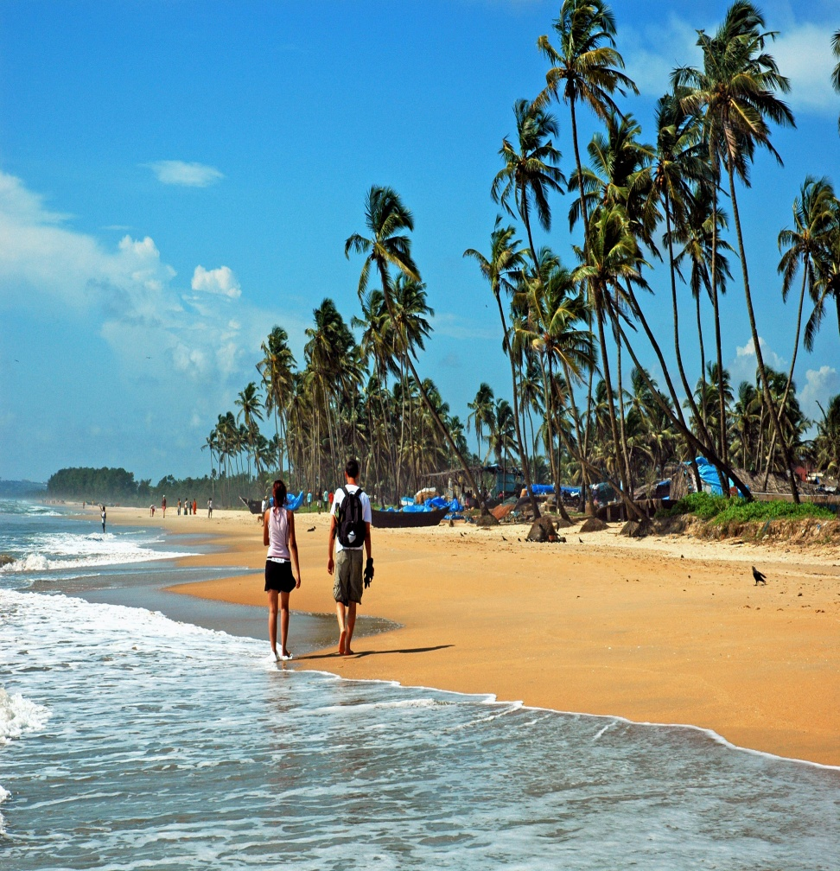
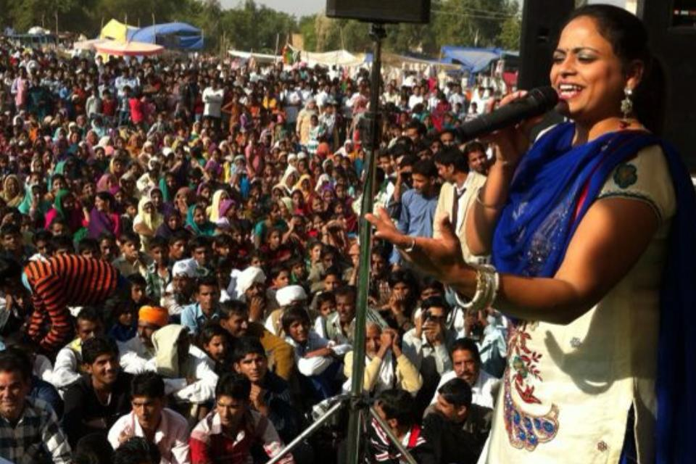

Slide 8
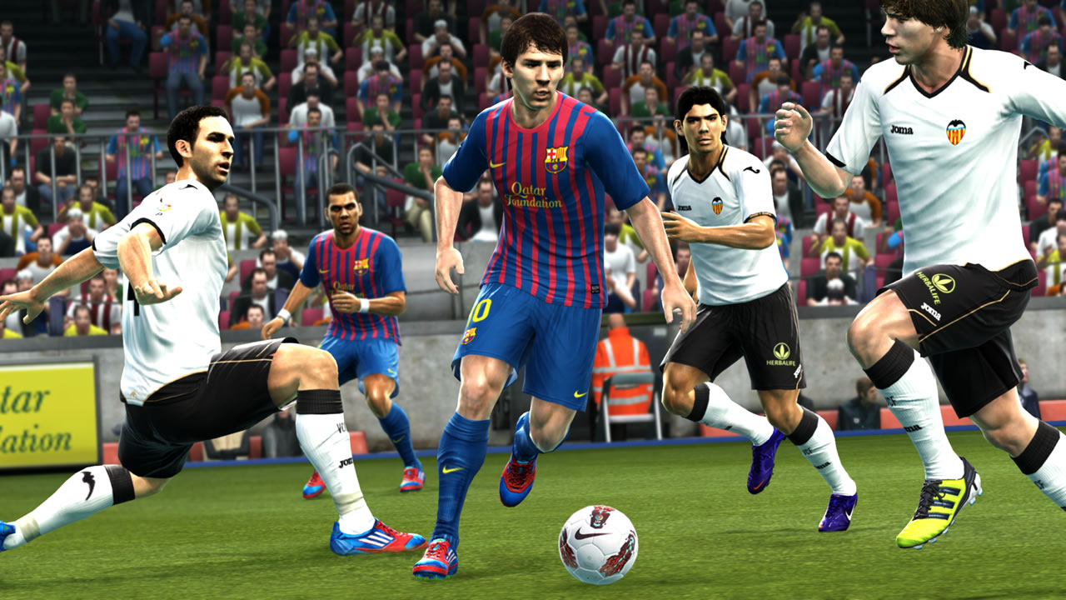

Slide 9
Group Works
Divide yourself into Eight groups:
The First four, write about the source of entertainments?
The next ,Write the name of your favorite source of entertainment?

Slide 10
Evaluation
A) What is entertainment?
B) In how many ways you can entertained yourself?
C) Which types of entertainment do you like most and why?
D) Have it’s any positive effects in a country’s development?

Slide 11
Home Task
Write an article about the positive effect of entertainment on our daily life?

Slide 12
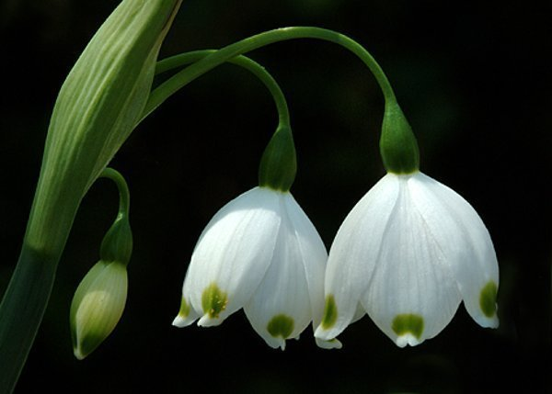
Thanks a lot

