Slide 1


WELCOME

Slide 2


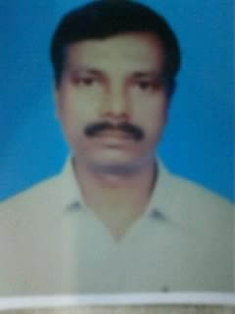
Teacher Introduction :
Ramesh chandra paul
Asst. Head master
Ataikula J.K. High School
Kashimpur, Ranigar, Naogaon.

Slide 3

Class Introduction
Class : Seven
subject : English Second Paper
Total Students : 60
Period : 4th
Time : 45 minutes
Date : 06-02-2013

Slide 4

Objectives :
1. Students’ will be able to tell vocabulary
2. They will be able to read the composition
3. They can tell about revel poet

Slide 5
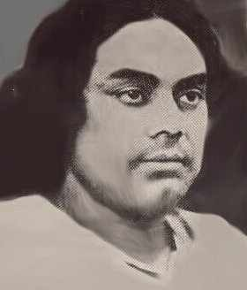

Look at the image and think about it.
lam
Writings : Poems - Agni Bina, Bisher Banshi, Sargohara , sindhu Hillole etc.
Born:
Bengla-
11 Jaiastha- 1306 B.S
Kazi Nazrul islam
Kazi Nazrul Islam
Died on: 12 Bhadrha- 1383

Slide 6
TITLE DECLARATION
Composition: “KAZI NAZRUL ISLAM”

Slide 7
Kazi Nazrul Islam is the National Poet of Bangladesh. He is the unique rebel poet of the undivided Bangla. He comes of poor family of the village. A center named Kabi Bhaban was established for making research. He served as a primary school teacher.

Slide 8
Individual Work
Read the passage carefully
Pair work
Discus vocabulary word and meaning them- education, freedom, unique, undivided, poet, research. singer

Slide 9

Evaluation
Write the name five poems of Nazrul
2. Why is Nazrul called rebel poet ?
Home Work
Write on short composition about Kazi Nazrul Islam

Slide 10
Thanks

