Slide 1
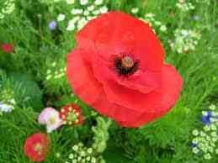
Welcome

Slide 2
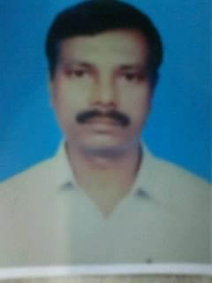
Introduction
Class : Ten
Sub : English 1st Paper
Time : 45 Minutes
Date : 21/07/2013
Ramesh Chandra Paul
Asst. Head master
Ataikula J.K. High School
Kashimpur,Raninagar, Naogaon.

Slide 3
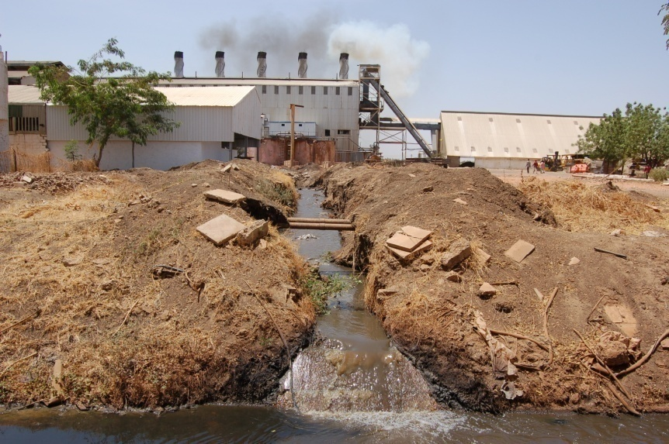
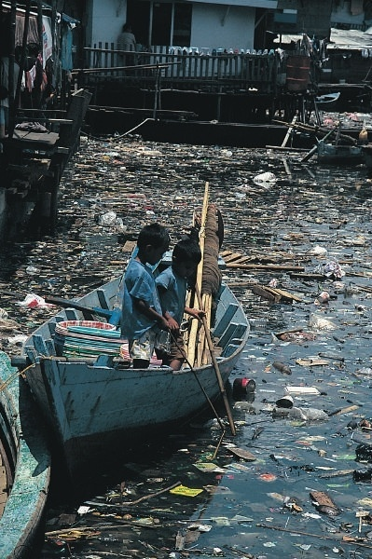
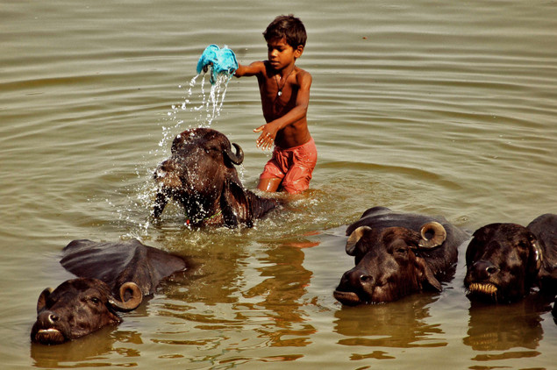
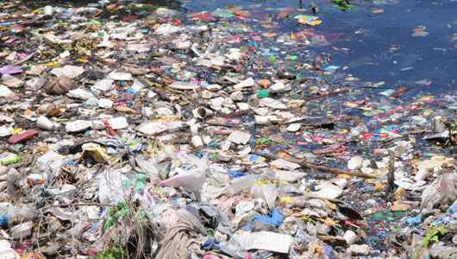
Look at the picture and talk
in pair(2/3) minutes:-

Slide 4
Declaration of the topic name
The killing water
Unit :-22
Lesson:-06

Slide 5
objectives
By the end of the lesson learners will have
Mentioned soime water-borne diseases
Answered questions on arsenicosis/water polution
Abled to find out information the text
Learnt some vocabularies such as in effect, pesti cide, address,arsenic

Slide 6
IDENTIFY THE WATER BORNE DISEASES
DENGUE
ARSENICOSIS
1
2
HEADACHE
4
3
5
TYPHOID
SMALL POX

Slide 7
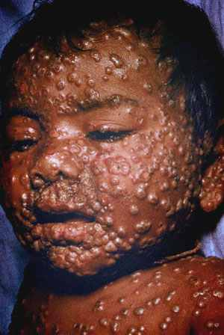
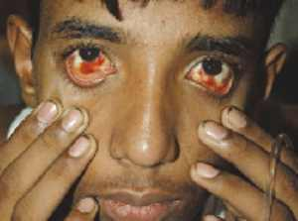
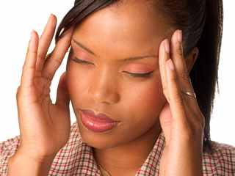
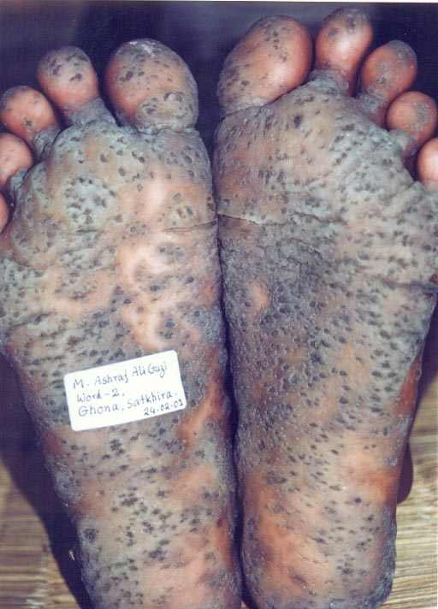
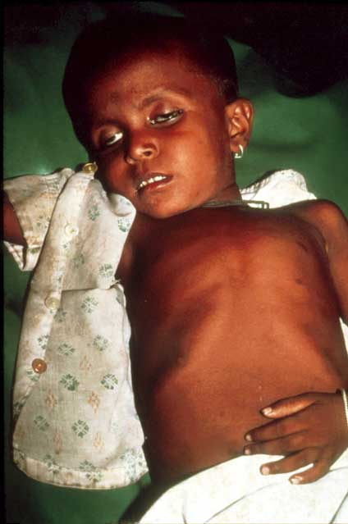
MATCH THE PICTURES
ARSENICOSIS
DENGUE
1
2
SMALL POX
DIARRHOEA
3
HEADACH
4
5

Slide 8
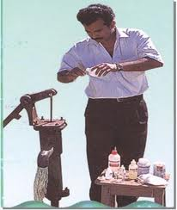
Tubewell is being tested

Slide 9
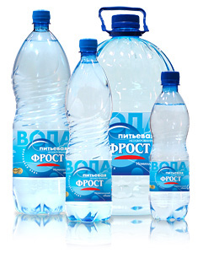
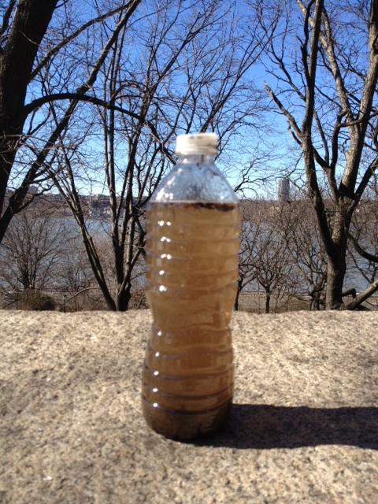
What do you see in the picture

Slide 10
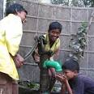

What difference do you see between two tubewell?

Slide 11

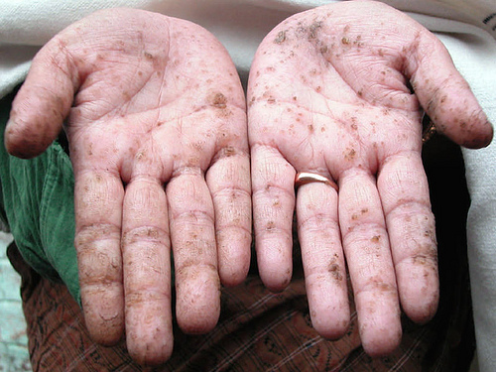
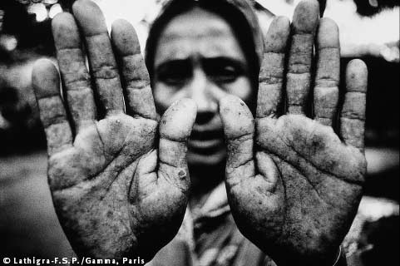
What are these pictures about ?
Why this caused?

Slide 12


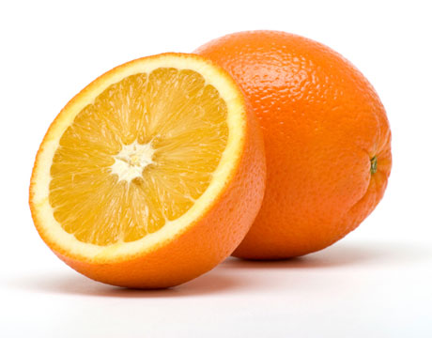
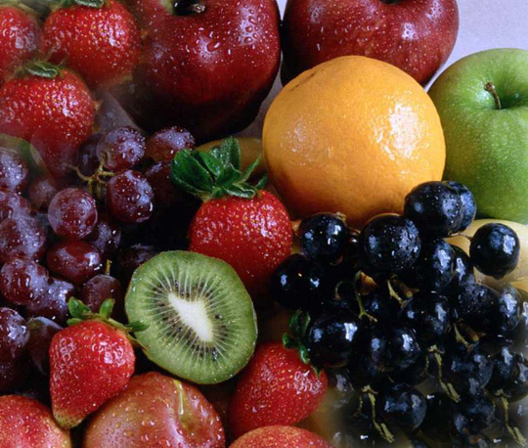

Treatment related to arsenicosis

Slide 13






VOCABULARY
IN EFFECT
INFACT
PESTICIDE
INSECTICIDE
ADDRESS
TO THINK ABOUT A PROBLEM TO DEAL WITH IT
ARSENIC
A POISONOUS SUBSTANCE

Slide 14
Group work
How is arsenicosis caused ?
How water is polluted?
How to get rid of arsenic?

Slide 15
Evaluation
What is the initial treatment for arsenicosis?
What are effective for the treatment of arsenicosis?
What is a potential source of arsenic- free water?

Slide 16
_{Home Work}
Write some instructions about arsenicosis to make people aware of this diseases.

Slide 17

THANKS TO ALL

