Slide 1

WELCOME

Slide 2
INTRODUCTION
MOHAMMAD NAZRUL ISLAM
ASSISTANT TEACHER (ENGLISH)
FARIDPUR GOVT. GIRLS’ HIGH SCHOOL, FARIDPUR
EMAIL: inazrul120@gmail.com
MOBILE: 01818403446
CLASS-NINE
SUB: ENGLISH 1ST PAPER
UNIT: FIVE
LESSON: TWO
TIME: 50 MINUTES
DATE: 17/12/13

Slide 3
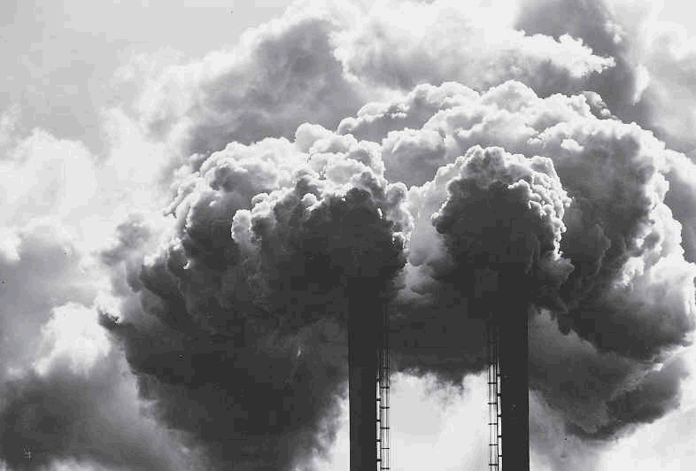
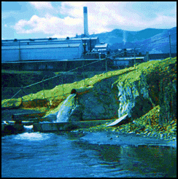

Slide 4
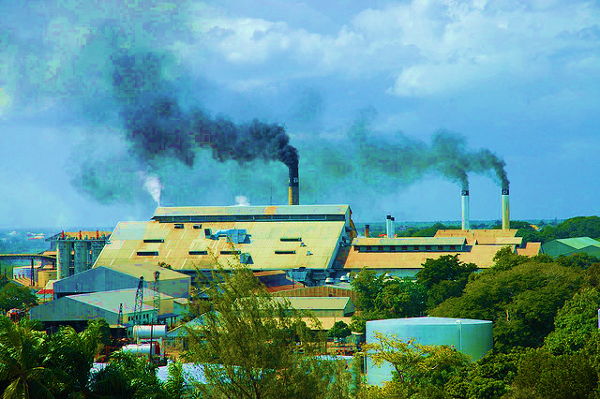
ENVIRONMENT POLLUTION

Slide 5
Learning outcome
After we have studied, we will be able to
tell the reasons of environment pollution.
find out the ways of reducing environment pollution.

Slide 6
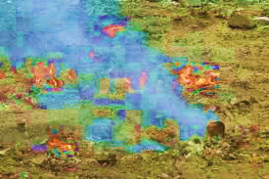

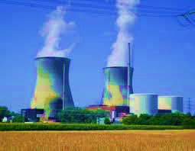
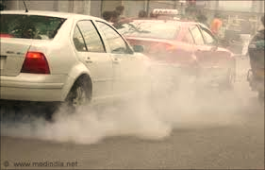

Slide 7
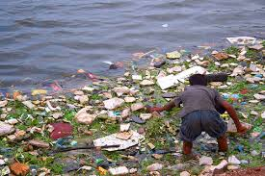
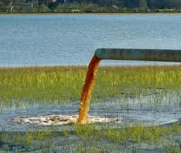
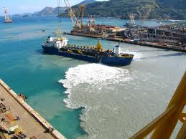
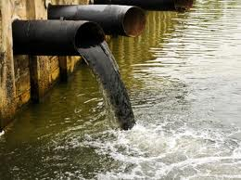

Slide 8
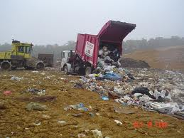
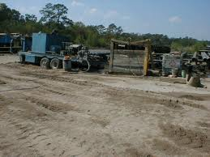

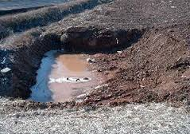

Slide 9

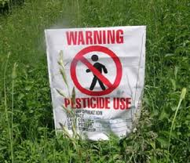
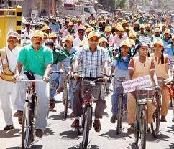
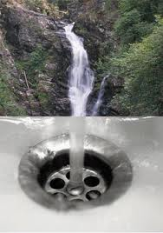

Slide 10
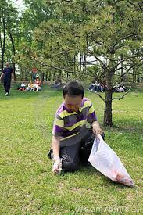
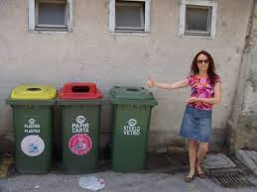

Slide 11
EVALUATION
What factors are responsible of air pollution?
How are water and soil polluted?
Who is the most culprit of environment pollution?

Slide 12
HOME WORK
Write a paragraph on Environment pollution with 200 words.

Slide 13
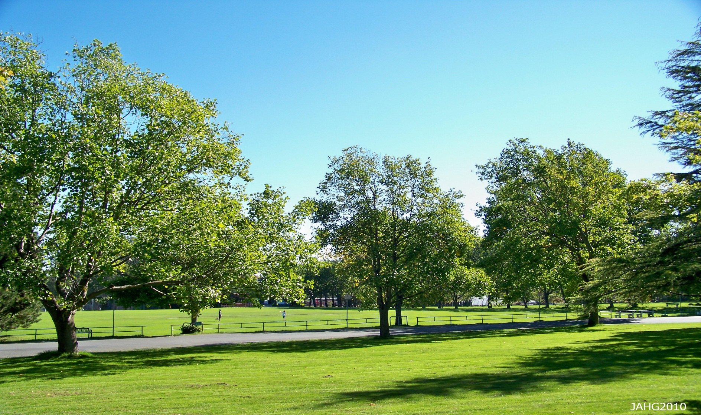
THANK YOU VERY MUCH.

