Slide 1

WELCOME

Slide 2



MD. JAHANGIR HOSSAIN
ASSISTANT TEACHER (English)
Prosadpur Girls’ High School,Chapi Nababgonj

Slide 3





Introduction To Lesson
Sub: English 2nd Paper
Class: Nine
Lesson: Paragraph
Duration: 50mts

Slide 4
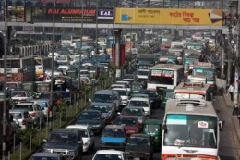
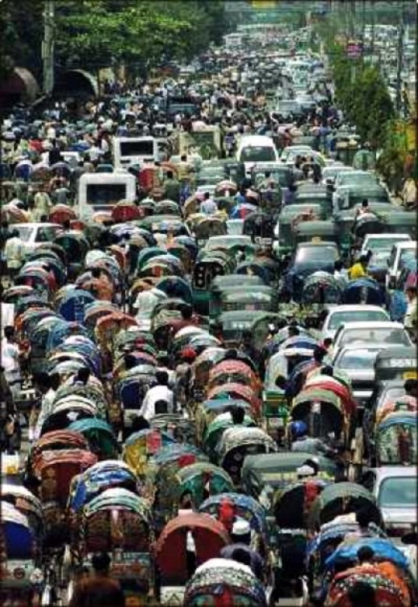
vehicles congested
Many rikshas
What are the pictures about?

Slide 5
Traffic Jam

Slide 6
Objectives:
By the end of the lesson you will be able to learn about traffic jam, its causes, effects and new words.

Slide 7
Individual Work
What is traffic jam?
wwwwqqdividual Work:
Trafiq jam is a long congestion of various vehicles on the street.It is a problem in big cities.

Slide 8
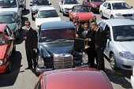
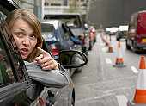
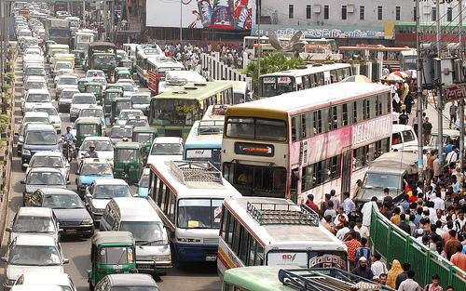
Vocabulary
Cogestion
Qurrelling
Boreness
Accident

Slide 9

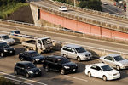
NARROW STREET
LOTS OF TRAFIC
RECKLESS DRIVING

Slide 10
Pair Work
Talk about two causes of traffic jam.
There are many causes of trafiq jam. Narrow streets ,reckless driving, parking on the road are the main causes of trafiq jam.

Slide 11
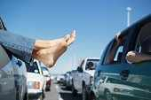
accident
querlling
boreness
Kills time

Slide 12
Group Work
What are the effects of traffic jam?
Trafiq jam causes many problems. Because of it we face accident, feel boring . Sometimes,people quarrel with one another. It also kills our time.

Slide 13
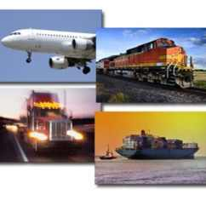
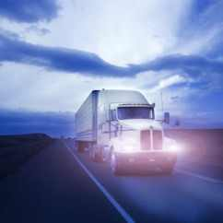
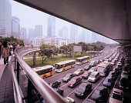
Travelling by air,water,train
Using flyover

Slide 14
Evaluation
Have you ever fallen in traffic jam?
How can we get rid of traffic jam?

Slide 15
Home work
Write a paragraph on traffic jam.

Slide 16

THANKS TO ALL

