Slide 1

WEL COME
স্বাগতম

Slide 2

●Md.Solaiman Hossain.
● Asst,teacher(Computer).
● Alhaj Amena Khatun Biddaypith.
● Kalukhali.Rajbari
Introduce

Slide 3

Class: Six. Date: 27/07/13
Subject : English 2nd paper.
Total sts:40. Time: 00:50:00
Section:

Slide 4


Look at the picture

Slide 5
Preposition

Slide 6
A preposition is a word used in front of a noun or pronoun to show its relation to other words of the sentence

Slide 7
Some prepositions are shows here-to,into,of,on,between, among,above,over,beside,through,out etc.

Slide 8
Over /above
0n
between
at
0ut
to/towards
Of/off
into
in
through
among
Under/Below
Beside/by

Slide 9
Pair work
●To use preposition

Slide 10

●What is preposition?
● Mention some prepositions.
Evolution

Slide 11

Home task
●● Write a diagram about preposition.

Slide 12
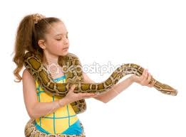
Good bye !!

