Slide 1
Welcome
To
CLASS: EIGHT
SUBJECT: ENGLISH
TOPIC: WRITING STORY ON
TIME: 50 minutes
“ HONESTY IS THE BEST POLICY”
Prepared
By
ROUFUN NAHAR
ASSISTANT TEACHER ( ENGLISH),
JAMALPUR GOVT. GIRLS’ HIGH SCHOOL,
JAMALPUR.

Slide 2
OBJECTIVES OF THE LESSON
By the end of this lesson the students will be able to ---
* talk about pictures.
* listen and understand a story.
* tell the meaning of the following words ___
Slip, Weep, Glad, Grief and Dive.
* write a story about “Honesty is the best policy”.

Slide 3
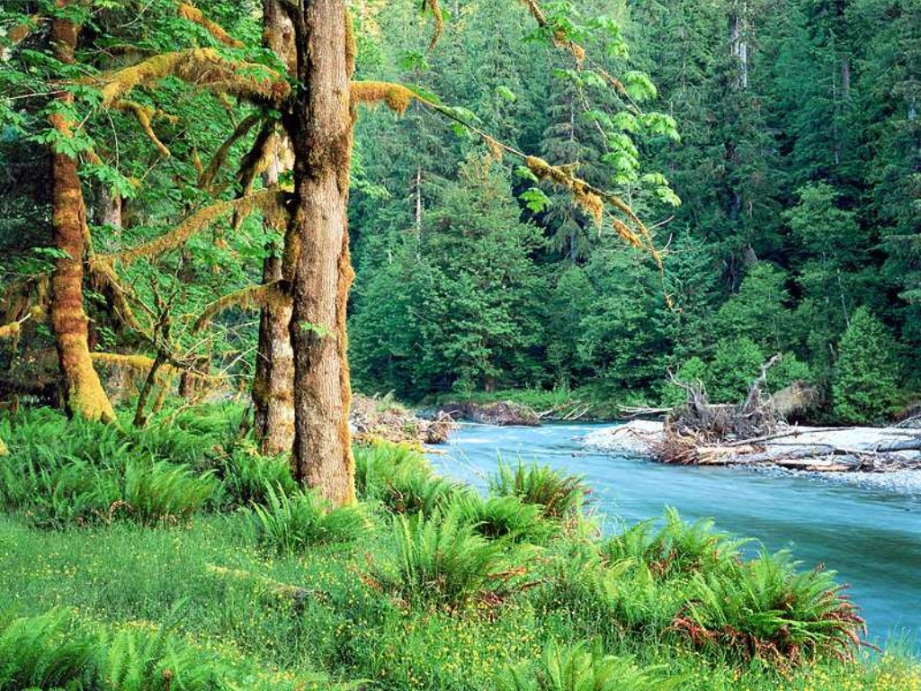
What do you see in the picture?

Slide 4
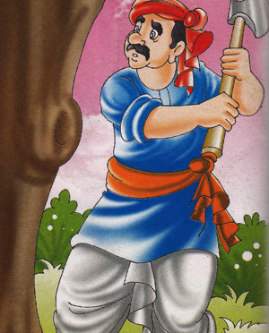
What do you see in the picture?
A wood-cutter

Slide 5
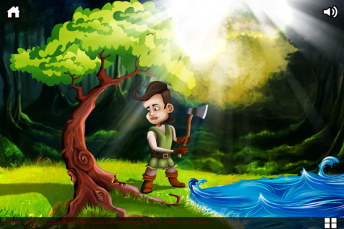
One day he was cutting wood in the jungle beside a river.

Slide 6
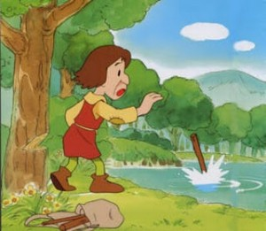
Then what happened?
Suddenly his axe slipped out of his hand.

Slide 7
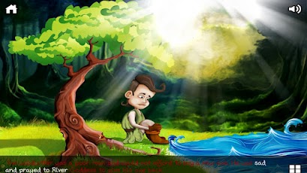
What happened after that?
He was in grief and began to weep.

Slide 8
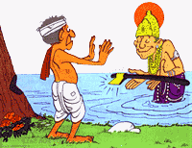
Then what happened?
The water god rose up from the river and showed him a golden axe and asked, “ Is it yours, son?”.
Guess what did wood cutter reply?
The wood cutter replied, “ No, it’s not mine.”

Slide 9
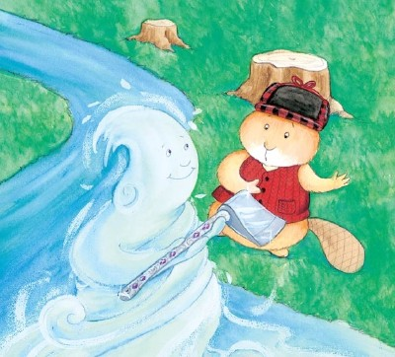
Then what happened?
The water god dove into the water and brought a silver axe and asked him “ Is it yours?”.
Guess what did wood cutter reply?
The wood cutter replied, “ No, it’s not mine.”

Slide 10
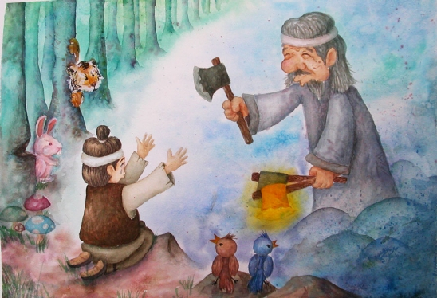
Then what happened?
Then the water god dove into the water and brought the real axe and asked him, “ Is it yours?”.
Guess what did wood cutter reply?
The wood cutter replied, “ Yes, it’s mine.”

Slide 11
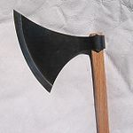
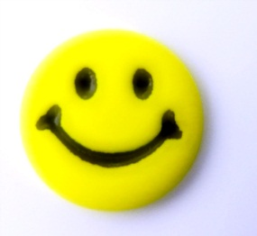
What did wood cutter do after getting the real axe and how did he feel?
He smiled and became very glad.

Slide 12
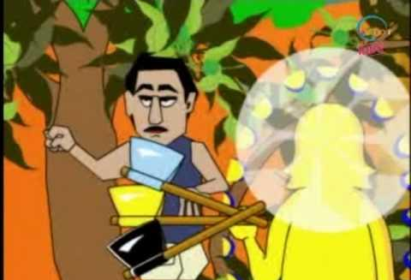
Then what happened?
The water god became pleased and gave him all the three axes as a reward of his honesty.

Slide 13
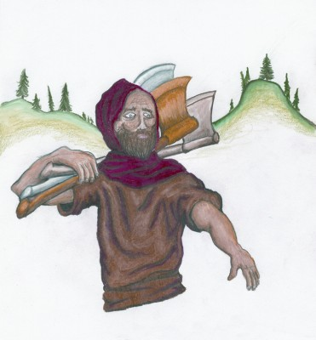
What happened here?
The wood cutter took all the three axes and went back home.

Slide 14
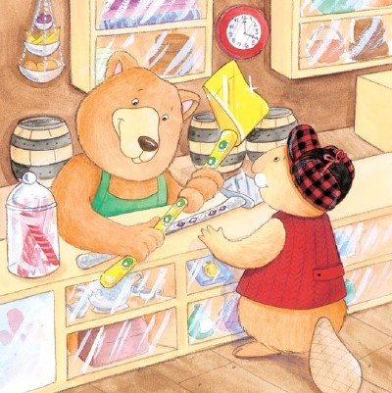
What did the wood cutter do with the axes?
He sold the golden and silver axes.

Slide 15
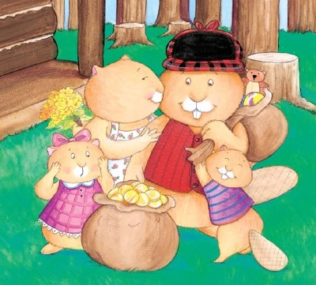
Then what happened?
He got a lot of money and his family became vey happy.

Slide 16
Let’s see a video clip on an honest wood cutter
The video may not clear one because here is the converted video clip for reducing MB of the file. To see the real video the URL id ---- http://www.youtube.com/watch?v=x5GH3kxobms

Slide 17
Answer the following question:
1. Where was the village?
The village was nearby a forest.
2. When did Deena start his work?
Deena started his work early in the morning.
3. Where did Deena go to find good wood?
Deena went to river side to find good wood.

Slide 18
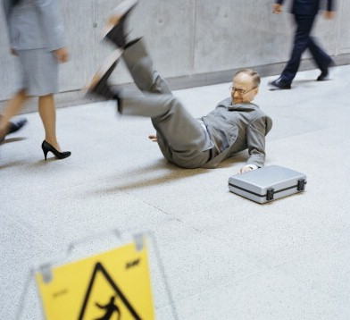
Vocabulary practice
Slip
(Verb)
To lose one’s balance and fall or nearly fall

Slide 19
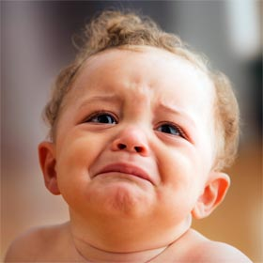
Weep
(Verb)
Shed tear/Cry

Slide 20

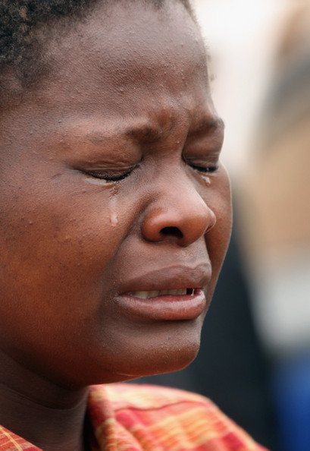
Glad
(Adjective)
Happy
Grief
(Noun)
Sorrow

Slide 21
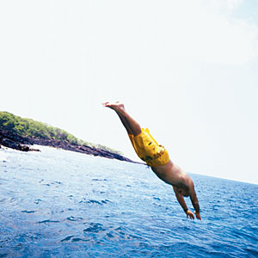
Dive
(Verb)
Go under water

Slide 22
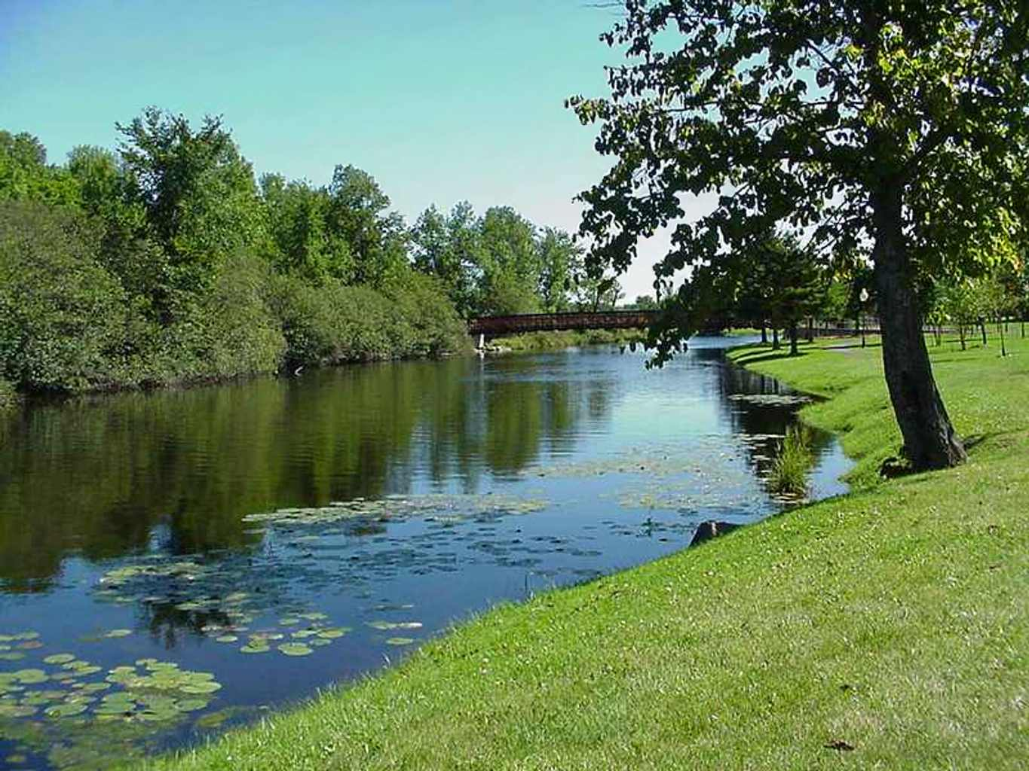
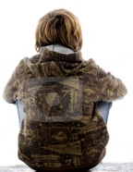

CLASS WORK
( Individual/pair/group)
Complete the following story----
Once there lived a poor boy named Tapu. But he was very honest. Everyday he used to sit beside a river. One day he sat beside the river. There was an apple in his hand. Suddenly…………….

Slide 23
How to evaluate the writing story
While the students will be writing, teacher will monitor, help them, take notes. After time is over if it is individual work few students will be asked to present their writing, if it is group work, the leaders will be asked to present their writing. Correction should be in general and in a soft way.

Slide 24
Be Honest

Slide 25
Honesty
Is the best
Policy

Slide 26

Thank You All

