Slide 1




Slide 2


Simul Rani Das
Assistant teacher
Oskhali Aleya Model
Govt. Primary School
Hatiya, Noakhali.

Slide 3
Class-Five
Subject-English
Lesson: four
Time : fourty m.

Slide 4
By the end of this lesson ss
will be able to –
.Read and say with correct pronunciation.
.Say about how do the members
of a family Spend their free time.
1
2

Slide 5




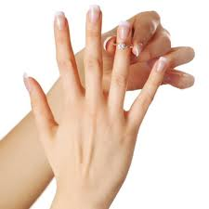

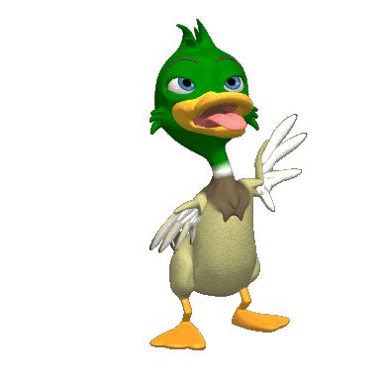
Let’s sing a song
Toes finger toes finger where are you?
Here I am here I am how do you do?
Four finger four finger where are you?
Here I am here I am how do you do?
Middle finger middle finger where are you?
Here I am here I am how do you do?
Ring finger ring finger where are you?
Here I am here I am how do you do?
Little finger little finger where are you?
Here I am here I am how do you do?

Slide 6
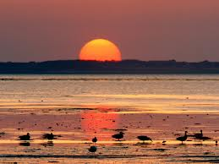
Look at the picture.
The sun is setting.
It’s Evening

Slide 7
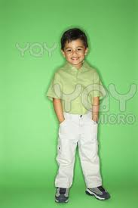
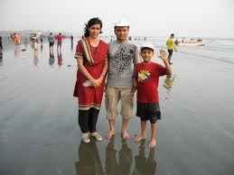
Look at the picture.
Saikat
Saikat’s family

Slide 8
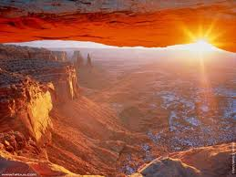
Todays lesson
An Evening with Saikat’s Family.

Slide 9


Input

Slide 10
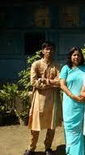
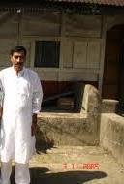
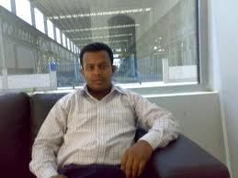
Look and say
Saikat lives with
his parents
His father is a banker

Slide 11
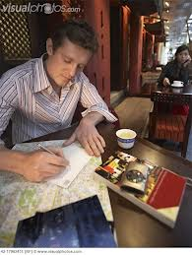

Look and say
Saikat’s father writes
stories In his free time.
He loves listening to
music of old time.

Slide 12
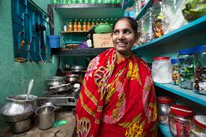
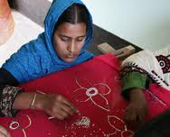
Look and say
Saikat’s mother is a housewife
She loves sewing in her free time

Slide 13
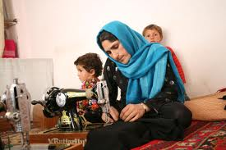
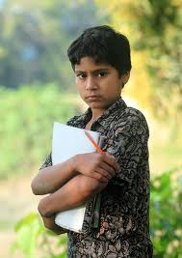
Look and say
She makes dresses
Saikat is a good student

Slide 14
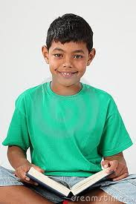
Look and say
Saikat reads english story books everyday

Slide 15

Loud reading by the teacher

Slide 16
. Listen and say
Pronunciation of difficult words
apartment
cartoons
neighbour
housewife
listening

Slide 17

Loud reading by students

Slide 18

Silent reading by the students

Slide 19
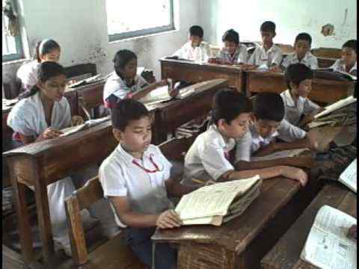
practice

Slide 20
Word , similar word and make sentences
Apartment
Housewife
listen

Slide 21
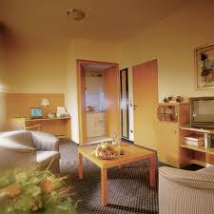
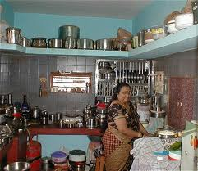
word
Similar word
Use in sentences
Apartment
flat
Their family lives in an apartment
Housewife
Home maker
My mother is a housewife .
Listen
hear
Raju, listen to me.

Slide 22
Fill in the blanks with
correct words.
Saikat’s family lives in -----.
b. He reads ----stories in his free time.
c.She gets ---for making dresses.
d. Saikat’s father likes---of old time.

Slide 23
Answer the following questions
a.Who is Saikat?
b. With whom does he live?
c.What does Saikot’s father love?
d. What does his mother do in her free time?
e.What does Saikat do to improve his English?

Slide 24
Read the following sentences
with correct pronunciation.
Saikat’s mother, Maleka Begum
is a housewife.She loves sewing
in her free time. She makesdreses.
She often gets orders from her friends and neighbours .

Slide 25

Task

Slide 26
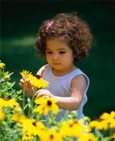
What do you do in your leisure time?

Slide 27

How do your parents spent their free time?

Slide 28


Spent your every moment for wel-fare.

