Slide 1

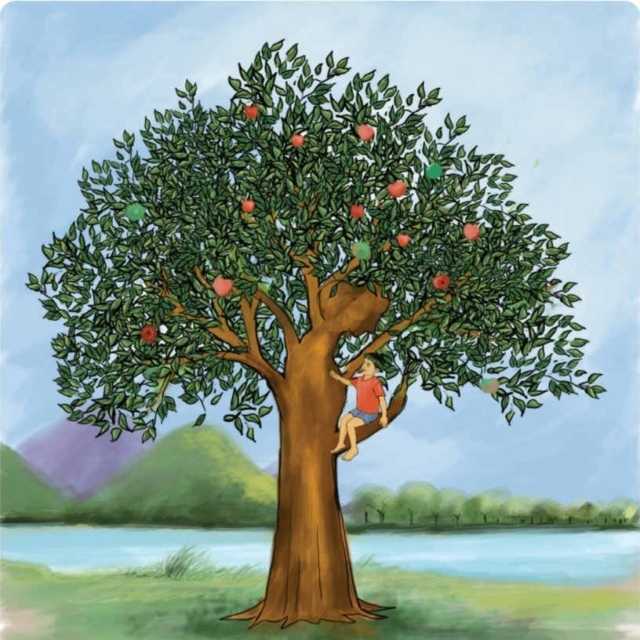
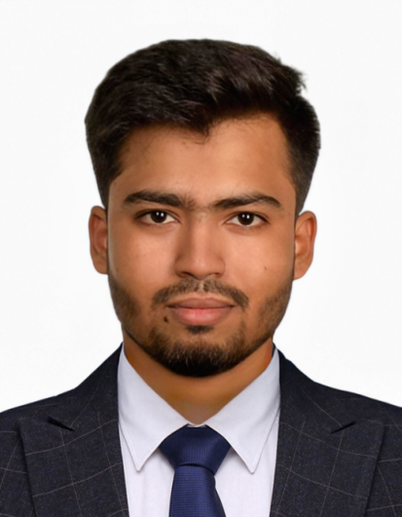
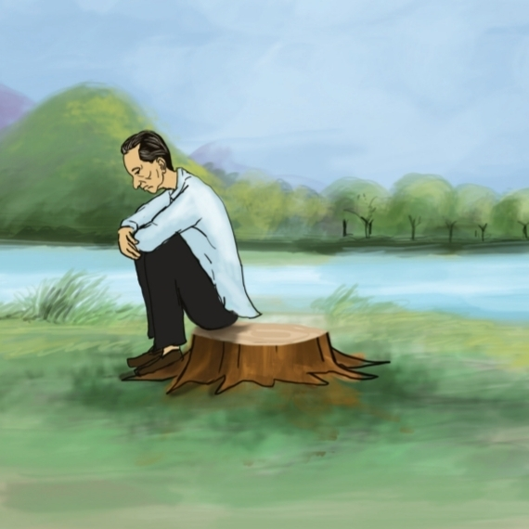
Class 5
UNIT 16 · SESSION 79
The Giving Tree
Teachers Information
Md. Al Amin
Assistant Teacher
Jamalpur Govt. Primary School
Ramganj, Lakshmipur.
English for Today · Activity 2.1, 2.2 · Textbook page. 86
Notes:
Session 79: Activity 2.1 and 2.2, textbook page 86. Learning outcomes: 3.4.2 answer simple questions appropriately and confidently; 5.1.2 get the specific information from simple texts; 5.1.4 get the general ideas from simple texts.

Slide 2




Let's say hello!
⏱ 1 min
Greet
Ask
Reply
Teacher: “Good morning / Good afternoon.” Say it back with a smile.
Teacher: “How are you today?”
Students: “Fine, thank you.”
Your turn: stand up, smile and greet your partner. Ask “How are you today?” and reply “Fine, thank you.”
English for Today · Unit 16 · Introduction
Notes:
INTRODUCTION (1 min). Exchange greetings with a smiling face saying 'Good morning/Good afternoon.' Ask Ss 'How are you today?' Encourage them to reply 'Fine, thank you.'

Slide 3



Today's lesson at a glance
3.4.2 Answer simple questions appropriately and confidently
5.1.2 Get the specific information from simple texts
5.1.4 Get the general ideas from simple texts
Materials: textbook, whiteboard, flashcards, worksheets
English for Today · Unit 16 · Plan
Notes:
Share today's goals. Outcomes: 3.4.2, 5.1.2, 5.1.4. Materials: textbook, whiteboard for True/False statements, flashcards, worksheets. Chart: sample 45-minute plan.

Slide 4
What do you remember?
⏱ 3 min
Today we will learn how nature provides us without anything in return.
What do you remember most about the story?
What did the tree give to the boy?
Possible answers
Possible answers
The tree loved the boy very much.
The boy made leaf crowns and played.
The boy grew older and went away.
The tree gave everything she had.
The old boy came back, tired and sad.
Apples, to sell for money
Branches, to build a house
Trunk, to make a boat
Stump, a quiet place to rest
English for Today · Unit 16 · Review
Notes:
REVIEW (3 min). Tell Ss: 'Today we will learn how nature provides us without anything in return', referring to the story. Briefly review the previous session's discussion. Ask: 'What do you remember most about the story? What did the tree give to the boy?' Accept any sensible answer; the cards show possible answers.

Slide 5








Word check: what do they mean?
shade
trunk
branches
stump
a cool place under a tree
the thick main part of a tree
arms that grow from the trunk
what is left of a cut tree
boat
sail
whispered
joy
it carries people over water
to travel on water
spoke very softly
great happiness
English for Today · Unit 16 · Words
Notes:
REVIEW. Review basic vocabulary (e.g. shade, stump, boat) and check that Ss understand the meaning of these words. Show a flashcard or a drawing for each word, say it, students repeat, then ask a student to explain the meaning or use it in a sentence.

Slide 6
Pair work: how to do it
⏱ 15 min
1
Sit with your partner
Say it like this
Listen as the teacher reads a statement aloud
I think it is true because…
I think it is false because…
I agree. / I don't agree.
The correct information is…
2
3
Discuss it together for one minute
4
Decide: true or false?
5
If it is false, give the correct information
Share your answer and explain your reasons
Take turns. Listen. Be kind.
6
English for Today · Unit 16 · Pair work
Notes:
PRESENTATION (15 min). Divide Ss into pairs for Activity 2.1 on page 86. Ss work in pairs to discuss whether the sentences are true or false and correct the false ones. Read each statement aloud and give Ss a minute to discuss. After each statement ask a pair to share their answer and explain their reasoning. Write the correct answer on the board and discuss corrections to false statements.

Slide 7
Activity 2.1: true or false?
Pair work: discuss. If it is false, give the correct information.
The tree didn't love the little boy.
The boy cut down the tree's trunk and made furniture.
a
f
The boy would sleep in the tree's shade when he was tired.
The tree was not really happy when the boy made a boat.
b
g
The tree was often alone because the boy grew older.
The boy came back to the tree after a long time.
c
h
The tree gave the boy money.
The tree had more apples, branches, or trunk to give to the boy.
d
i
The boy cut off the tree's branches to build a house.
The boy wanted a quiet place to rest when he was old and tired.
e
j
English for Today · Unit 16 · Activity 2.1
Notes:
Activity 2.1 (textbook p. 86). Read each statement aloud, one minute of pair discussion, then a pair shares the answer and reason. Write the correct answer on the board.

Slide 8
Answer key: 2.1
a) The tree loved the little boy.
f) He made a boat, not furniture.
F
F
b) The boy slept in the tree's shade when tired.
g) She was not really happy about the boat.
T
T
c) The boy grew older, so the tree was often alone.
h) The boy came back after a long time.
T
T
d) The tree had no money. She gave apples to sell.
i) She had nothing left to give.
F
F
e) The boy cut her branches to build a house.
j) The old, tired boy wanted a quiet place to rest.
T
T
English for Today · Unit 16 · Answers
Notes:
Answer key for 2.1: a) False, the tree loved the boy. b) True. c) True. d) False, the tree had no money; she gave apples to sell. e) True. f) False, he made a boat, not furniture. g) True. h) True. i) False, she had nothing left to give. j) True.

Slide 9

Practice: read the story again
Read “The Giving Tree” once again with your partner
Look for details
1
Take turns: one paragraph each
branches, trunk, shade, apples
2
Listen to your partner. Help with hard words
3
Feel the story
Read with feeling: change your voice for the tree and the boy
4
How does the tree feel? Why?
English for Today · Unit 16 · Practice
Notes:
PRACTICE (15 min). Ask Ss to read the story 'The Giving Tree' once again in pairs. Move around, help with pronunciation and hard words.

Slide 10
Activity 2.2: read and answer
⏱ 10–12 min
Read the story again. Answer the questions in your exercise book.
Find it
What things did the boy take from the tree?
a
Look for specific details: branches, trunk, shade.
Was the tree really happy when the boy took her things?
b
Did the boy give anything to the tree?
c
Think about it
Could the tree help the boy when it was just a stump?
d
Why was the tree happy? What does the story mean?
What can we learn from the story?
e
English for Today · Unit 16 · Activity 2.2
Notes:
Refer Ss to Activity 2.2 and say: 'After finishing reading, you should answer the questions at page number 86.' Give Ss 10-12 minutes. Encourage Ss to focus on specific information from the text (branches, trunk, shade) and to think about the inferred meaning (Why was the tree happy?). Then review the answers together as a class.

Slide 11
Share and check: 2.2
⏱ 2 min
a
What did the boy take?
Apples, branches and trunk.
b
Was the tree really happy?
Not really. She gave everything, and she was sad inside.
c
Did the boy give anything?
No. He only took.
d
Could the stump help?
Only with a quiet place to sit and rest.
e
What can we learn?
Giving, love and selflessness. Nature gives without asking back.
Make it stronger: add “because…” to explain your idea.
English for Today · Unit 16 · Feedback
Notes:
Review the Activity 2.2 answers together as a class and invite Ss to share their responses. Suggested answers: a) apples, branches and trunk. b) Not really; she gave everything and was sad inside. c) No, the boy only took. d) Only a quiet place to sit and rest. e) Giving, love and selflessness; nature provides us without anything in return. FEEDBACK (2 min): support Ss who find the key details or inferred meaning difficult; praise clear and confident answers and suggest expanding on inferred meanings.

Slide 12



Check: show what you know
⏱ 6 min
Hands up!
Write
Swap books
Listen to the statement. Raise your hand: true or false?
Copy the questions from the board. Write your answers in your exercise book.
Exchange books with your friend. Check each other's answers.
Praise: great participation, everyone! Keep sharing your ideas.
English for Today · Unit 16 · Check
Notes:
ASSESSING LEARNING (6 min). 1) Say the statements of Activity 2.1 aloud; Ss raise their hands to say true or false. 2) Write the Activity 2.2 questions on the board; Ss write the answers in their exercise books (monitor and support). 3) Ss exchange exercise books to check. Praise active participation. Indicators: S gets specific information through true/false statements; S answers simple questions appropriately and confidently; S understands the inferred meaning of giving, selflessness and love.

Slide 13


Summary: what have we learnt?
⏱ 2 min
“We have learnt how nature provides us without anything in return.”
Giving
Love
Selflessness
The tree gave all she had.
She always loved the boy.
She asked for nothing back.
Think: how can you give and care like the tree?
Notes:
SUMMARY (2 min). Recap the main points of the lesson. Ask: 'What have we learnt today?' Encourage Ss to say: 'We have learnt how nature provides us without anything in return.'

Slide 14
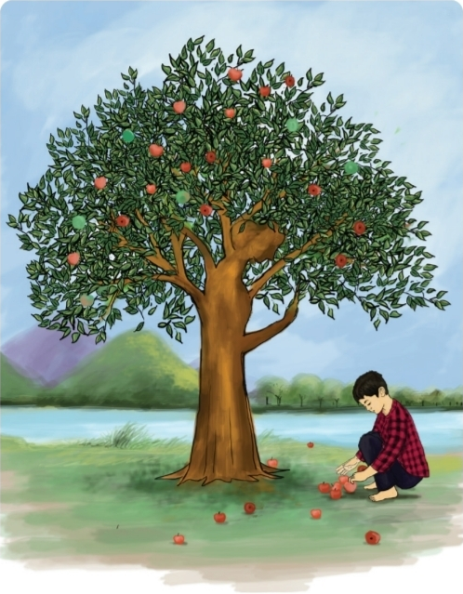
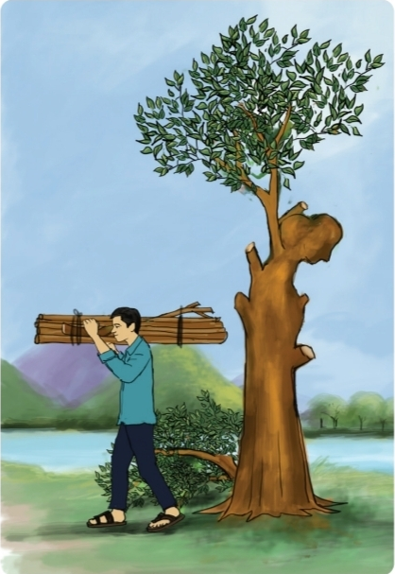
Have a nice day!
See you again in the next class. Take care.
Unit 16 · The Giving Tree · Session 79
Notes:
CONCLUDING (1 min). End the class by saying: 'Have a nice day. See you again in the next class. Take care.'

