Slide 1


Slide 2
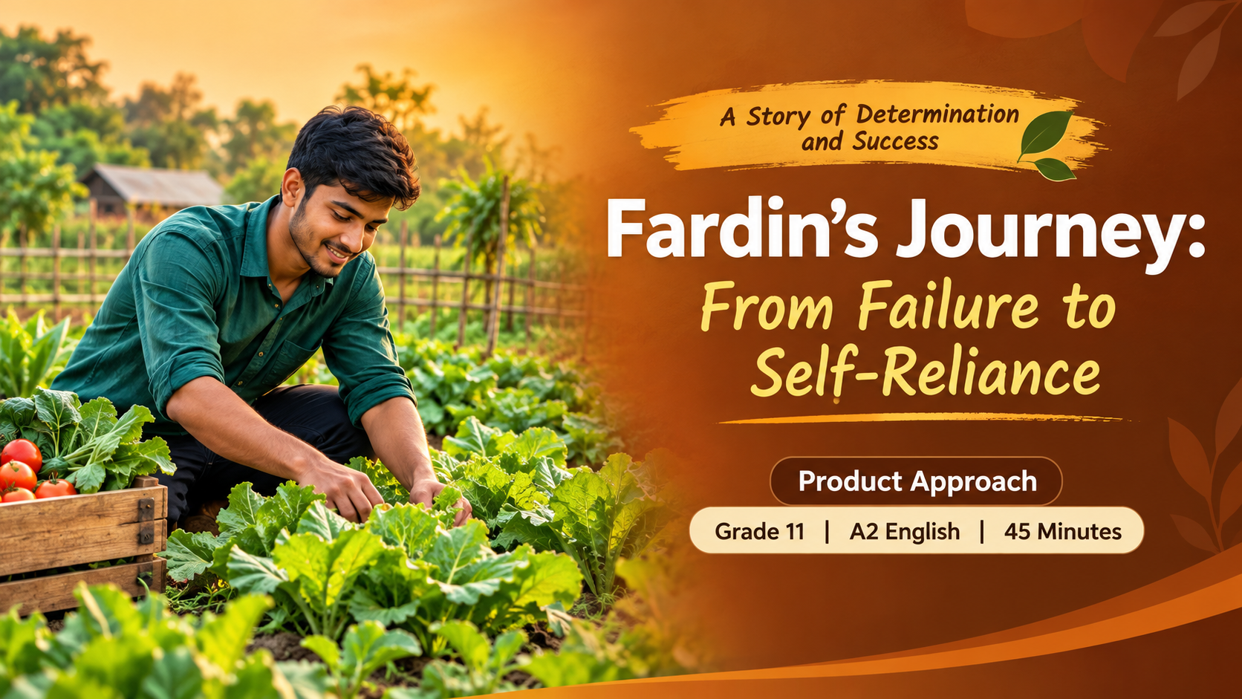
Big idea: A setback can become a new beginning.
Story Writing
Barisal Board-23

Slide 3
WARM-UP
What can you do after a setback?
Think alone, then share one idea with a partner.
A SETBACK
A NEW START
You apply for a job,
but you do not get it.
What skill or resource
could you use instead?
Pair talk • Can failure teach us something?
02 • LEAD-IN
3 min
Notes:
Give learners time to think, then pair-share. Prompt: try another plan, learn a skill, or start a small business.

Slide 4
STAGE 1 • READ & NOTICE
Read the story: Fardin’s problem
Underline the problem. Circle words that show feelings.
Fardin was an educated young man. After completing his MA, he went to Dhaka in search of a job. He applied for different posts, but he did not get any. Feeling frustrated, he returned to his village with a heavy heart. The busy streets of the capital had brought him only rejection, and he felt sad about facing his parents without a job.
For the first few weeks, Fardin stayed in his room and felt like a burden to his family. His father, a wise and hardworking farmer, noticed his sadness. One evening, he sat beside Fardin and said, “Education is not only a key to open someone else’s door, son. It is a light that shows you how to build your own.”
Character
Fardin: educated, sad
Problem
He cannot find a job.
Turning Point
His father gives advice.
03 • MODEL STORY 1
5 min
Notes:
Read aloud at a measured pace. Learners underline the problem and circle feeling words. The story is simplified to support A2 readers.

Slide 5
STAGE 1 • READ & NOTICE
Read the story: Fardin’s solution
Find what Fardin did and how his village changed.
Fardin understood his father’s words. He saw farmland around him and many young people without jobs. He decided to use his knowledge to start an organic vegetable and poultry farm on a small piece of family land. He learned modern farming methods online and reduced waste.
Within a year, the farm became successful. Fardin also created a digital platform to connect local farmers directly with city buyers. Farmers could earn more money. His business gave him financial independence and jobs to many local young people.
Later, a local college invited him to speak to students. Fardin said that failure in the usual job market is not the end. It can be the beginning of a better journey towards self-reliance.
ACTION
Farm + digital platform
RESULT
Success and new jobs
MESSAGE
Turn failure into action.
04 • MODEL STORY 2
4 min
Notes:
Students identify Fardin's actions and outcomes. Ask: who benefits from his business besides Fardin?

Slide 6
STAGE 1 • NOTICE LANGUAGE
How does the story move forward?
Work in pairs. Find examples in the model.
Past simple
Time phrases
1
2
went • applied • returned
After completing his MA • Within a year
Feelings
Linking words
3
4
frustrated • sad • heavy heart
but • however • later • in this way
NOTICE • Problem → advice → action → result → lesson
05 • NOTICE FEATURES
3 min
Notes:
Point out past simple verbs, time phrases, feeling words and linking expressions. Ask pairs to find another example.

Slide 7
STAGE 2 • CONTROLLED PRACTICE
Choose the correct word
Work alone, then compare answers with a partner.
1
Fardin ______ to Dhaka to look for a job.
go / went / going
2
He felt sad ______ he did not get a job.
because / but / later
3
______ a year, his farm became successful.
Within / During / Since
4
He did not get a job, ______ he started a farm.
so / although / because
CHALLENGE • Write one sentence using “However”.
06 • CONTROLLED PRACTICE
5 min
Notes:
Answer key: 1 went; 2 because; 3 Within; 4 so. Challenge example: However, he did not give up.

Slide 8
STAGE 2 • CHECK & BUILD
Make the story clearer
Complete the sentence starters with your own ideas.
ANSWER CHECK
SENTENCE STARTERS
1 went
2 because
3 Within
4 so
At first, Fardin felt…
His father advised him to…
As a result, he…
Finally, he learned that…
07 • SENTENCE PRACTICE
3 min
Notes:
Possible answers vary. Encourage full sentences, but accept short oral answers from learners who need support.

Slide 9
STAGE 3 • ORGANISE DETAILS
Put the events in order
Work in pairs. Use the story to help you.
1 PROBLEM
2 ACTION
3 RESULT
Fardin cannot find a job
Father gives advice
Farm and platform succeed
He returns home sad
Fardin starts a farm
Young people get jobs
Plan: Introduction → Problem → Advice → Action → Results → Lesson
08 • ORGANISE IDEAS
5 min
Notes:
Pairs arrange the main events. Confident learners can add details about modern farming and the digital platform.

Slide 10
STAGE 4 • WRITE
Write a story-based direction and question.
Write 150–200 words: “How Fardin turned failure into success.”
1
INTRODUCTION
Who was Fardin?
USEFUL LINKS
2
PROBLEM
What happened in Dhaka?
At first,…
However,…
After that,…
As a result,…
Finally,…
3
ADVICE
What did his father say?
4
ACTION + RESULTS
What did Fardin do? Who benefited?
5
LESSON
What can we learn from his story?
WRITE QUIETLY • Use your plan; do not copy the model word for word.
09 • INDEPENDENT WRITING
10 min
Notes:
Suggested target 150–200 words; adapt to your syllabus. Learners can use sentence starters but should not copy the model.

Slide 11
STAGE 5 • FEEDBACK
Help a partner improve
Swap writing. Read and tick what you can find.
□
Fardin and the problem are introduced
TWO STARS
□
Events are in a clear order
Name 2 things done well.
□
Includes his father’s advice
□
Explains the farm and its results
□
Uses past tense and linking words
ONE WISH
Suggest 1 clear improvement.
□
Ends with the story’s lesson
10 • PEER FEEDBACK
3 min
Notes:
Peer reviewers tick only features they can find. Ask for two specific strengths and one useful suggestion.

Slide 12
STAGE 5 • COMPARE & IMPROVE
Compare with the model
Make one change to improve your writing.
MODEL CHECK
MY EDIT
✓ Events in time order
✓ Feelings and actions included
✓ Past-tense verbs
✓ Linking words
✓ A clear lesson at the end
I will improve…
□ my event order
□ my verb forms
□ my linking words
□ my ending
EXIT TICKET • What lesson did Fardin learn? Write one sentence.
11 • REFLECT
2 min
Notes:
Compare structure and language features, not exact wording. Learners revise one feature and complete the exit ticket.

Slide 13
SUCCESS CRITERIA
A strong story-based the following.
Before you submit, check your work.
Content
All key events and the main lesson
Organisation
Beginning → problem → action → result
Language
Past tense, time phrases and linking words
Accuracy
Capital letters, spelling and full stops
Remember: Fardin’s story is about resilience, initiative and helping the community.
12 • FINAL CHECK
—
Notes:
Use this as a final self-check. Reinforce resilience, self-reliance and community benefit.

