Slide 1
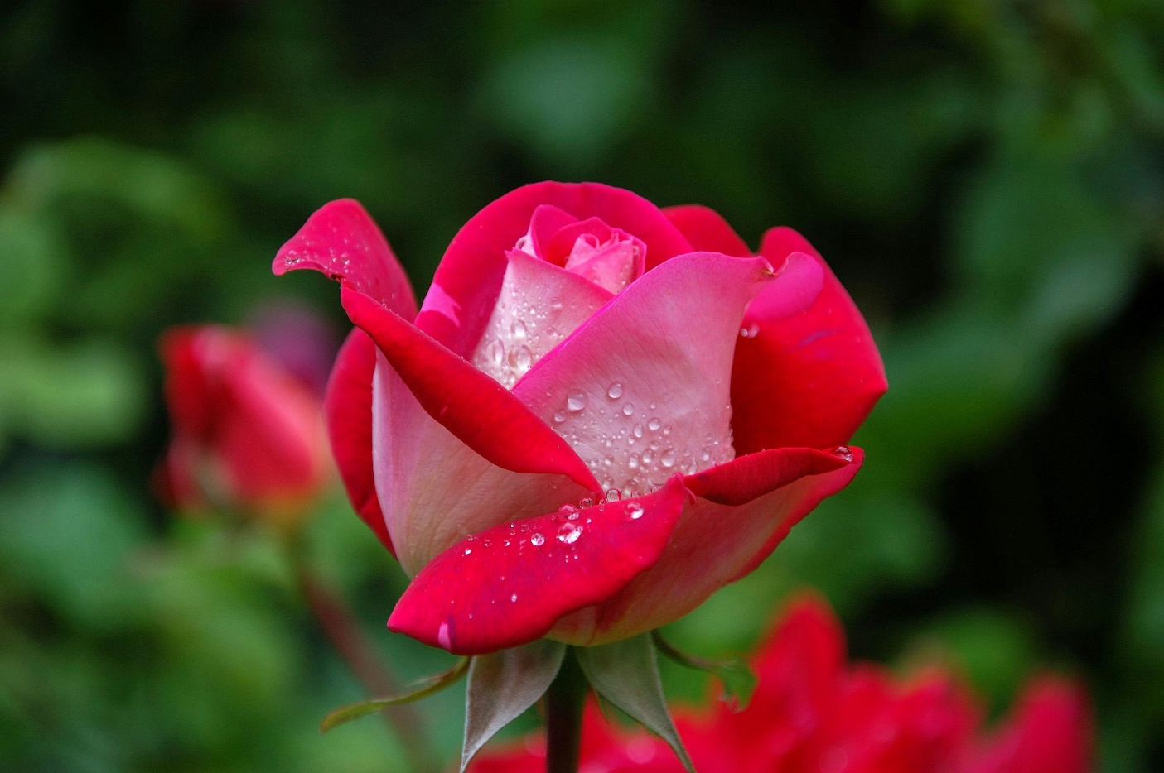
WELCOME

Slide 2
IDENTITY
Forid Ahamed
Assistant Headteacher
Daulatpur High School
Gafargaon,Mymensingh
Email:ahmforid@gmail.com

Slide 3
LESSON IDENTITY
Class:Eight
Subject:English First Paper
Unit:one
Lesson:Two
Time:50 minutes
Date:20.06.2025

Slide 4
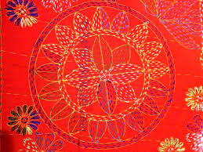
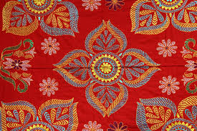
What can you see in pictures?

Slide 5

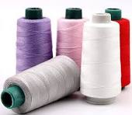
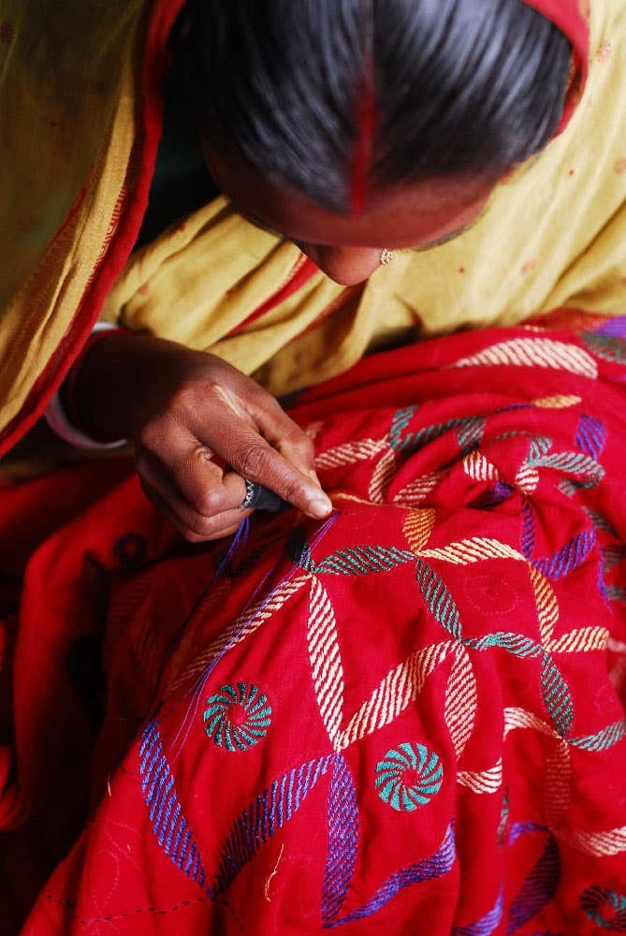
Let’s see some picture

Slide 6
Our today’s topic is----
NAKSHI KANTHA

Slide 7
Learning Outcomes----
By the end of the lesson, students will be able to-
read and explain the text
  ask and answer questions
fill in the gaps
Make sentences

Slide 8
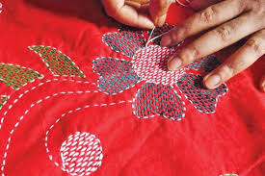
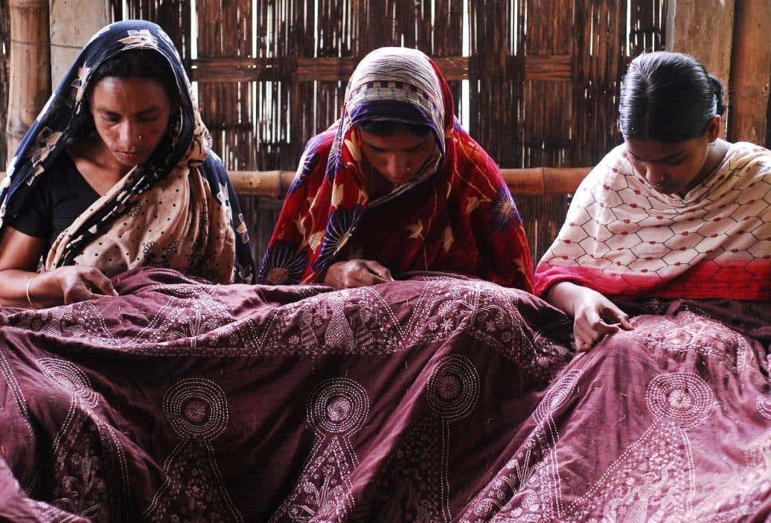
What are the women doing here?

Slide 9
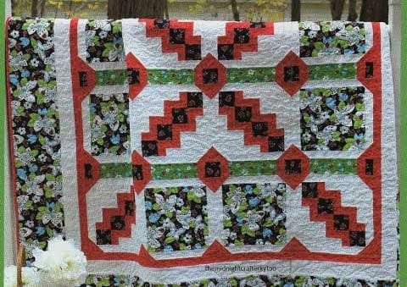
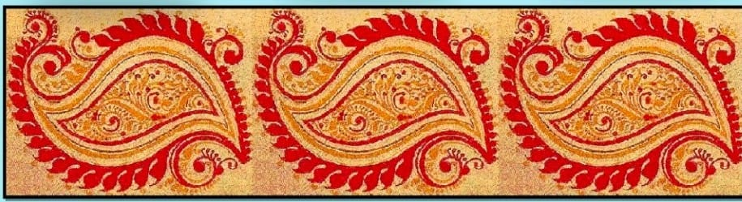
Key Words
Quilt
a decorative cover for a bed
having or revealing natural creative
skill
artistic

Slide 10
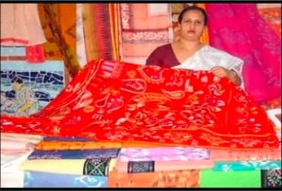
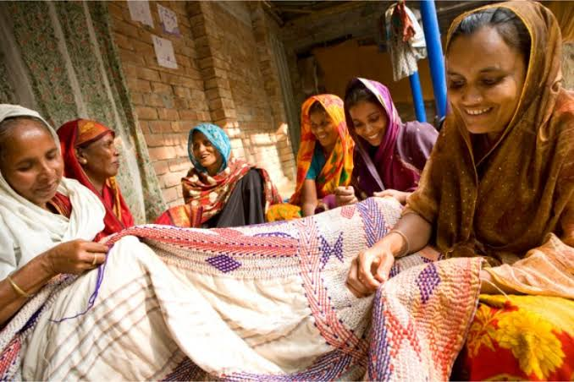
connected with the buying
and selling of goods and services
commercially
being part of the beliefs, customs
or way of life
traditional

Slide 11
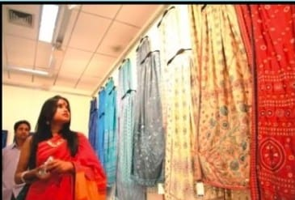
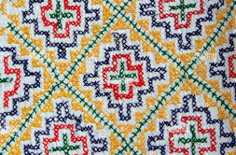
demand
a very firm request for needs
a model or design used as a guide
in needle work and other crafts
pattern

Slide 12
Read the following text silently;
Nakshi kantha is a kind of embroidered quilt. The name was taken from the Bangla word, 'naksha' which means artistic pattern. It is a kind of traditional craft and is said to be indigenous to Bangladesh and West Bengal in India. The art has been practised in rural Bengal for centuries. The name Nakshi Kantha became popular after the poet Jasimuddin's poem 'Nakshi Kanthar Math' was published in 1929.Traditional kanthas are made for family use. Old or new cloth and thread are used to make these quilts. Mymensingh, Jamalpur, Rajshahi, Faridpur, Bogura and Jashore are most famous for this craft. Now it is produced commercially. You can find them in many expensive handicraft shops in cities. The quilts are now in great demand because of the colourful patterns and designs embroidered on them.

Slide 13
Individual work
Complete the sentence with clues given. There are more words than necessary.
Bengali patterns embroidery years fashion art rural designs quilt naksha
Naksha means artistic ______.
The name was taken from a _______ word.
The art has been practised in _______ Bengal for _______.
Nakshi kanthas are now sold in ___________shops.
Nakshi kanthas are in great demand because of their colourful ______ and ______.
Nakshi kanthas are kind of ________.

Slide 14
Group work
Write answer of the following questions
1. What does naksha mean?
2. From where was the name taken?
3. How long has the art been practiced?
4. What are used to make this quilt?
5. Why are Nakshi Kanthas in great demand?

Slide 15
Make 5 Setences from the words given below.
Popular
Design
Famous
Expensive
Tradition

Slide 16
Evaluation
Do you likeNakshi Kantha or an ordinary Kantha?why?
Which areas are famous for Nakshi Kantha?
How did the name Nakshi Kantha become popular?

Slide 17


Home work
Write ten sentences describing
how Nakshi Kantha is made
.

Slide 18
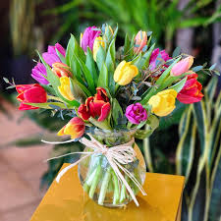
Thank you

