Slide 1
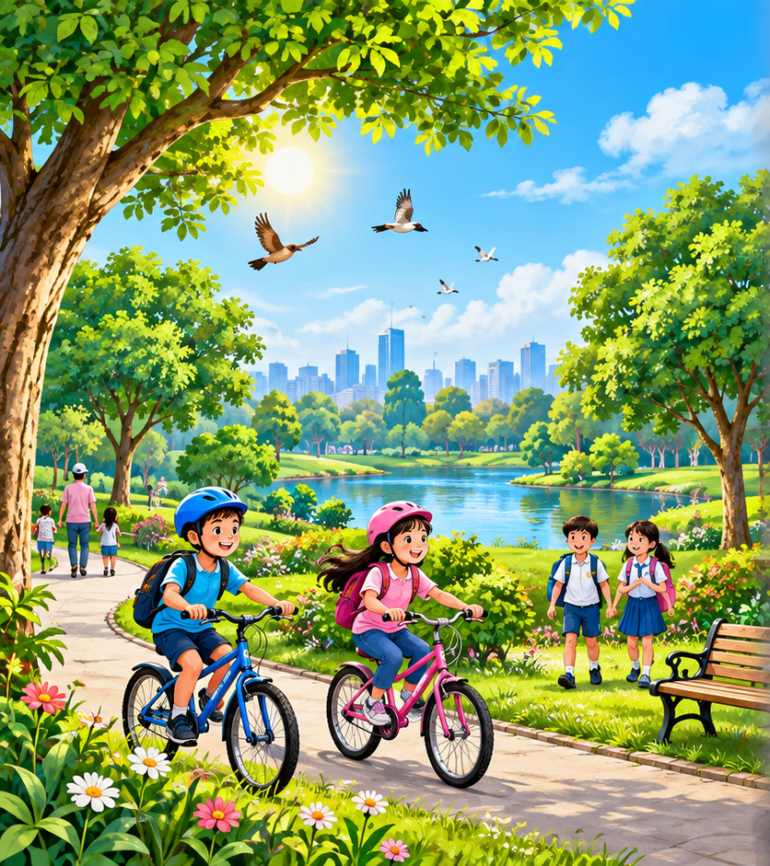
The Air We Share
Class Five • English • Unit 17
Teacher
Mubarak Miah
School
Julekhanagar Tea Garden Govt. Primary School
Sreemangal, Moulvibazar

Slide 2
Breathe In… Breathe Out…
BREATHE IN
BREATHE OUT
WHAT DID YOU TAKE IN?
AIR
Can we live without air?

Slide 3
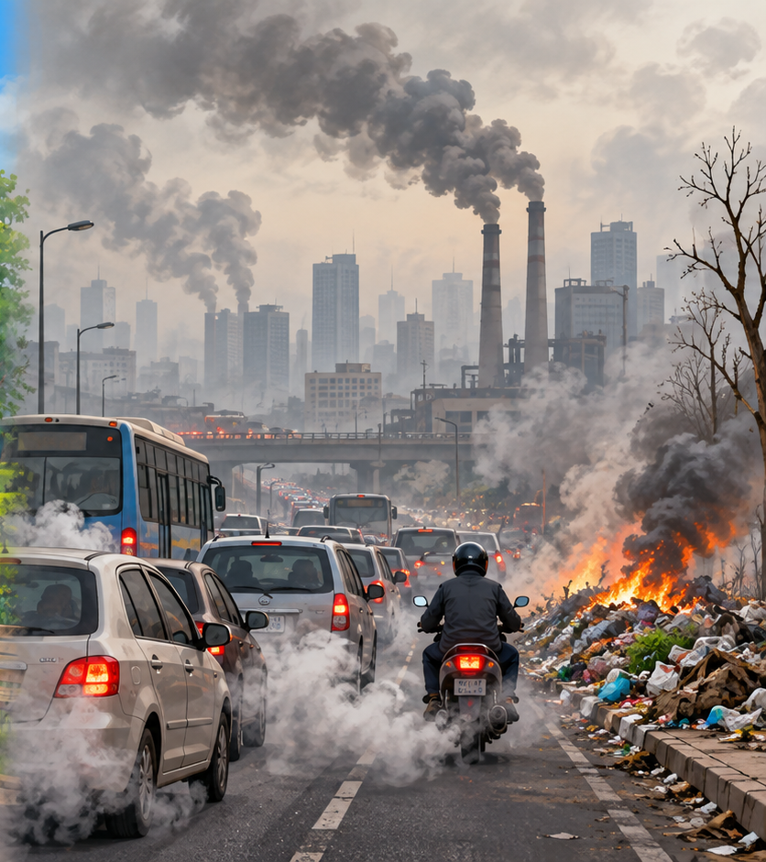
Which Air Would You Choose?
CLEAN AIR
POLLUTED AIR

Slide 4
Mystery Question
We cannot see air…
Can air become dirty?
YES
NO

Slide 5
Today We Will…
READ
FIND
UNDERSTAND
clearly
specific information
the main idea
Then we will talk about how to keep the air clean.

Slide 6
Word Power
POLLUTION
FOSSIL FUELS
1111111
CHEMICALS
dirty air / water / land
coal • oil • natural gas
substances that may harm
Say it → Read it → Use it

Slide 7
More Important Words
SMOKE
DUST
OXYGEN
HARMFUL
GLOBAL WARMING

Slide 8
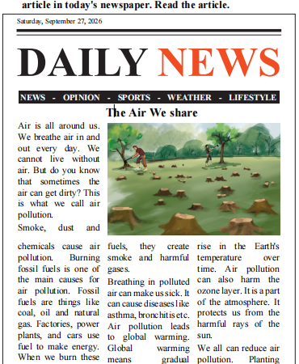
Textbook Connection
Look at the article.
What is the headline?
The Air We Share

Slide 9
Read Together
Air is all around us.
We breathe air in and out every day.
We cannot live without air.
Teacher reads → Class repeats → Pair reads

Slide 10
What Is Air Pollution?
Sometimes the air can get dirty.
This is what we call air pollution.
SMOKE
DUST
CHEMICALS

Slide 11
What Causes Air Pollution?
FACTORIES
CARS
BURNING FUELS
smoke and gases
burn fuel
coal • oil • gas
Cause → Smoke / harmful gases → Dirty air

Slide 12
Why Is Dirty Air Harmful?
HEALTH
EARTH
asthma breathing problems
OZONE LAYER
temperature can rise
can be harmed
Dirty air can hurt people and the planet.

Slide 13
How Can We Keep the Air Clean?
PLANT TREES
WALK
RIDE A BICYCLE
For short distances.
Trees absorb harmful gases.
It does not burn fuel.
Every small effort helps.
Together we can make a big difference.

Slide 14
Find the Clues
CAUSE
EFFECT
SOLUTION
smoke • burning fuels
dirty air • illness
trees • walk
Can you give one more example?

Slide 15
Quick Check
1. What is air pollution?
2. What are fossil fuels?
3. Name one harmful effect.
4. How do trees help us?
Answer in a short sentence.

Slide 16
Pair Work — Activity 2.1
1
2
3
4
Explain why.
Read the question.
Choose one answer.
Talk to your partner.
Teacher walks around and helps.

Slide 17
Check Your Answers
1 → B Air pollution = smoke, dust and chemicals
2 → A Fossil fuels = coal, oil and natural gas
3 → B Air pollution can cause asthma
4 → B Planting trees helps clean the air
5 → C Trees absorb harmful gases

Slide 18
Game: Clean Air or Dirty Air?
Planting trees
Burning plastic
Walking to school
CLEAN AIR
DIRTY AIR
CLEAN AIR
Riding a bicycle
Black smoke
DIRTY AIR
CLEAN AIR

Slide 19
Exit Ticket
1
2
3
One cause of air pollution
One effect of air pollution
One way to keep air clean
I can read. I can understand. I can care for the air.

Slide 20
Remember
Clean air is for everyone.
Plant trees.
Walk or ride a bicycle when you can.
Every effort helps.

