Slide 1
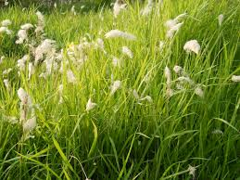
Great Day to you

Slide 2
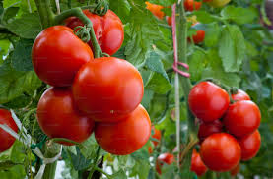
Class- two
Subject-English
Unit -02
Tittle-Vegetables

Slide 3
Learning Outcomes
2.1 Listening to rhymes, cartoons and digital contents in English for enjoyment

Slide 4
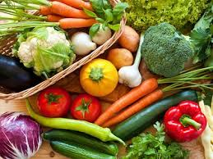
Do you eat vegetables?

Slide 5
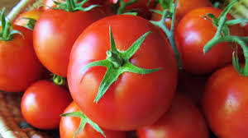
What is it?
Tamato

Slide 6
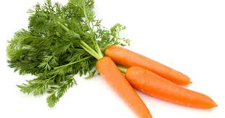
What is it?
carrot

Slide 7
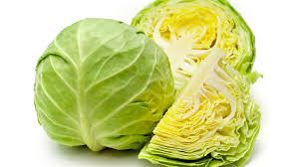
What is it?
cabbage

Slide 8
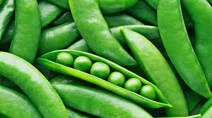
What is it?
peas

Slide 9
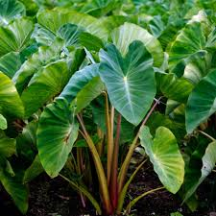
What is it?
Calocasia leaves

Slide 10
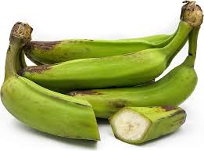
What is it?
Green Banana

Slide 11
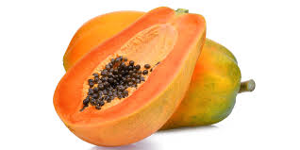
What is it?
Papaya

Slide 12
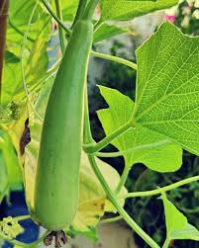
What is it?
Goard

Slide 13
Good Bye

