Slide 1
SSC English Class
স্বাগতম!
Welcome, Dear Students!
আজকের বিষয়: Load Shedding Paragraph
Today's Topic: Load Shedding
📚 ✏️ 🎯 ⭐ 📝

Slide 2
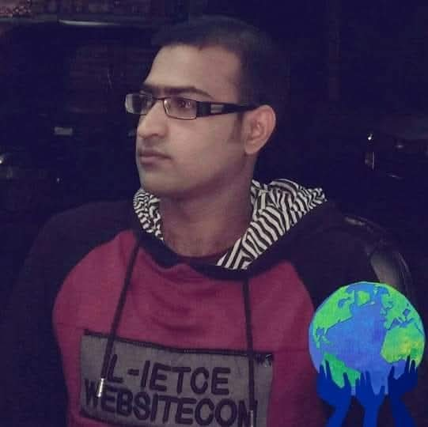
শিক্ষকের পরিচয় | Teacher Introduction
👨‍🏫
নাম / Name
Abdus Samad
পদবী / Designation
Assistant Teacher
বিষয় / Subject
English (SSC)
প্রতিষ্ঠান / School
Bhatera High School, Bhatara, Kulaura, Moulvibazar.
শিক্ষাই জাতির মেরুদণ্ড — Education is the backbone of a nation

Slide 4
SSC ENGLISH
Load
Shedding
লোড শেডিং
💡
📚 Paragraph for SSC Examination

Slide 5
What is Load Shedding?
লোড শেডিং কী?
Definition
Load shedding is the
temporary interruption of electricity supply in a particular area.
It has become a
common problem in Bangladesh.
🔌
❌
No Power!
💡 Key Concept: Electricity is cut off temporarily to manage power distribution

Slide 6
⚡ Causes of Load Shedding
🏭
Lack of adequate
power generation
📈
Increasing demand
for electricity
🔧
Outdated transmission
systems
⛽
Insufficient
fuel supply
These factors combine to create frequent power outages across Bangladesh

Slide 7
📚 Effects on Students
1
Cannot study properly at night
📖
😔
2
Online classes get disrupted
3
Cannot use computer or laptop
4
Results in poor academic performance
5
Examination preparation suffers badly
Students Suffer!

Slide 8
🏭 Effects on Economy
↓ 40%
↓ 35%
↓ 25%
Factory Output
Business Revenue
Export Production
Economic Impact:
Factories stop their production which hampers the economy significantly. Small businesses and shops suffer huge financial losses due to frequent power cuts.

Slide 9
🏠 Effects on Daily Life
🏥
🧊
🌡️
Hospitals
Refrigerators
Summer Heat
Patients face life-threatening situations
Food gets spoiled, wastage increases
Cannot use fans or air conditioners
💼
📡
💧
Businesses
Communication
Water Supply
Shops lose daily income and customers
Internet & TV services get disrupted
Pumps fail, water shortage occurs

Slide 10
🏥 Health & Hospital Impact
🏥
⚠️
Critical Situations:
• Patients in hospitals face
life-threatening situations
• Operation theatres lose power
• ICU equipment may fail
• Medicine storage at risk
• Emergency services disrupted
Load shedding is literally a matter of life and death in hospitals!

Slide 11
🏛️ Government Solutions
01
New Power Plants
02
Import Electricity
⚡
Setting up modern power generation facilities across Bangladesh
🌍
Importing electricity from neighboring countries like India
03
Renewable Energy
04
Infrastructure
☀️
Investing in solar, wind and hydroelectric power projects
🔧
Upgrading old transmission lines and distribution systems

Slide 12
💡 What People Should Do
People should use electricity carefully to reduce wastage
💡
Use energy-saving LED bulbs instead of regular ones
🔌
Switch off lights and fans when leaving a room
❄️
Use air conditioner at moderate temperature (24-26°C)
☀️
Use solar panels for home electricity needs
📱
Charge devices during non-peak hours to save grid load
🌿
Spread awareness about saving electricity in community

Slide 13
🎯 Full Paragraph & Conclusion
Load shedding is the temporary interruption of electricity supply in a particular area. It has become a common problem in Bangladesh. The main causes of load shedding are the lack of adequate power generation, increasing demand for electricity, outdated transmission systems, and insufficient fuel supply. Load shedding affects our daily life in many ways. Students cannot study properly at night. Factories stop their production which hampers the economy. Food gets spoiled in refrigerators. Patients in hospitals face life-threatening situations. Besides, small businesses and shops suffer huge financial losses. During summer, load shedding becomes unbearable as people cannot use fans or air conditioners. The government is trying to solve this problem by setting up new power plants and importing electricity from neighboring countries. People should also use electricity carefully to reduce wastage. We hope that one day Bangladesh will be free from the curse of load shedding.
🌟 We hope that one day Bangladesh will be free from the curse of load shedding!

Slide 14
✦
✦
ধন্যবাদ!
Thank You!
পরীক্ষায় সাফল্য কামনা করি ★
Best wishes for your SSC Examination!
মনোযোগী
পরিশ্রমী
আত্মবিশ্বাসী
সফল হও
✦

