Slide 1
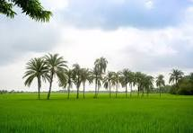





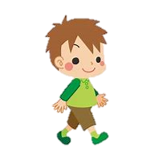
W
L
M
C
E
O
E

Slide 2
Unit : 7
Colours , Shapes and signs
Lesson 1 To 6

Slide 3
Special Note :
In this presentation there are 6 lessons . Teacher can use this in 6 classes for 6 lessons by their way . I thought , in this unit the lessons are similar in colours . So I made the unit . Thanks.

Slide 4
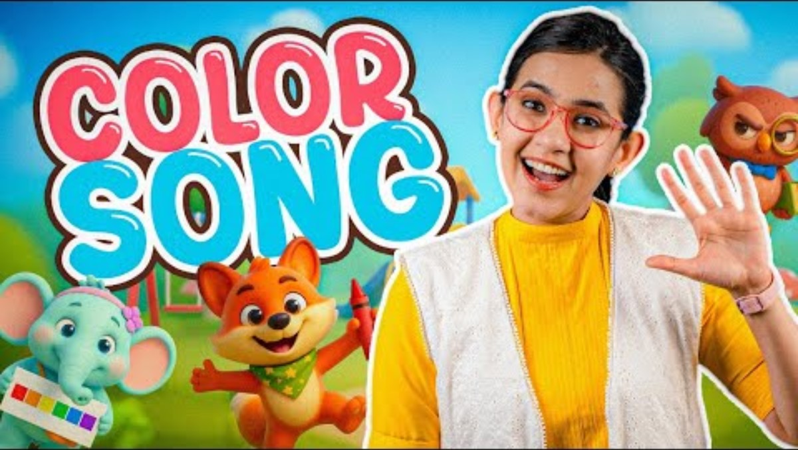
Let,s sing and dance

Slide 5

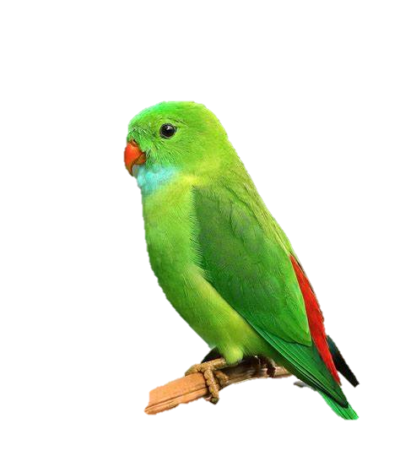


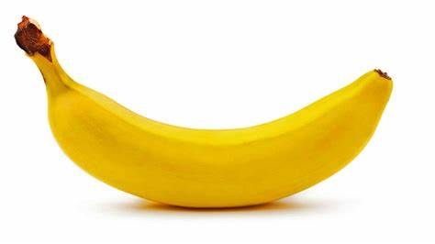
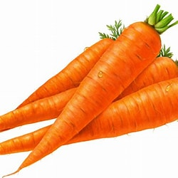
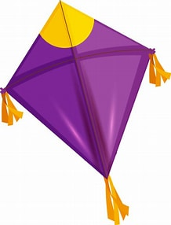
Red , red , red
The rose is red .
Blue, blue ,blue
The sky is blue .
Violet , violet , violet
The balloon is violet .
Green , green ,green
The parrot is green .
The carrot is orange .
Yellow , yellow , yellow
The banana is yellow .
Indigo , indigo , indigo
The kite is indigo .
Orange , orange , orange

Slide 6

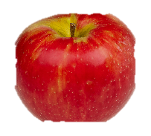
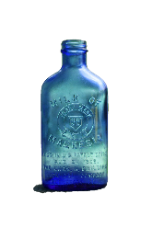
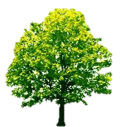

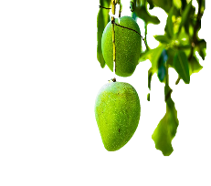

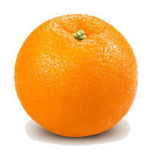
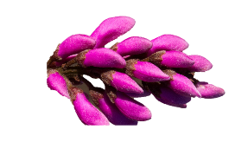
Match the colours :
violet
green
indigo
orange
blue
red
yellow

Slide 7

Look at the picture. Read the name colours .
RED
ORANGE
YELLOW
GREEN
BLUE
VIOLET
INDIGO

Slide 8

R A I N B O W
Seven colours make a rainbow.
Do you know ? Do you know ?
Seven colours make a rainbow .
Red , orange and yellow .
Green and blue ,
Violet , indigo too .
Raindrops and sunlight
Make the colours look so bright .

Slide 9
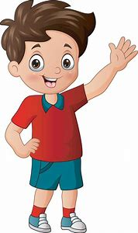

Look at the colourful grand clock and shapes
CIRCLE
SQUARE
TRIANGLE
RECTANGLE

Slide 10
Mr. Shape
I am Mr. Shape , look at me .
I have circles , squares , triangles and rectangles
As many as there could be .
My eyes are round and so is my face ,
My body is square if haven’t noticed incase .
My arms are rectangles and so are my legs .
My hands are circles and my feet are triangles , you see .

Slide 11
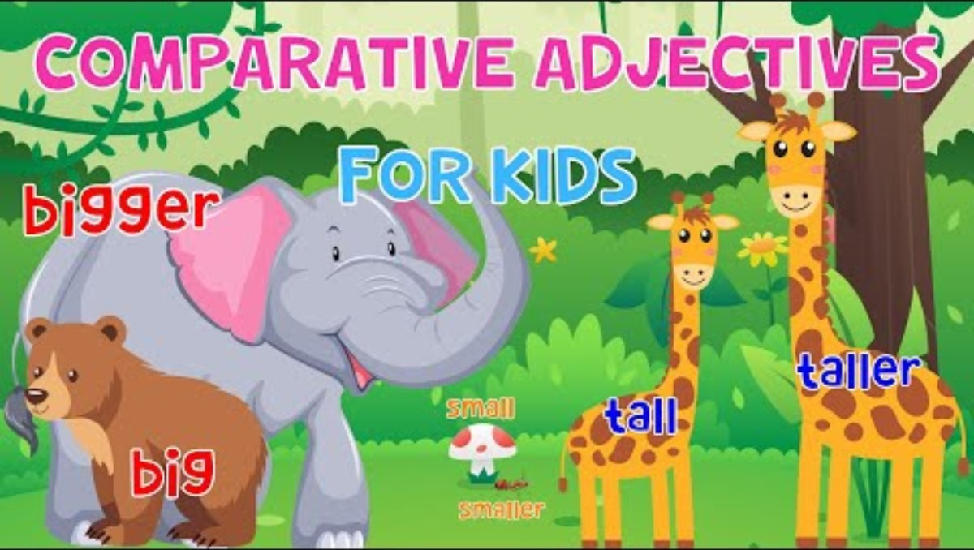
Comparisons
LET’S WATCH A VIDEO

Slide 12

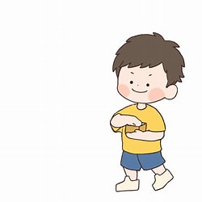
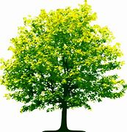
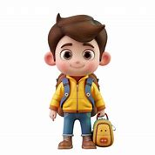

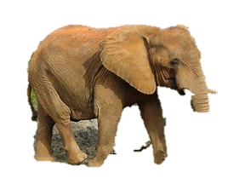

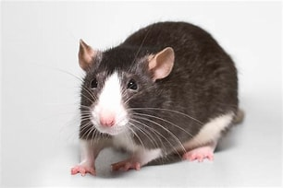
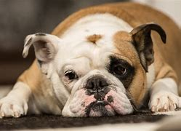
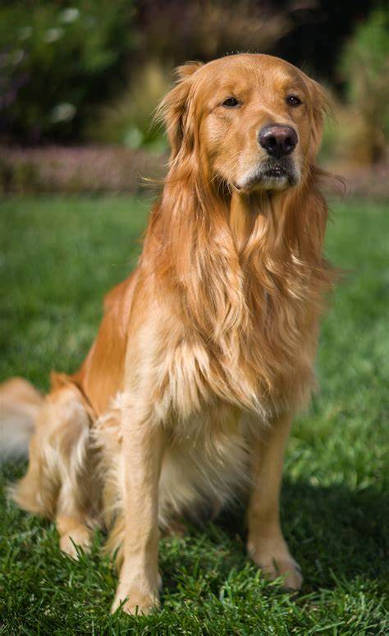
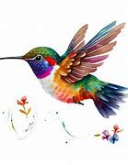
SIZES
Tall short
Tall short
fat thin
Big small
Fat thin
Big small

Slide 13
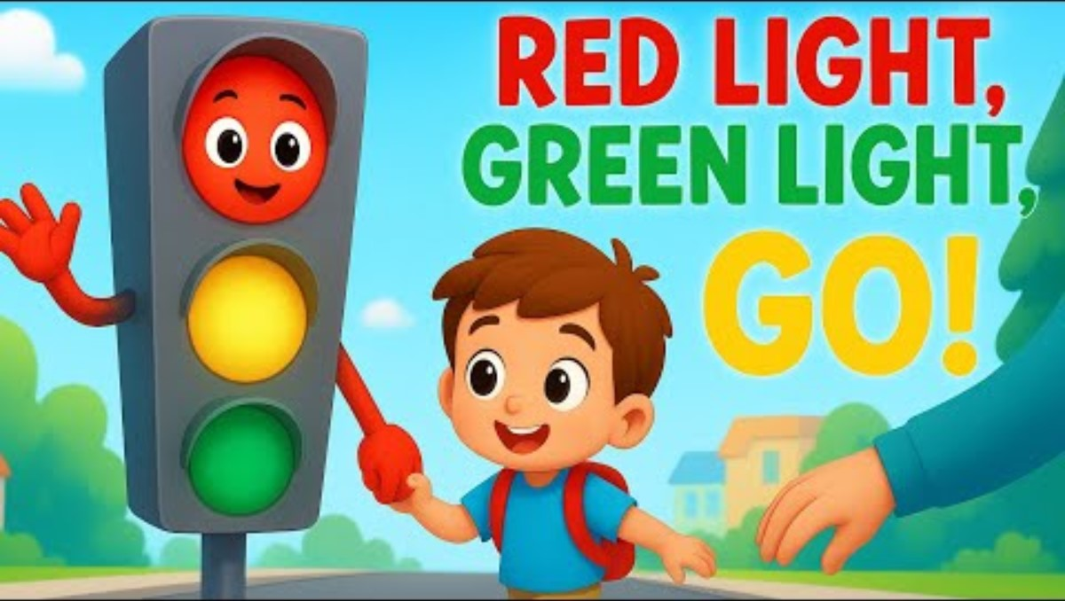
Watch a video

Slide 14

ROAD SIGNS
Red light, red light
What do you say ?
I say stop and stop right away .
Yellow light, yellow light
What do you mean ?
I mean wait, till the light is green .
Green light, green light
What do you say ?
I say go, go right away .

Slide 15
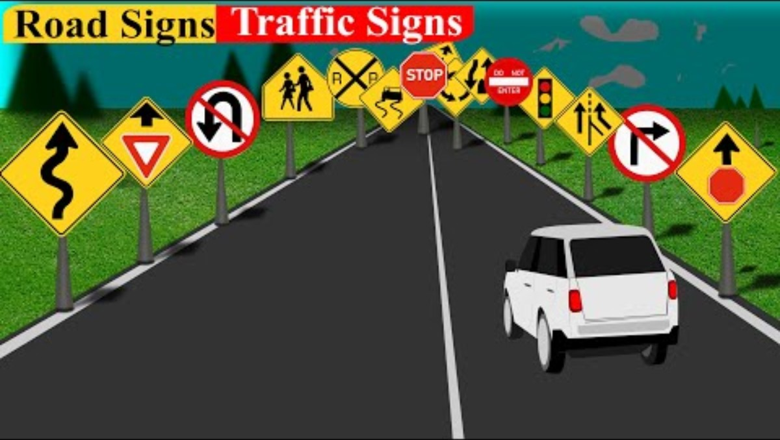
Know the road signs

Slide 16
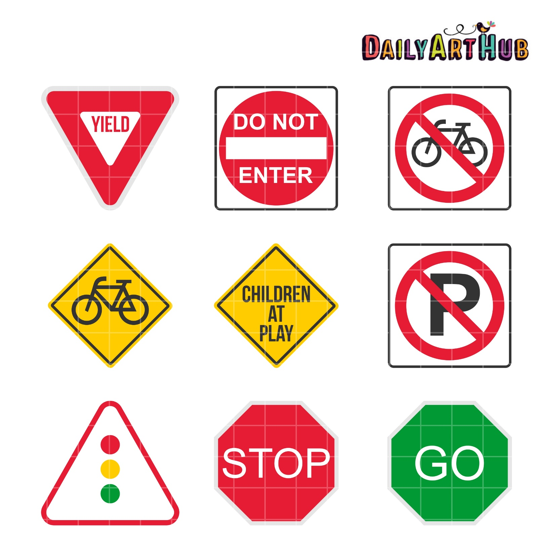
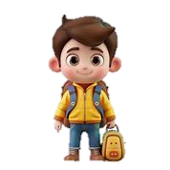
ROAD SIGNS
School
No byecycle
Keep Byecycle
Don,t play
Road sign

Slide 17
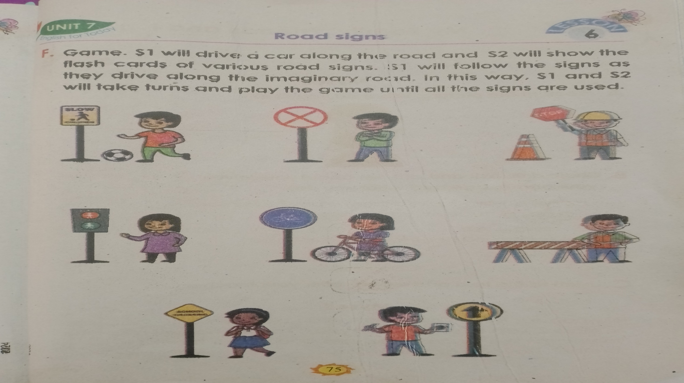

Slide 18
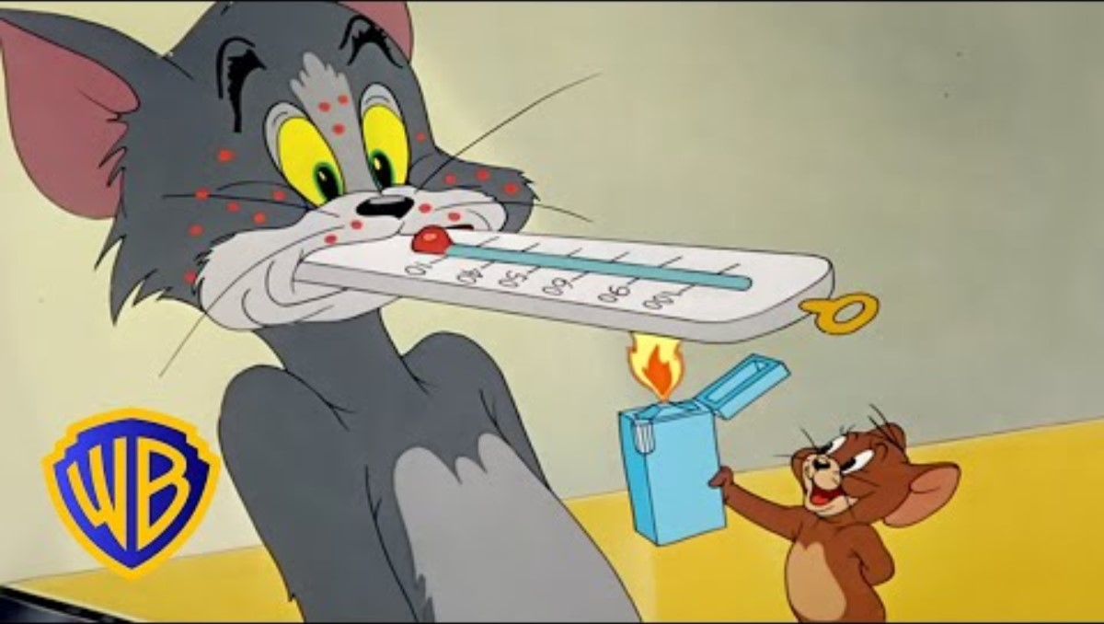
Let,s enjoy a cartoon

Slide 19
Teacher,s name : Rowshan Ara Begum
Assistant teacher of
Badalpura Govt. Primary School
Anoara , Chattogram .
THANKS

