Slide 1


Slide 2


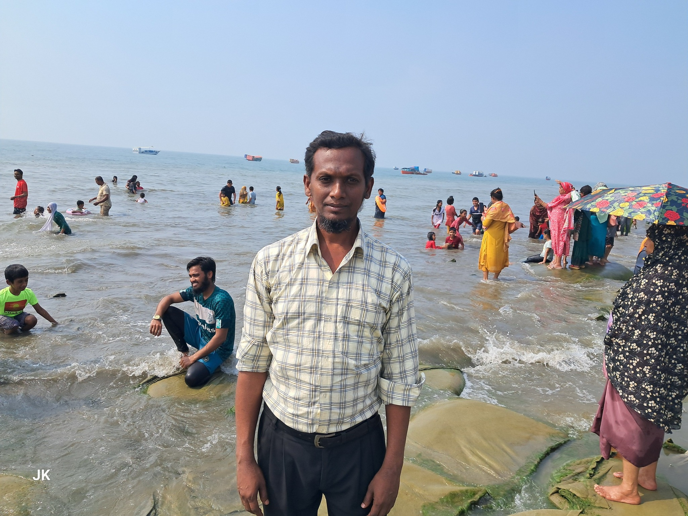
TEACHER’S INFORMATION:

Slide 3
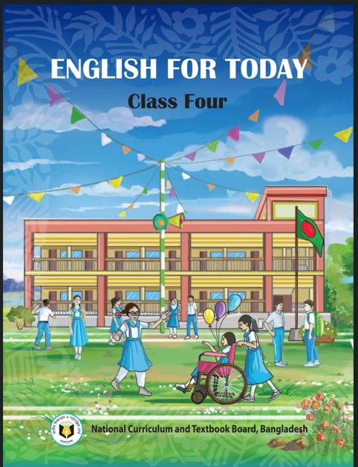
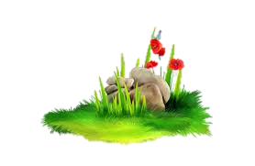
Lesson’s Identity
Class : Four
Subject : English
Unit : 8
Lesson : 1.1 & 1.2,1.3.
My Family
Time: 50 Minutes
3

Slide 4
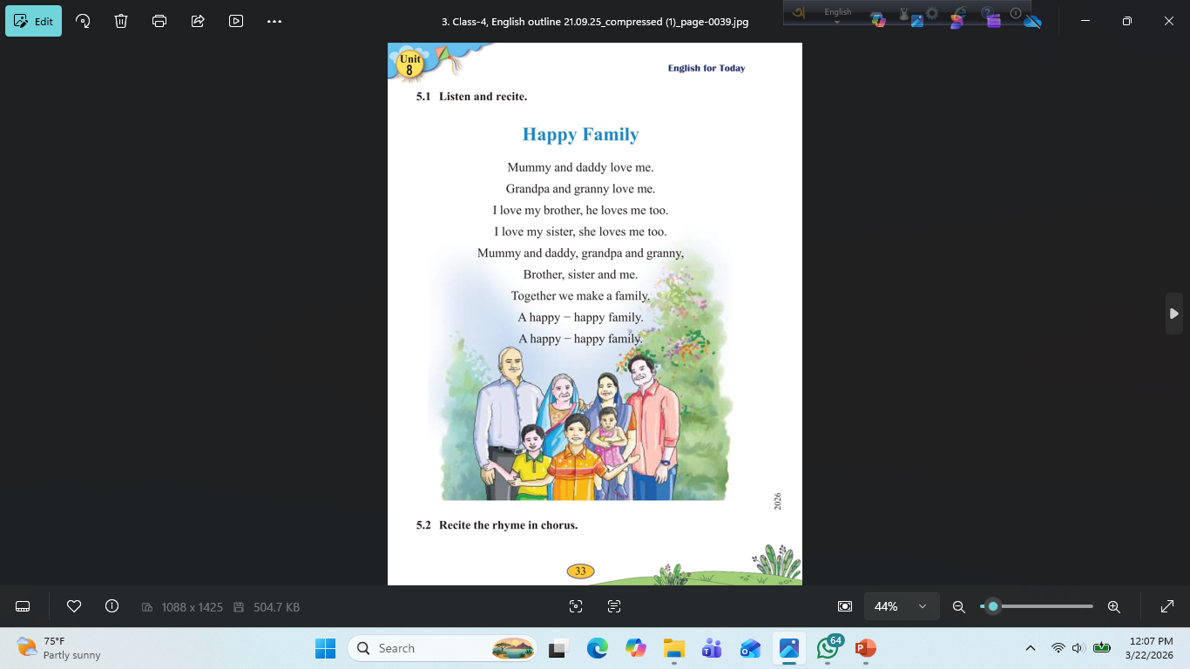

Slide 5

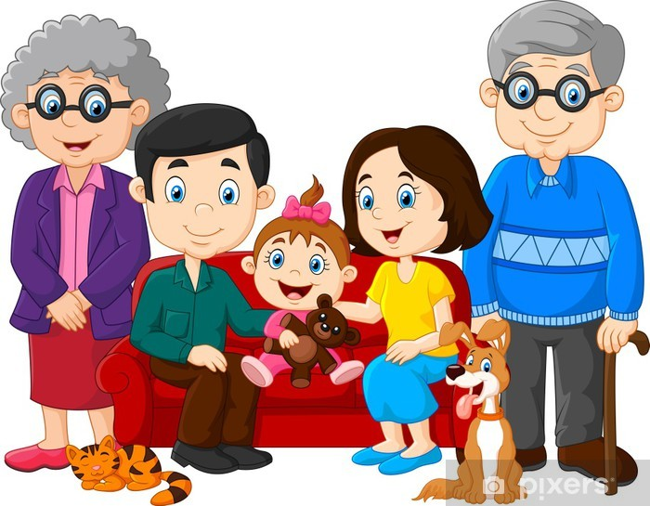
What are these pictures?
Family

Slide 6
Whom do you live with us?
Father, mother, sister and brother usually make a family. Grandmother and grandfather also live with us. They are also a part of the family.

Slide 7

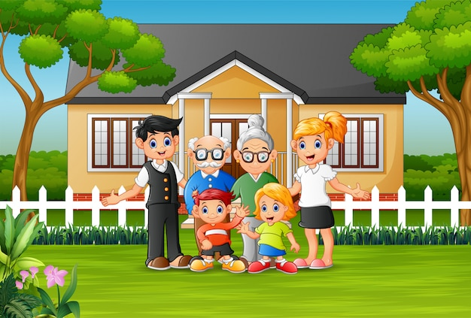

Todays lessons is –
Family

Slide 8
Learning Outcomes
Students will be able to –
1.4.1 read words, phrases and sentences in the text.
1.5.1 read words, phrases and sentences in the text with proper
pronunciation, stress and intonation.
1.7.1 read short paragraphs, dialogues and simple letters.
5.1.1 read silently with understanding paragraphs, stories and their texts.

Slide 9
NOW, WE START TODAY’S CLASS.
AT FIRST
WE SEE OUR ENGLISH BOOK.

Slide 10
Open Your Book on
Page 30,31,32,33.

Slide 11
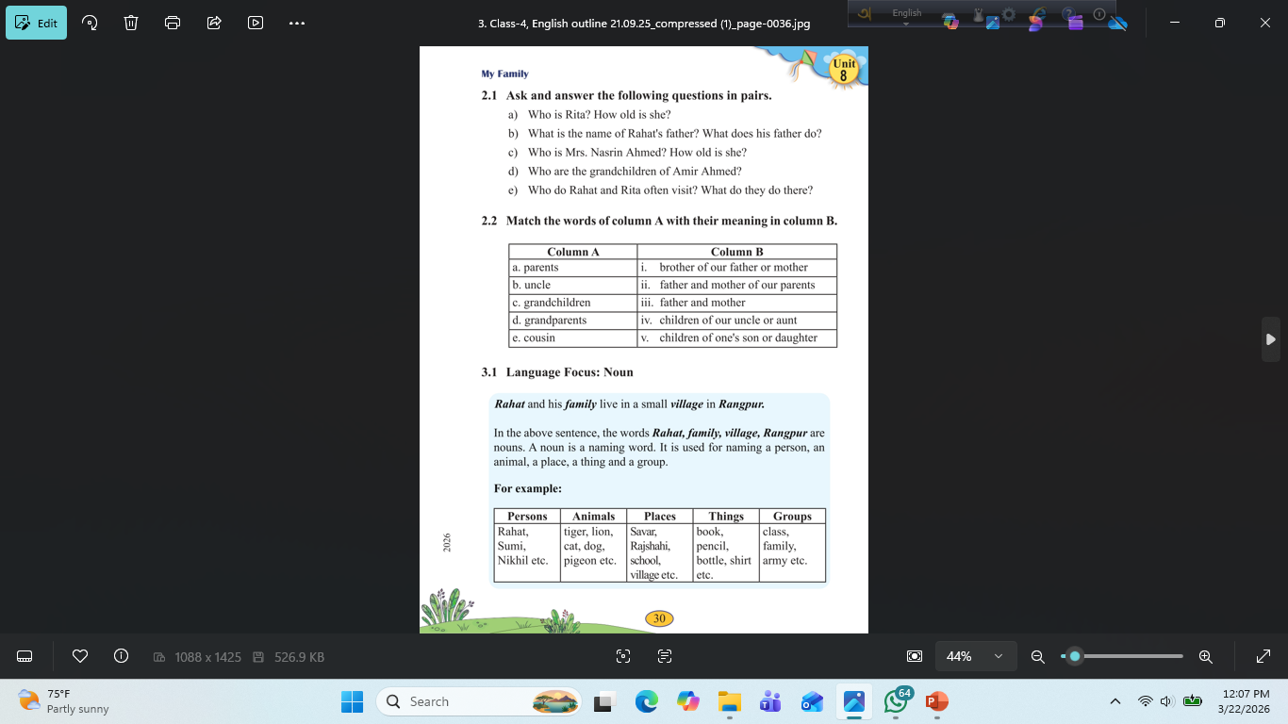
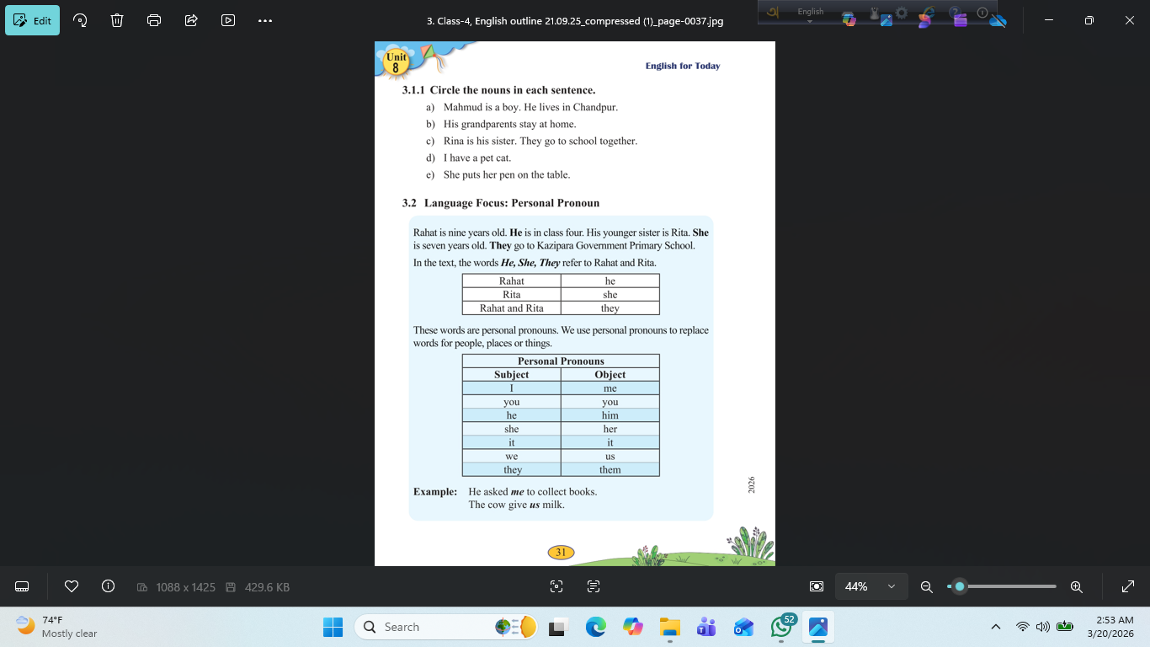
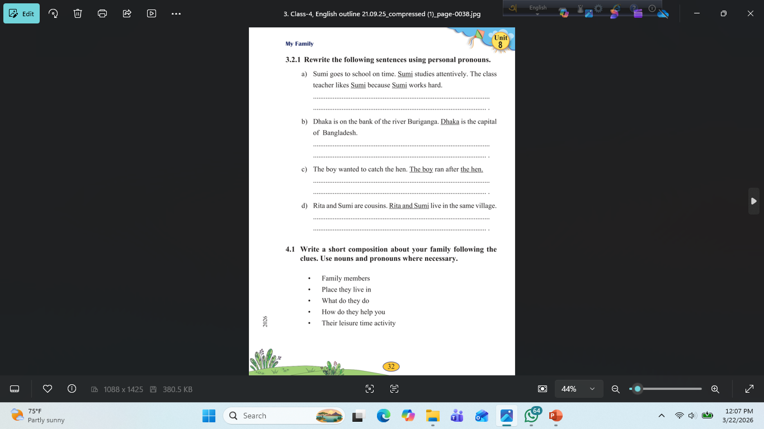
Sima Ma,am(English Teacher,Barishal) 01790748270

Slide 12
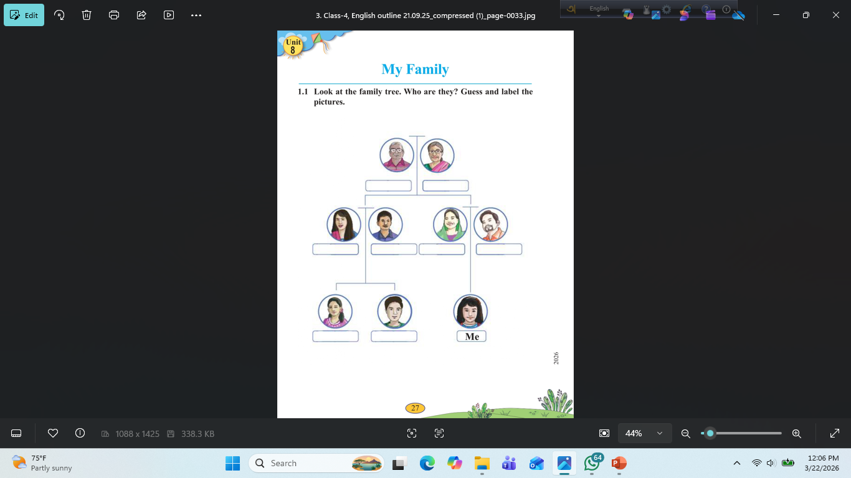
1.1 Look at the family tree. Who are they? Guess and label the pictures.

Slide 13
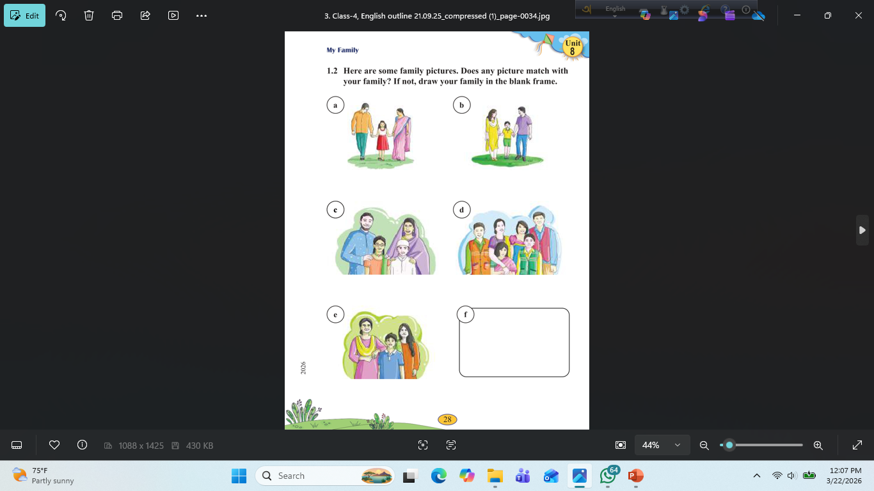
A
B
C
D
E
f
1.2 Here are some family pictures. Does any picture match with your family? If not, draw your family in the blank frame.

Slide 14

New words
Grocery
Stay
Subject
Groups
Pronoun
Noun
Together

Slide 15
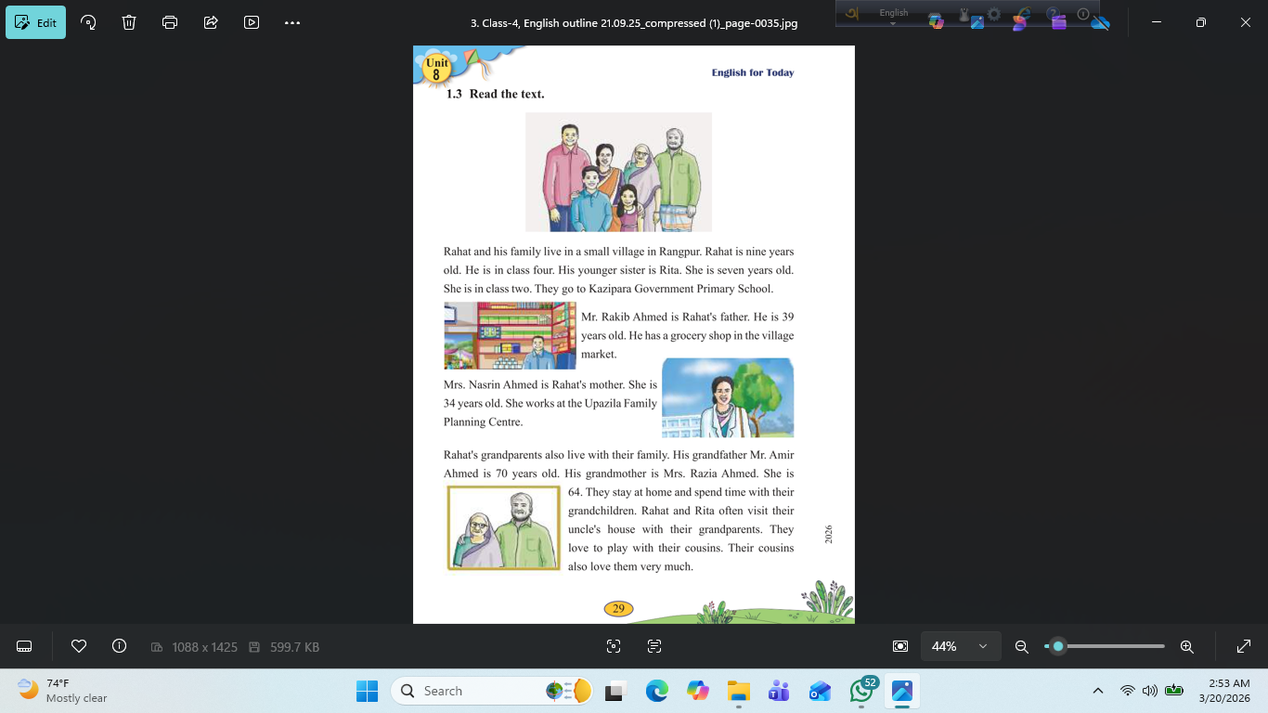
Let’s read the text
Rahat and his family live in a small village in Rangpur. Rahat is nine years old. He is in class four. His younger sister is Rita. She is seven years old. She is in class two. They go to Kazipara Government Primary School.
Mr. Rakib Ahmed is Rahat's father. He is 39 years old. He has a grocery shop in the village market.

Slide 16
Let’s read the text
Mrs. Nasrin Ahmed is Rahat's mother. She is 34 years old. She works at the Upazila Family Planning Centre.
Rahat's grandparents also live with their family. His grandfather Mr. Amir Ahmed is 70 years old. His grandmother is Mrs. Razia Ahmed. She is 64. They stay at home and spend time with their grandchildren. Rahat and Rita often visit their uncle's house with their grandparents. They love to play with their cousins. Their cousins also love them very much.

Slide 17

Open Your Book on
Page 30

Slide 18
2.1 Ask and answer the following questions in pairs.
Who is Rita? How old is she?
b) What is the name of Rahat's father? What does his father do?
c) Who is Mrs. Nasrin Ahmed? How old is she?
d) Who are the grandchildren of Amir Ahmed?
e) Who do Rahat and Rita often visit? What do they do there?
Here are the answers …..
Rita is Rahat’s younger sister. She is seven years old.
b) The name of Rahat’s father is Mr. Rakib Ahmed. He is a grocery shopkeeper in the village market.
c) Mrs. Nasrin Ahmed is Rahat’s mother. She is 34 years old.
d) The grandchildren of Mr. Amir Ahmed are Rahat and Rita.
e) Rahat and Rita often visit their uncle’s house. They play with their cousins there.

Slide 19
Here is the correct matching:
a. parents → iii. father and mother
b.uncle → i. brother of our father or mother
c.grandchildren → v. children of one's son or daughter
d.grandparents → ii. father and mother of our parents
e.cousin → iv. children of our uncle or aunt

Slide 21
Open Your Book on
Page 31

Slide 22
3.1.1 Circle the nouns in each sentence.
Mahmud is a boy. He lives in Chandpur.
b) His grandparents stay at home.
c) Rína is his sister. They go to school together.
d) I have a pet cat.
e) She puts her pen on the table.
Here are the nouns (বিশেষ্য) from each sentence:
Mahmud, boy, Chandpur
b) grandparents, home
c) Rína, sister, school
d) pet, cat
e) pen, table

Slide 23
Sima Ma,am(English Teacher,Barishal) 01790748270

Slide 24
Open Your Book on
Page 32

Slide 25
3.2.1 Rewrite the following sentences using personal pronouns.
Sumi goes to school on time. Sumi studies attentively. The classteacher likes Sumi because Sumi works hard.
b) Dhaka is on the bank of the river Buriganga. Dhaka is the capital of Bangladesh.
c) The boy wanted to catch the hen. The boy ran after the hen.
d) Rita and Sumi are cousins. Rita and Sumi live in the same village
Here are the sentences rewritten using personal pronouns:
Sumi goes to school on time. She studies attentively. The class teacher likes her because she works hard.
b) Dhaka is on the bank of the river Buriganga. It is the capital of Bangladesh.
c) The boy wanted to catch the hen. He ran after the hen.
d) Rita and Sumi are cousins. They live in the same village.If you want, I can explain personal pronouns in a simple way 👍

Slide 27


Home work 22/03/26
Write 10 Noun and 10
Pronoun in your text book

Slide 28
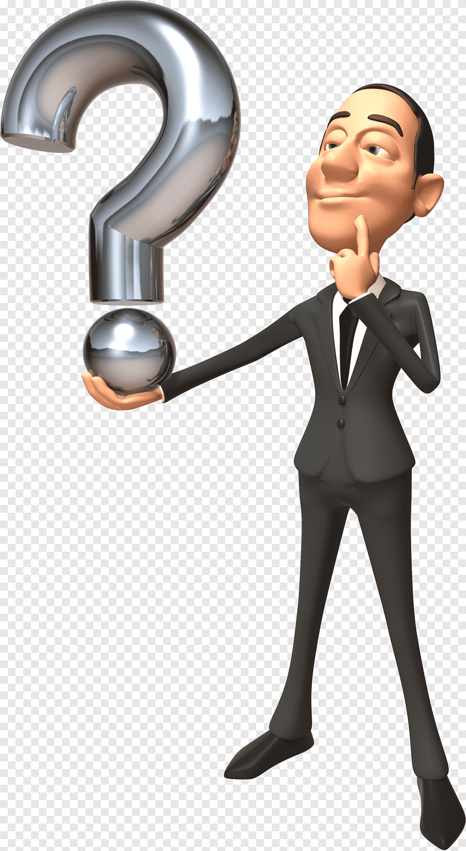
How did you feel today’s class?
If you have any questions, please let me know in the chat box.

Slide 29

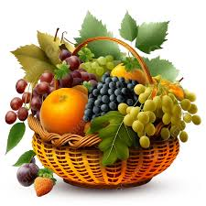
The End

