Slide 1


Slide 2





Mohammed Saiful Alam Rasel(Assistant teacher)01916109473

Slide 3


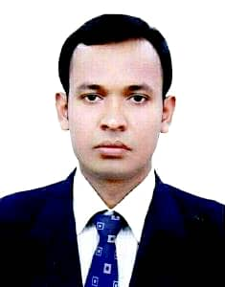
Teacher Identity
Mohammed Saiful Alam Rasel
Assistant Teacher
Shuvopur Adarsha G.P.S.
Shuvopur,Adarsha Sadar,Cumilla.

Slide 4


TODAY’S LESSON:
Class 4
Subject English
Unit 03
Lesson 1.1,2.1
Lesson title My School Assembly.
Mohammed Saiful Alam Rasel(Assistant teacher)01916109473

Slide 5
Learning Outcomes:
Student will be able to
3.5.1 Describe familiar objects clearly and confidently.
4.2.1 Read aloud short and simple texts with proper
stress and intonation.
Mohammed Saiful Alam Rasel(Assistant teacher)01916109473

Slide 6
Let’s enjoy a warm up song.
Good morning!
Good morning!
How are you today?
I'm fine, I'm fine.
I wish you a good day.
Mohammed Saiful Alam Rasel(Assistant teacher)01916109473

Slide 7
Review of the prior knowledge:
Good Morning students!
Can you say why we all gather in the school field before starting our classes?
What do you do in your assembly?
Mohammed Saiful Alam Rasel(Assistant teacher)01916109473

Slide 8
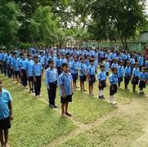
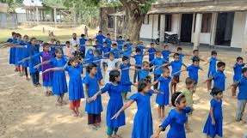
Look at the pictures.
Mohammed Saiful Alam Rasel(Assistant teacher)01916109473

Slide 9
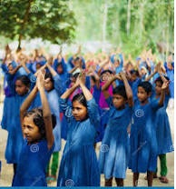
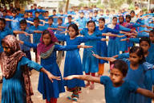
Look at the pictures.
Mohammed Saiful Alam Rasel(Assistant teacher)01916109473

Slide 10
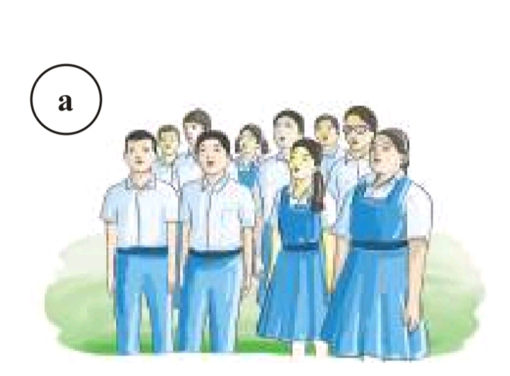
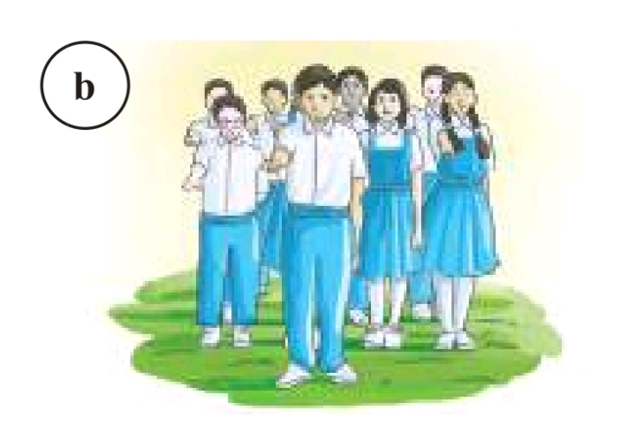
Look at the pictures.
Mohammed Saiful Alam Rasel(Assistant teacher)01916109473

Slide 11
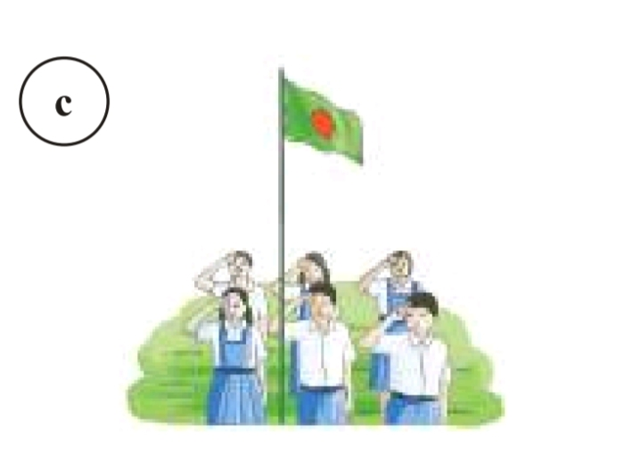
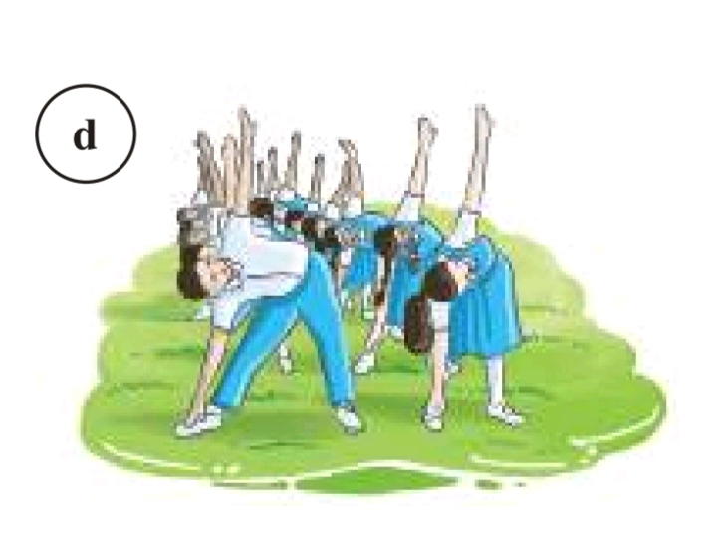
Look at the pictures.
Mohammed Saiful Alam Rasel(Assistant teacher)01916109473

Slide 12
The students are singing the national anthem.
Mohammed Saiful Alam Rasel(Assistant teacher)01916109473

Slide 13
They are taking an oath at the school assembly.
Mohammed Saiful Alam Rasel(Assistant teacher)01916109473

Slide 14
They are saluting the national flag.
Mohammed Saiful Alam Rasel(Assistant teacher)01916109473

Slide 15
They are doing physical exercise .
Mohammed Saiful Alam Rasel(Assistant teacher)01916109473

Slide 16
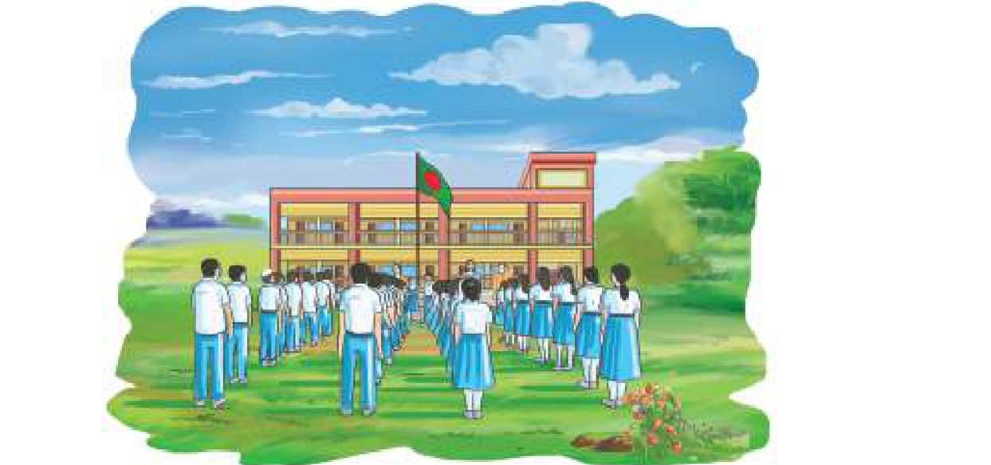
Our School Assembly
Mohammed Saiful Alam Rasel(Assistant teacher)01916109473

Slide 17
Teacher reads the text loudly and clearly
I am Razıb. I am in class four. I study at Azimia Government Primary School in Chandpur. Our school starts with the assembly in the morning. It is a gathering of all the teachers and students in the school field. Every class leads the assembly for a week in turns. At the beginning of the daily assembly, we recite from the holy books. Then we sing our national anthem and salute to the national flag. We also repeat the oath after the assembly leader. Finally, we do physical exercises. It is the best time to meet all the students and teachers of our school.
Mohammed Saiful Alam Rasel(Assistant teacher)01916109473

Slide 18
Group Work
New words :
Assembly =
National Anthem =
Oath =
Physical exercise =
Repeat =
Gathering.
A song that represents a country.
A serious promise.
Physical activity.
To say again.
Mohammed Saiful Alam Rasel(Assistant teacher)01916109473

Slide 19
Pair Work
Fill in the blanks with appropriate words from the box.
exercises
week
assembly
oath
a) Our school starts with the .................... in the morning.
b) Students repeat the ................ after the assembly leader.
c) Every class leads the assembly for a ………………
d) Finally, they do physical …………………
Mohammed Saiful Alam Rasel(Assistant teacher)01916109473

Slide 20
Individual Work
Read the following statements. Write `True’ for correct statement and `False’ for incorrect statement.
a)Razib is a student of class five.
b)Razib studies at Azimia Government Primary School.
c)The school assembly is held in the classroom.
d)Every class leads the assembly for a week in turns.
e)The students salute to the national flag.
False
True
False
True
True
Mohammed Saiful Alam Rasel(Assistant teacher)01916109473

Slide 21



Write three activities that students do in the daily assembly.
O
A
H
M
E
T
S
K
Mohammed Saiful Alam Rasel(Assistant teacher)01916109473

Slide 22


THANKS

