Slide 1
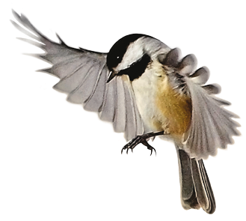


Slide 2

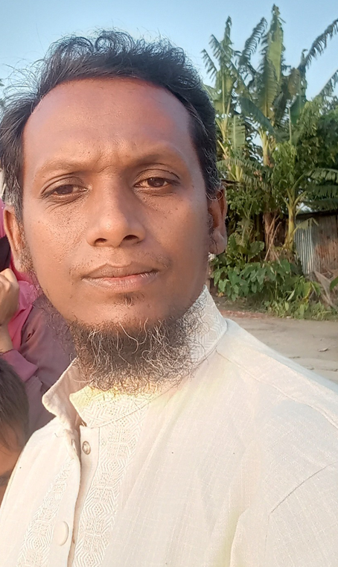
TEACHER’S INFORMATION:
JABER DEWAN
ASSISTANT TEACHER
Arpangashia Govt. Primary School
Amtali, Barguna

Slide 3
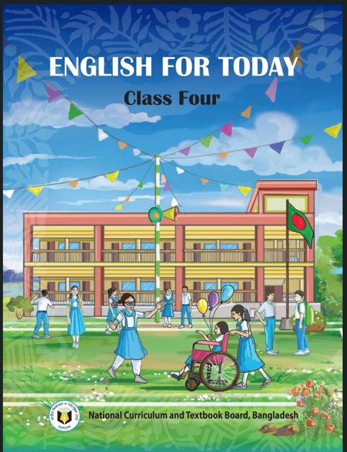
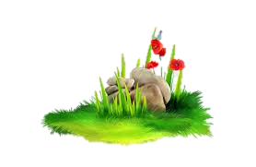
Lesson’s Identity
Class : Four
Subject : English
Unit : 8
Lesson : 1.1
My Family
Time: 50 Minutes
3

Slide 4

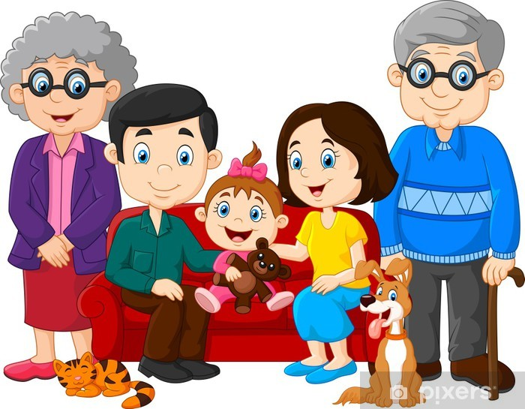
What are these pictures?
Family

Slide 5

Whom do you live with us?
Father, mother, sister and brother usually make a family. Grandmother and grandfather also live with us. They are also a part of the family.

Slide 6

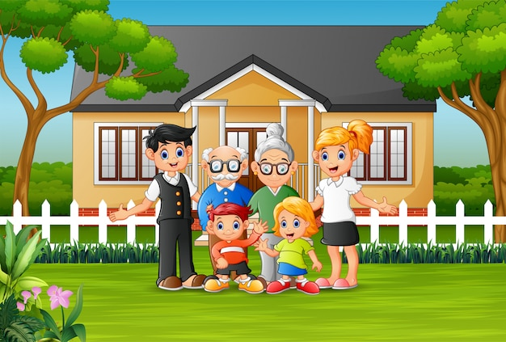

Todays lessons is –
Family

Slide 7


Learning Outcomes
Students will be able to –
1.4.1 read words, phrases and sentences in the text.
1.5.1 read words, phrases and sentences in the text with proper

Slide 8
NOW, WE START TODAY’S CLASS.
AT FIRST
WE SEE OUR ENGLISH BOOK.

Slide 9

Open Your Book on
Page 27,28, 29

Slide 10
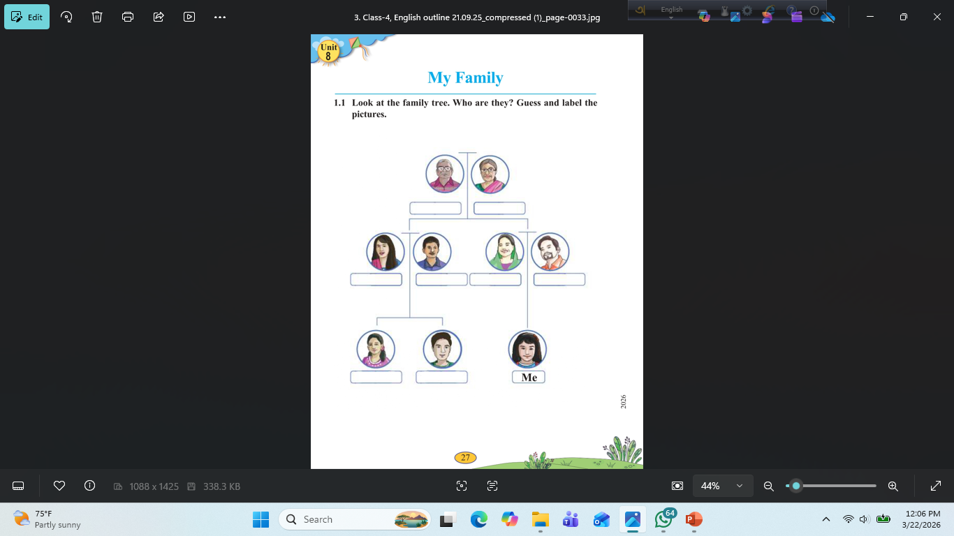
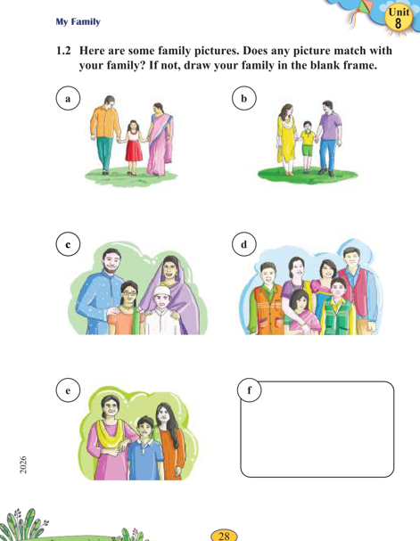
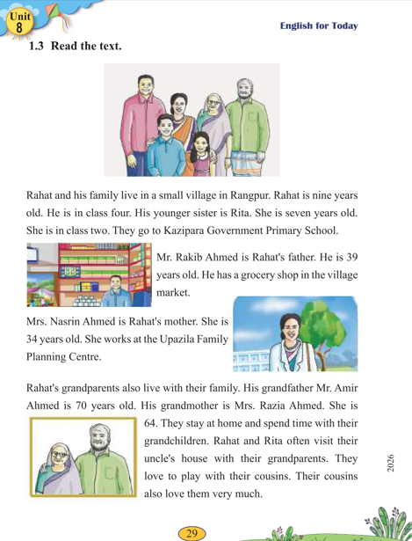

Slide 11
Look at the family tree. Who are they? Guess and label the pictures.

Slide 12
A
B
C
D
E
f
1.2 Here are some family pictures. Does any picture match with your family? If not, draw your family in the blank frame.

Slide 13

New words
Grocery
Visit
Spend
Play
Centre
Travel

Slide 14


Home work 22/03/26
Write 10 new words.

Slide 15
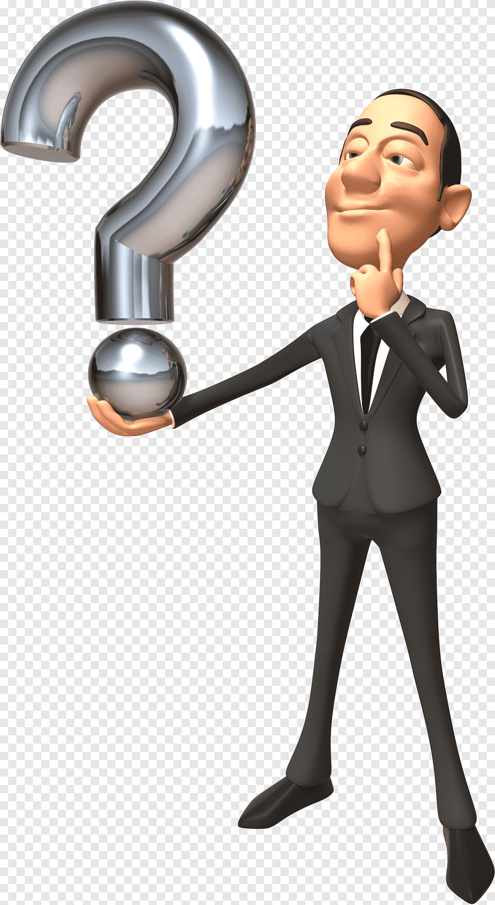
How did you feel today’s class?
If you have any questions, please

Slide 16

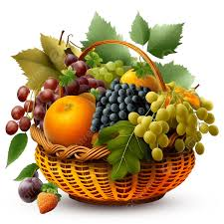
Good Bye.
See You Again.

