Slide 1
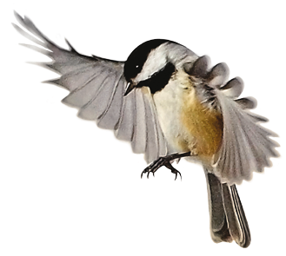


Slide 2
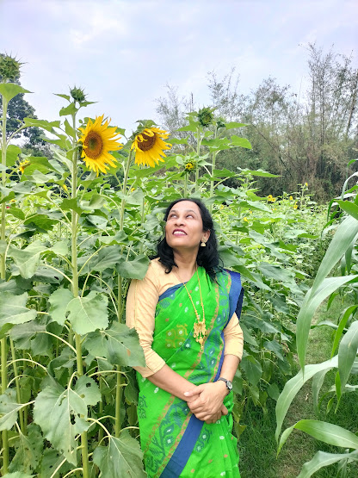
Teacher identity
Rina pervin
Assistant teacher
Surjanagar govt. primary school
Rajbari sadar, Rajbari.

Slide 3
Lesson identity
Subject : English
Class : Four
Lesssons :My family
Unit :8

Slide 4
Learning outcomes:
Listening:
1.1.1 recognize sound differences in the context of words.
Speaking:
1.1.1 repeat after the teacher and say words , phrases and sentences with proper sounds , stress and intonation.
Reading:
1.5.1 read words , phrases and sentences in the text with proper pronunciation , stress and intonation.
Writing:
8.1.2 make sentences using phrases given in the text book
7.2.1 write the time(hours only) and mention a.m/p.m

Slide 5
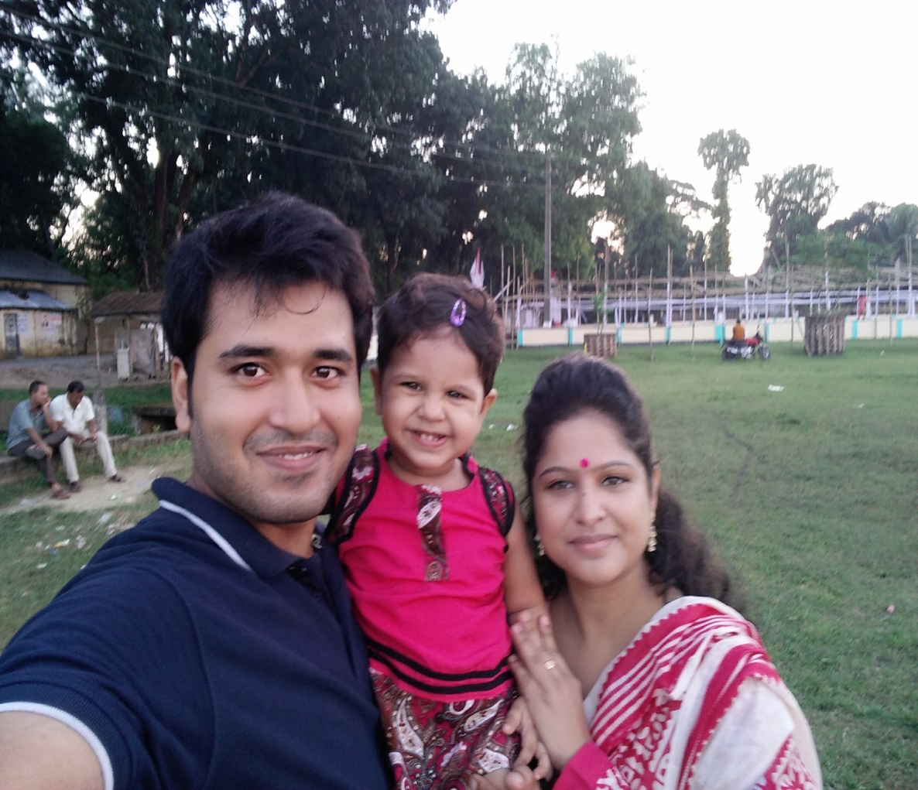
Look at the picture
Todays lesson: My family

Slide 6
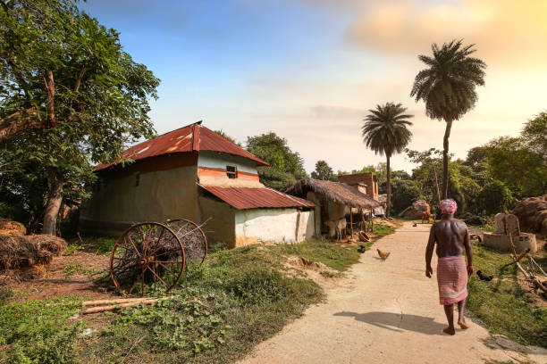
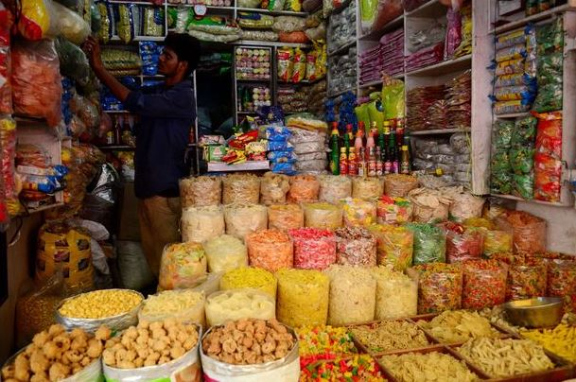
Find out new words
village
Grocery shop

Slide 7

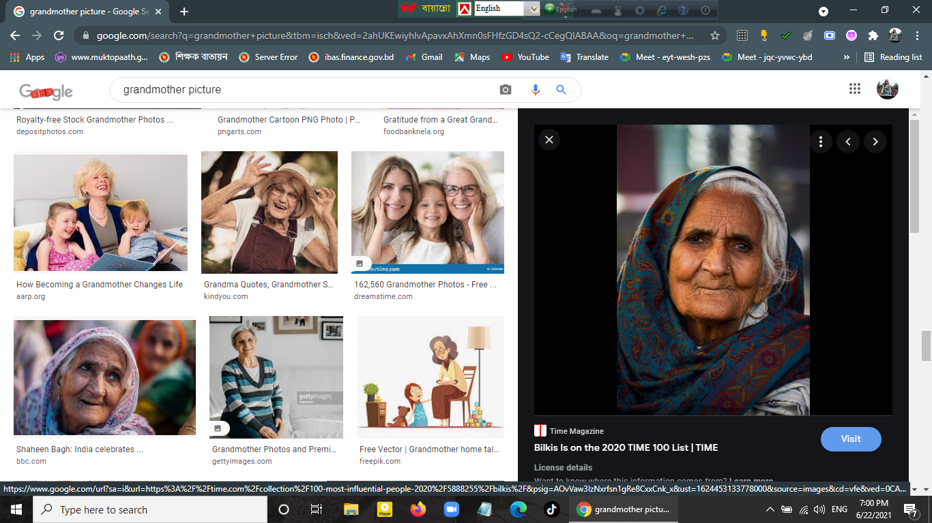
family
grandmother

Slide 8
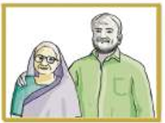
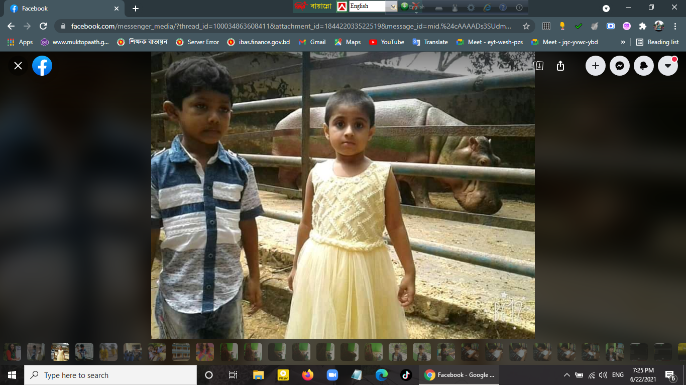
grandfather
visit

Slide 9
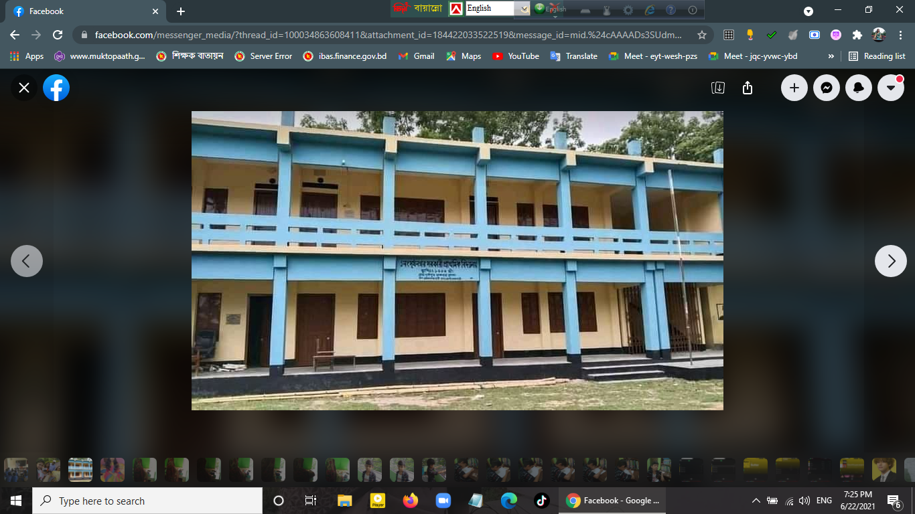
School
Grandparents

Slide 10
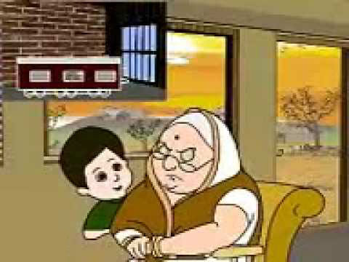
They stay at home and spend time with their grandchildren. Rahat and Rita often visit their uncle's house with their grandparents. They love to play with their cousins. Their cousins also love them very much.

Slide 11
They stay at home and spend time with their grandchildren. Rahat and Rita often visit their uncle's house with their grandparents. They love to play with their cousins. Their cousins also love them very much.

Slide 12
They stay at home and spend time with their grandchildren. Rahat and Rita often visit their uncle's house with their grandparents. They love to play with their cousins. Their cousins also love them very much.

Slide 13
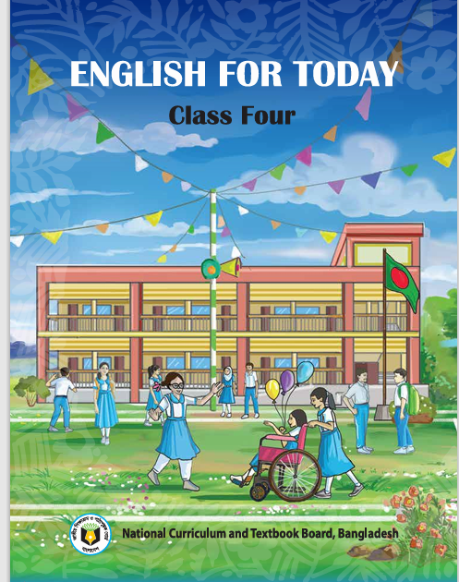
Open your english book page 29

Slide 14
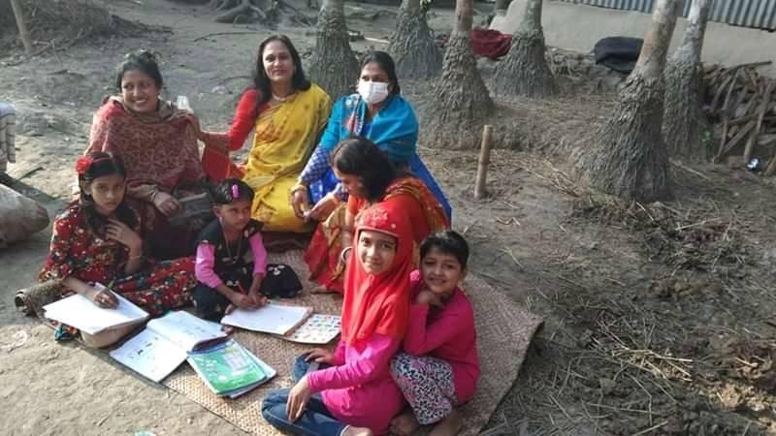
Teacher’s loud reading

Slide 15
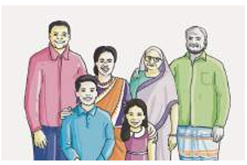
Rahat and his family live in a small village in Rangpur.Rahat is nine years old.He is in class four his younger sister is Rita.She is seven years old. She is in class two.They go to Kazipara Government Primary School.

Slide 16
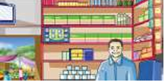
Mr. Rakib Ahamed is Rahat’s father.He is 39 years old.He has a grocery shop in the village market.

Slide 17
Rahat's grandparents also live with their family. His grandfather Mr. Amir Ahmed is 70 years old. His grandmother is Mrs. Razia Ahmed. She is 64

Slide 18
They stay at home and spend time with their grandchildren. Rahat and Rita often visit their uncle's house with their grandparents. They love to play with their cousins. Their cousins also love them very much.

Slide 19
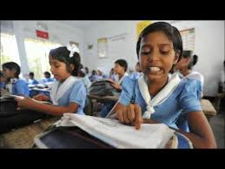
Students silent Reading

Slide 20
Individual Work:
Answer the flowing questions
1.Who is Rita ?How old is she?
2.What is the name of Rahat,s father?What does his father do?
3. Who is Mrs.Nasrin Ahamed?Hoe old is she?
4.Who are the grandchildren of Amir Ahamed?
5. Who do Rahat and Rita often visit? What do they do ther?

Slide 21
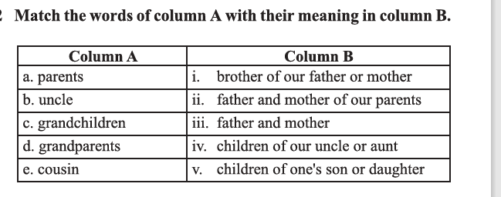

Slide 22
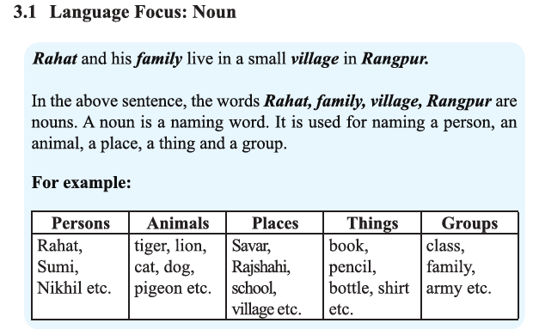

Slide 23
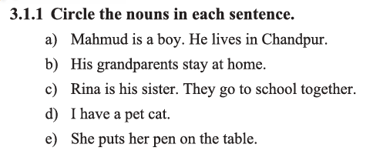

Slide 24
a) (Mahmud) is a boy. He lives in Chandpur.
b) His grandparents stay at home.
c) Rina is his sister. They go to school together.
d) I have a pet cat.
e) She puts her pen on the table.

Slide 25
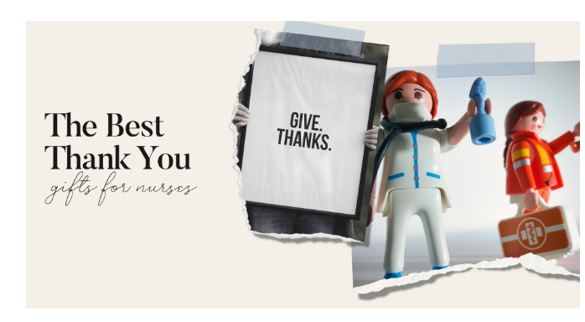
Thank you

