Slide 1
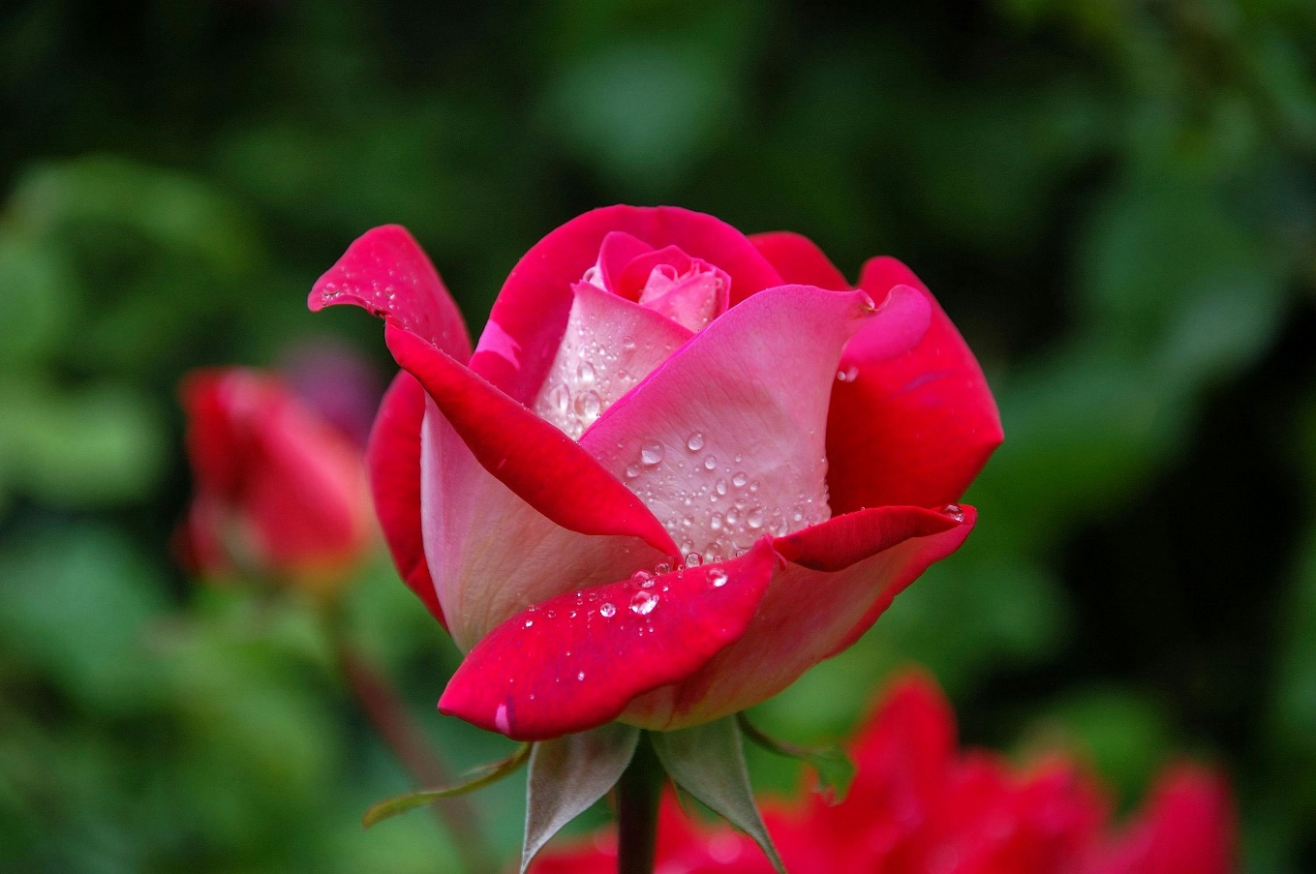
Welcome
To
My new class

Slide 2

Introduction
Teacher’s Identity
Name: Md.Yousuf Khan
Assistant teacher of English
Tenua High School
Hironpur,Purbadhala
Netrokona
Lesson Identity
Subject: English 2nd paper
Class: Ten
Unit: 8,Lesson-1
Date:
Time:45 minutes

Slide 3

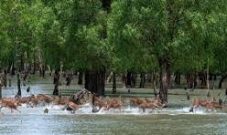
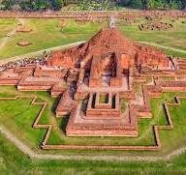
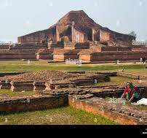
Do you know about these pictures?
What are the names of these of pictures?

Slide 4
These are called ‘The Sundarbans @ The Somapura Mahavihara.’
These are the parts of our heritage.
“Heritage” is what we inherit from the past , live with in the present and then pass on to our children or future generations.

Slide 5
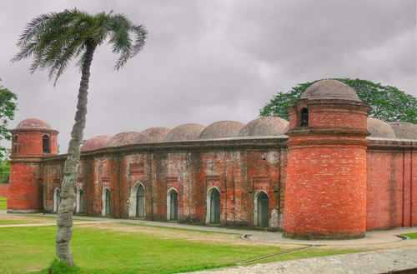
What do you see in the picture? Describe it.
This is the Shat Gombuj Mosque . It is one of the historical places of Bangladesh. It is also one of the world heritages .

Slide 6
Today’s Topic is
The Shat Gambuj Mosque
Unit – 08
Lesson -01

Slide 7
Learning Outcomes
After completing this lesson , the learners will be able to
1.To talk about the picture
2. Read the understand text through silent reading
3. The will be able to identify key information.
4. Write about a historical place of Bangladesh.
Notes:
Write

Slide 8
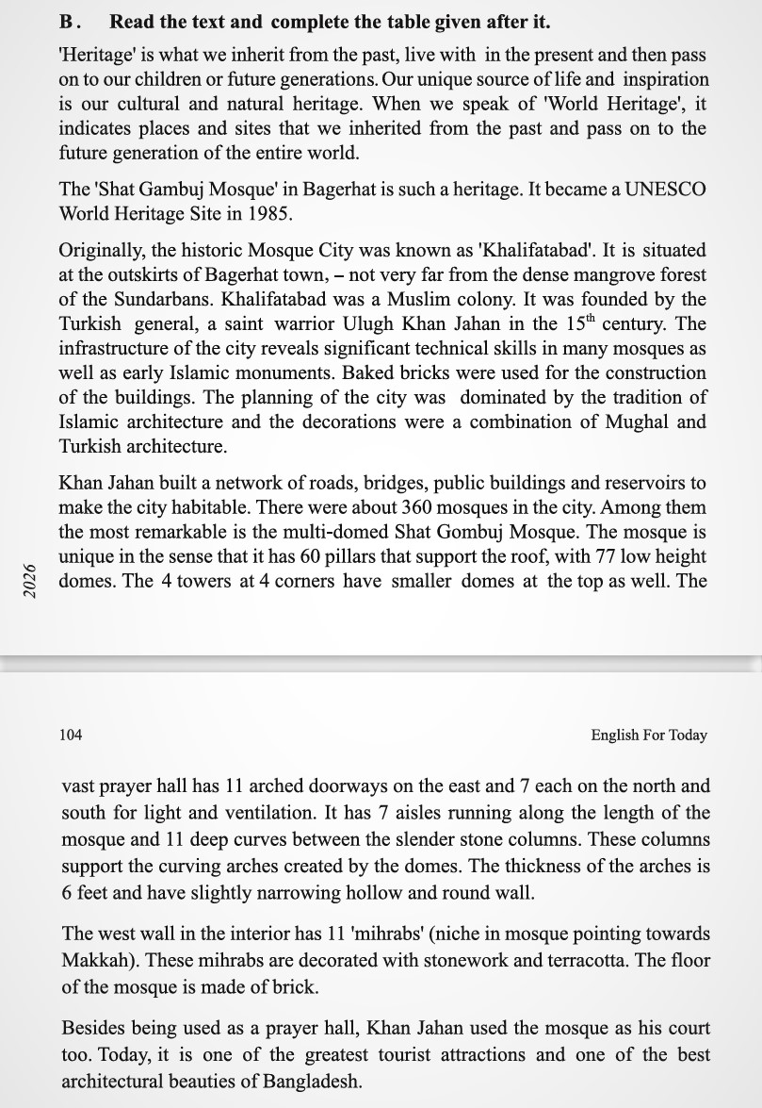

Slide 9
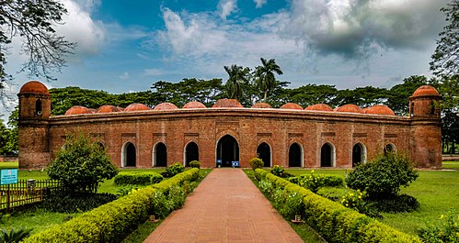
Have a look outside the mosque.
Four corners have 4 smaller dooms
77 low height dooms
11 Arched doorways easton

Slide 10
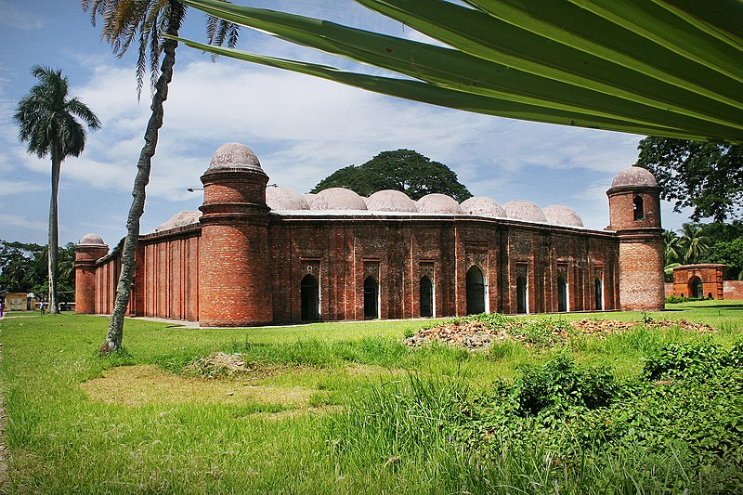
7 Arched doorways each on north and south

Slide 11
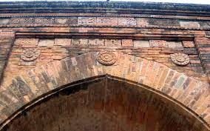
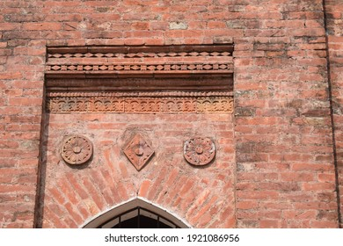
The interior western wall of the mosque is beautifully decorated with terracotta

Slide 12
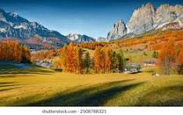
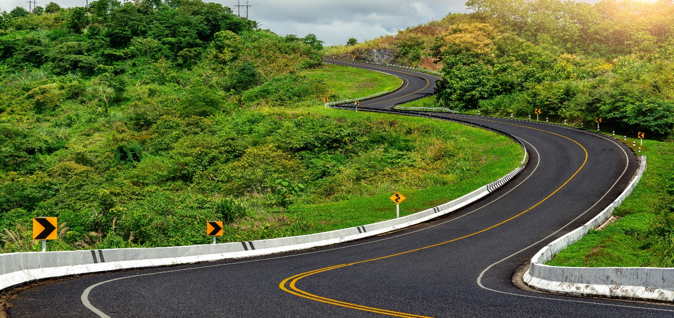
The outer part of a town or city
Outskirts
The place is outskirts of the city
Curve
Bend
The road has a big curve to the left.

Slide 13
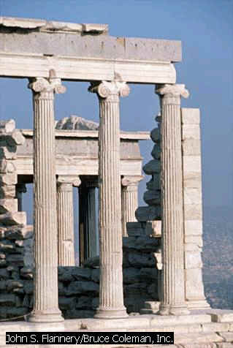
=
Slender
Thin
A tall pillar made of stone
Column
Few slender columns of the destroyed building are still standing.

Slide 14
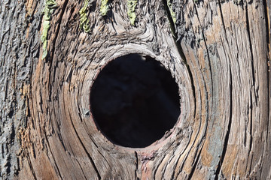
Hollow
Empty space inside
There is a big hollow in this tree.

Slide 15
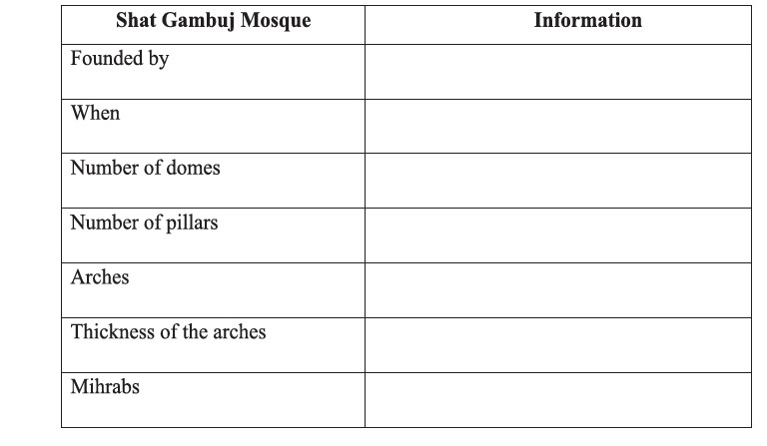
Pairs Work

Slide 16
Take it together
Shat Gambuj Mosque | Information
Founded by | Khan Jahan Ali
When | 15th century
Number of domes | 77 domes
Number of pillars | 60 pillars
Arches | 11 arches
Thickness of the arches | 6 feet thick
Mihrabs | 11 miharabs

Slide 17
Group Work
1. Why is the Shat Gambuj Mosque a world heritage?
2. Why is it famous?
3. For what purpose was the mosque used?

Slide 18




Evaluation-1
Now read the text in the book and choose the correct answer
1. How many world heritage sites are there in Bangladesh?
a) one b) two c) three d) four
$$$$
2. Where is the Shat Gombuj Mosque situated in?
a) centre of Bagerhat b) out of Bagerhat
c) suburb of Bagerhat d) centre of Khulna
$$$$
3. Which have worn away with the passage of time?
a) pillars b) domes c) doors d) roof
$$$$
4. When Khan Jahan Ali established this mosque?
a) before 1405 b) after 1405
c) before 1459 d) after 1500
$$$$

Slide 19
Evaluation-2
Read the text again and fill in the table .
Who / What | Event / Activities | When/Why
The Satgombuj mosque |  | In 1985
It | was founded
Khan Jahan Ali |  | to fit the city to live in.
The mosque | is unique
It |  | for its architectural beauties.
(a) became a UNESCO world heritage sight
(b) in the 15th century
c) built a nteworks of roads, bridges, public buildings and reservoirs
d) for its 60 pillars that supports the roof with 77 low height domes.
e) attracts the tourists

Slide 20
HOME WORK
Write some sentence about ‘ A Mosque’ in the village where you live .

Slide 21

THANK YOU All

