Slide 1
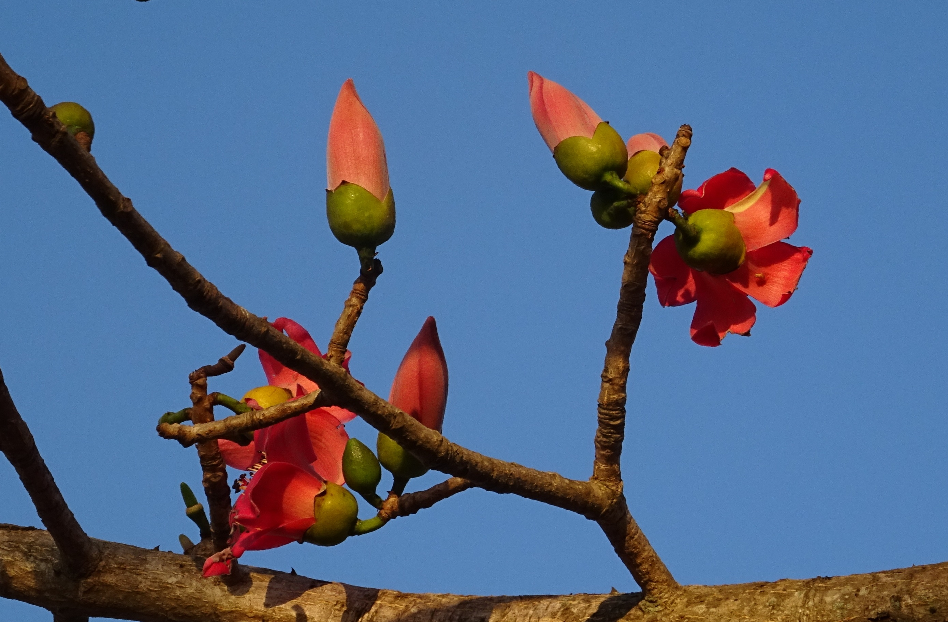
WELCOME

Slide 2
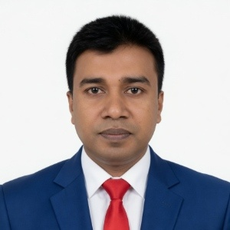
Introduction of the Teacher
Md. Mofijul Haque
Assitant Teacher (Islamic Studies)
Moinpur High School,
Kasba, Brahmanbaria.
Mobile: 01616-115131
Email: mofijulhaque54@gmail.com

Slide 3


Introduction of Lesson
Class : Seven
Subject : English
Unit : Three
Lesson : 1
Time : 50 Minutes

Slide 4
Learning Outcomes
-By the end of the lesson students will be able to..
-ask and answer questions.
-talk about familiar events.
-read and understand the text.

Slide 5
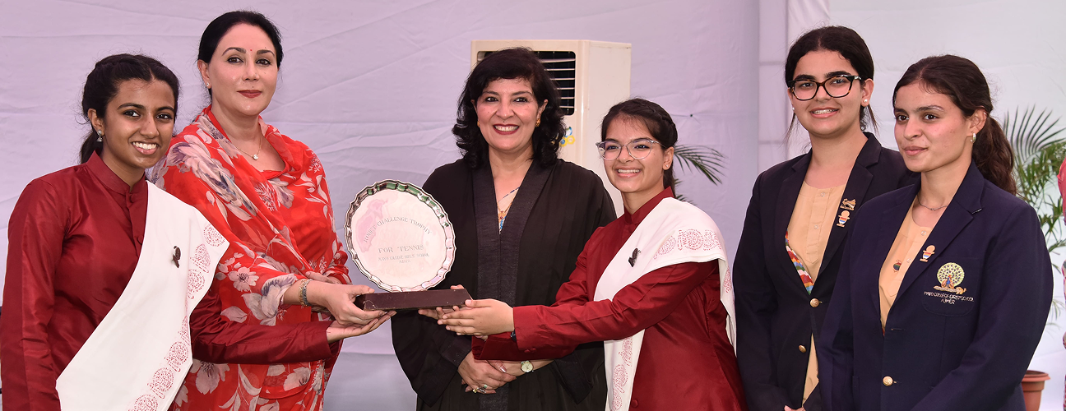
What do you see in the picture?

Slide 6
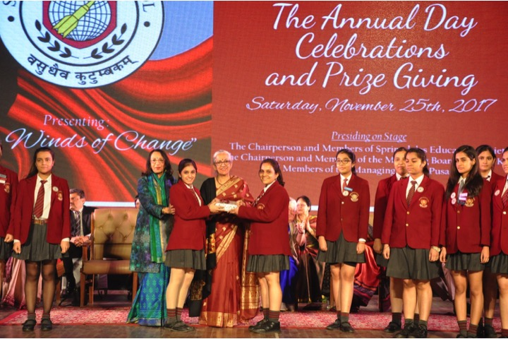
What can you see in the picture?

Slide 7
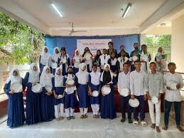
Today’s Lesson
Prize-giving day at School

Slide 8

Now Open The Book At Page 17

Slide 9
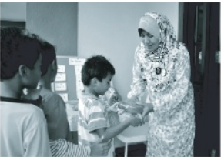
Activity: A
Look at the picture and discuss
the following questions in pairs.
Who can you see in the picture?
What are they doing?

Slide 10
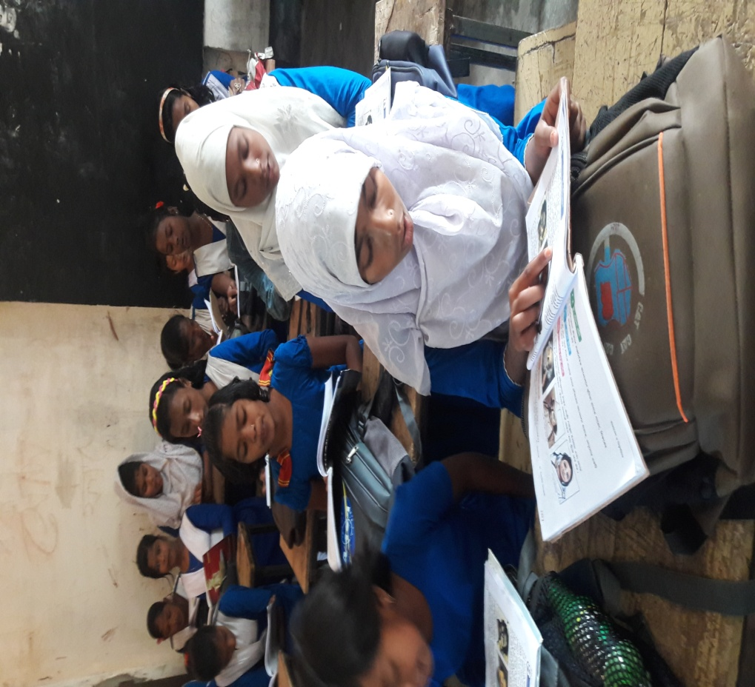
Activity: B
Students’ silent reading

Slide 11

New Words & Vocabulary
Occasion ------ event
Decorated ------ furnished/ adorned
Displayed ------ Show/ Exhibition
Function ------ ceremony/ festival
Eminent ------ famous/ great
Praised ------ admired
Gave away ------ distribute

Slide 12
Individual Work
Write the answer of the following questions:
a)Who was the chief guest of the function?
b) When did the function start?
c) How many prizes did Flora get?

Slide 13
Check your answers.
a)Who was the chief guest of the function?
- The principal of PN college was the chief guest of
the function.
b) When did the function start?
-The function started at 4 pm.
c) How many prizes did Flora get?
- Flora got two prizes-one for regular attendance and
the other for good results in the annual exams.

Slide 14
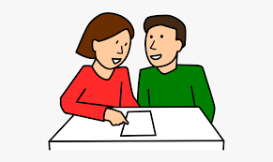
Activity: C
Students’ pair work

Slide 15

Make pairs and match words with their meanings.
Words | Meanings
visit | Speak highly of something or somebody
ceremony | Extremely good
eminent | Go to see a person or place
praise | Put something in a place where you can see easily
outstanding | function
display | People having lots of power and influence

Slide 16
Check your answers.
1. visit go to see a person or place.
2. ceremony function.
3. Eminent People having lots of power and
influence.
4. Praise speak highly of something or
somebody.
5. outstanding extremely good.
6. display put something in a place where
you can see easily.

Slide 17
Home Work
Write a short paragraph on ‘A prize-giving ceremony at your school’.

Slide 18


