Slide 1





W
E
L
O
E
C
M

Slide 2

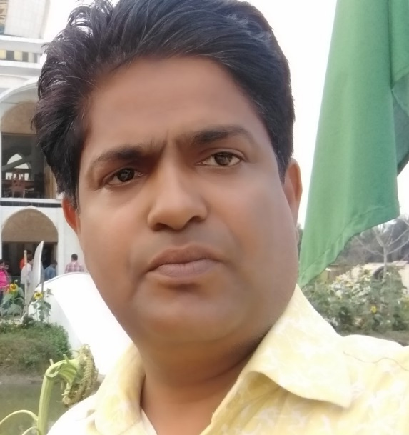
Teacher’s Identity
Md Jahid Hossen Khan
Headteacher
Rajihar Government Primary School .
Agailjhara , Barishal .
Mobile: 01623309794

Slide 3
Class:1
Subject:English
Unit:2
Lesson:5
Topic: Two Little Hands

Slide 4
Learning Outcomes:
Students will be able to…
sing the song with action.
2.reproduce a song.

Slide 5

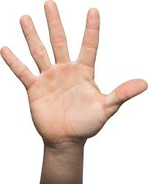
Lead in: Draw a hand.

Slide 6
What’s this?

Slide 7
What’s this?

Slide 8

What’s this?

Slide 9

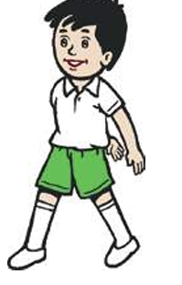
What’s this?

Slide 10

What’s this?

Slide 11
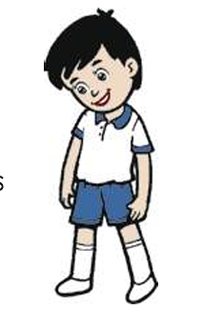
What’s this?

Slide 12
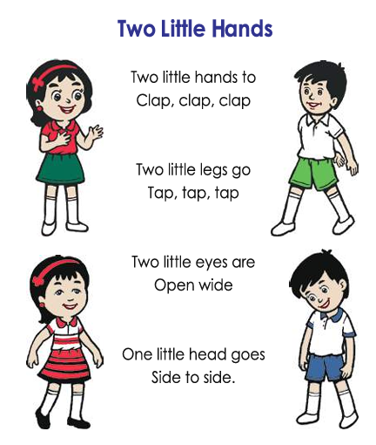
Recite the Rhyme with Action

Slide 13
Group Work

Slide 14
Pair Work

Slide 15
Say the missing word
a.One hand.
Two ……..
b. One leg.
Two ……..
c. One eye .
Two ………

Slide 16

Game: Touch the board
with the pictures leg , hand, eye, head

Slide 17
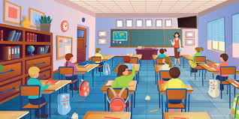
Reproduce a song by changing words.

Slide 18


