Slide 1


Slide 2


Dabasish Kumar Ghosh
Assistant teacher
Modhukhali Govt Primary School
Jhikargacha
Jashore.

Slide 3


Sub: English
Class:1
Unit-02, Lesson:17
Todays Lesson:Letter “Q &R ”
Session:01
Time: 40 Minutes

Slide 4

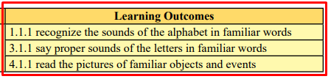

Slide 5
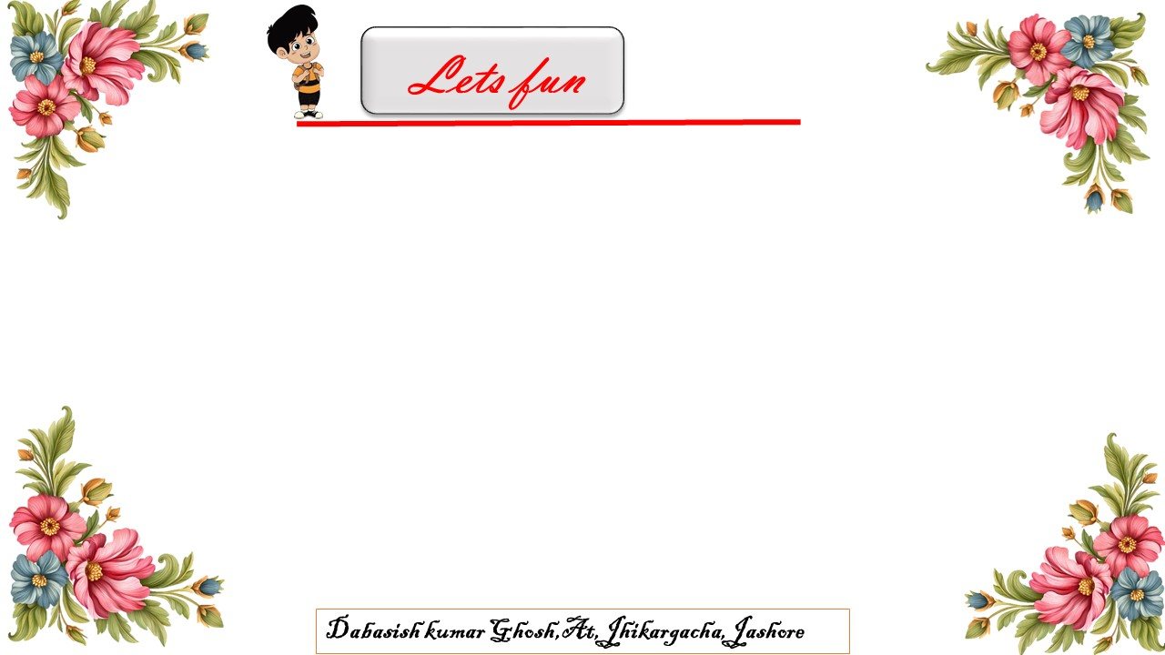
We’re going to singing Alphabet song.
Lets start

Slide 6


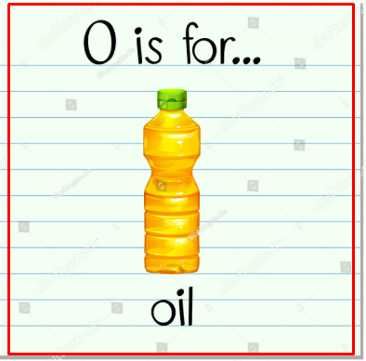

Slide 7
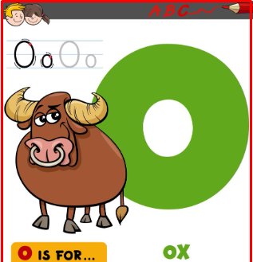

Slide 8


Slide 9


Slide 10

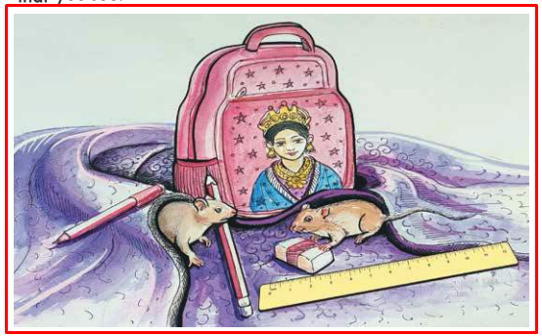
What can you see in the picture?

Slide 11

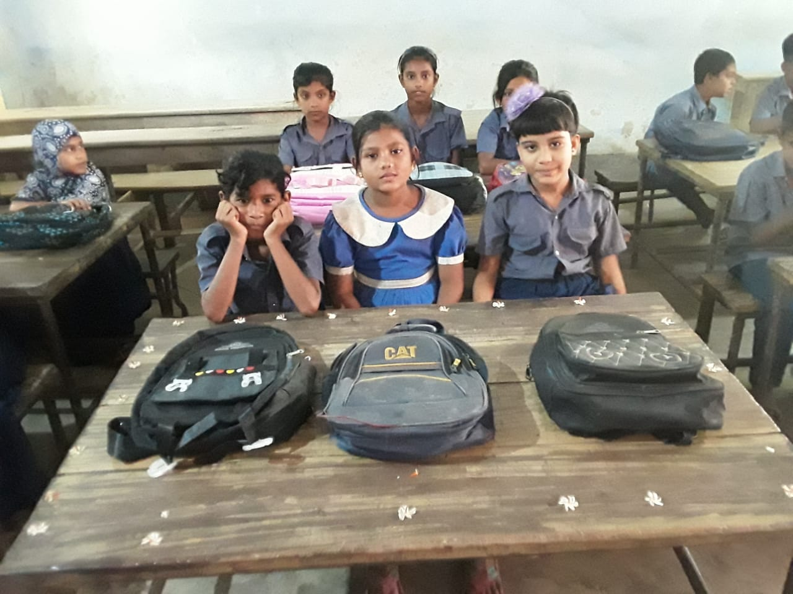
Queen.
Bag.
Rular.
Rat.
Eareser.

Slide 12
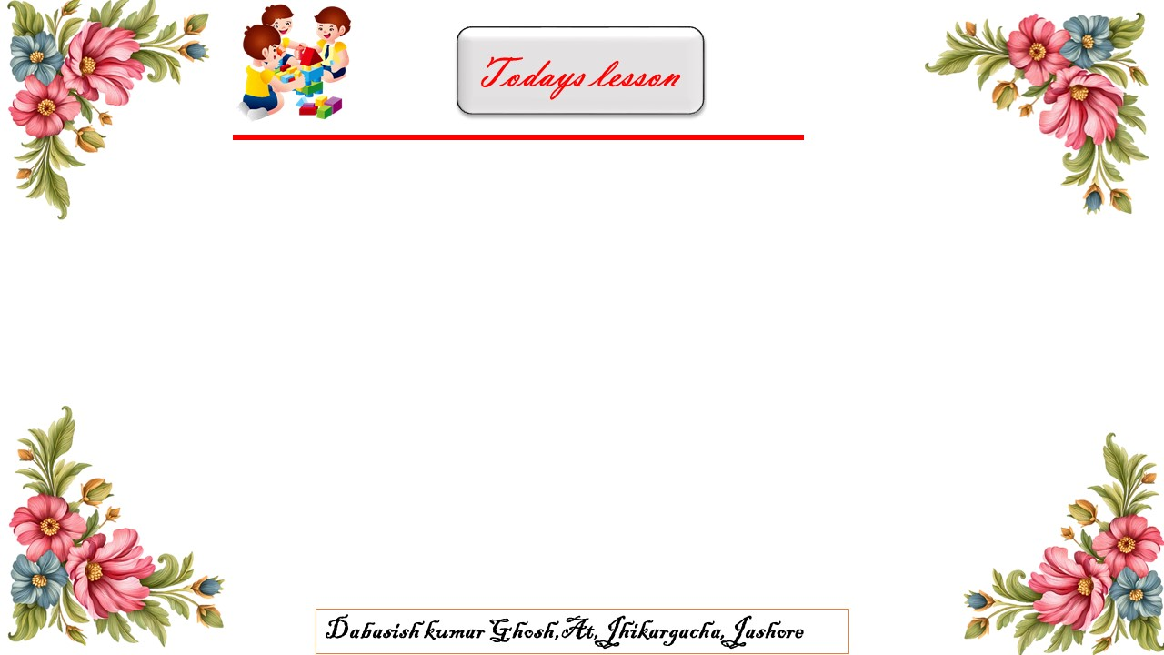
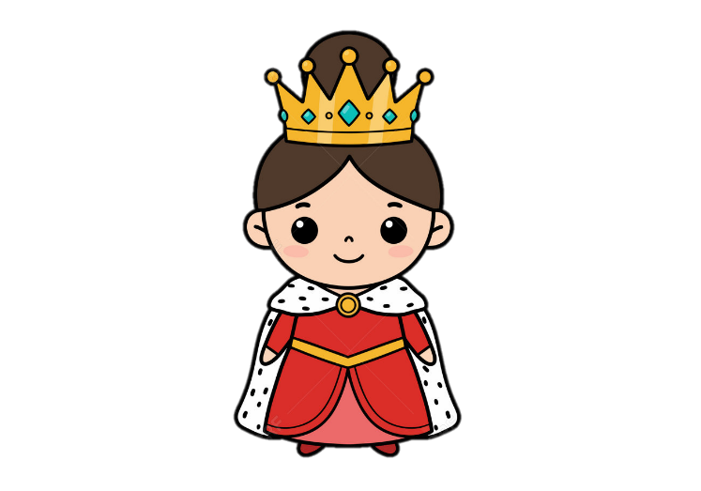
Q is for Queen
Queen

Slide 13
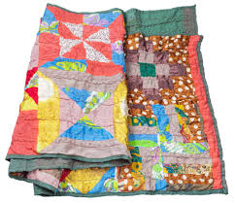
Q is for Quilt
Quilt

Slide 14

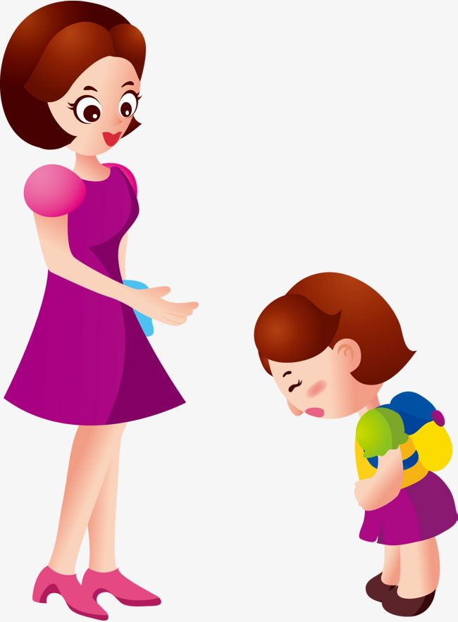
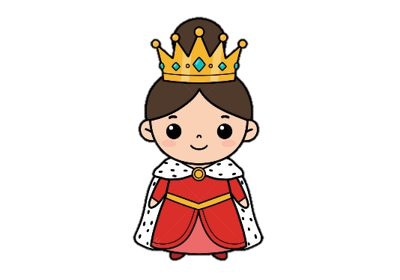
Q is for-----
Q is for
Queen

Slide 15
Q is for-----
Q is for
Quilt.

Slide 16

Goodbye

