Slide 1


Slide 2
Class : 5
Sub : English
Unit : 10
Poem: The Swing
Date : 12/5/26

Slide 3
Activity | Learning Outcome
Activity: 1.1, 2.1 | 6.1.1 Read rhymes and poems and recite with joy.
Textbook page: 52,53 | 6.1.2 Comprehend and express the main ideas of rhymes and poems through reading.

Slide 4
Good Morning
How Are you?

Slide 5
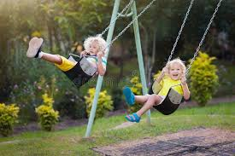
The Swing

Slide 6
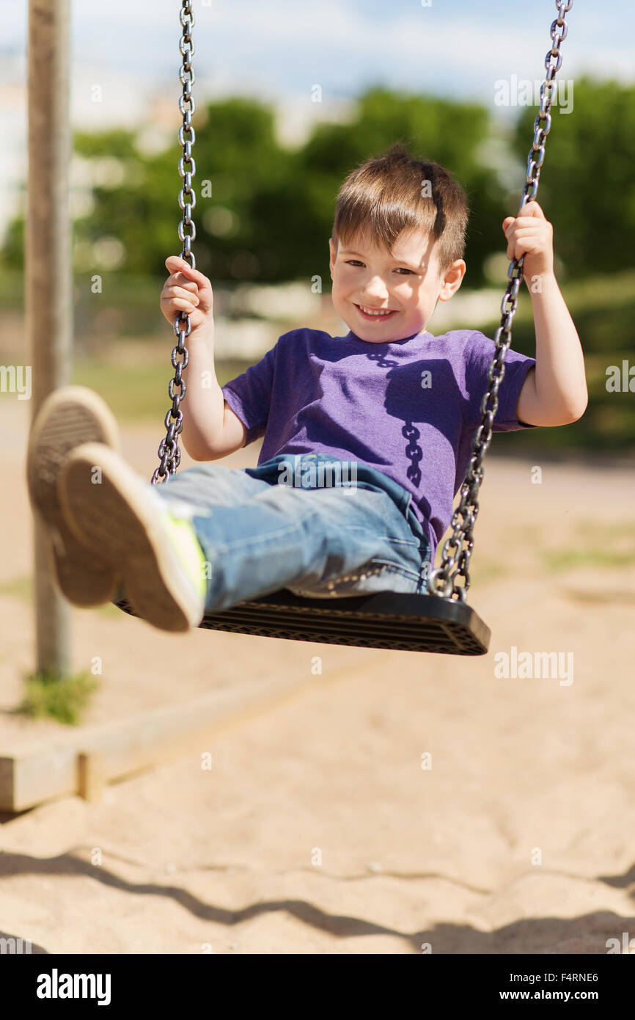
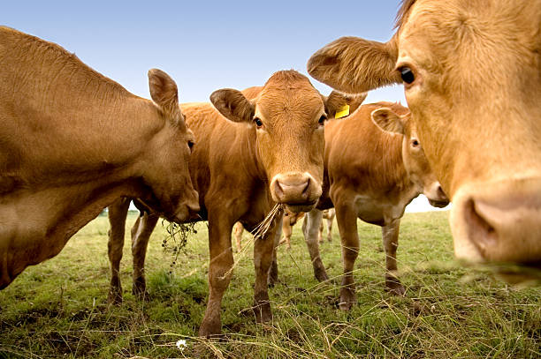
Swing
Cattle

Slide 7
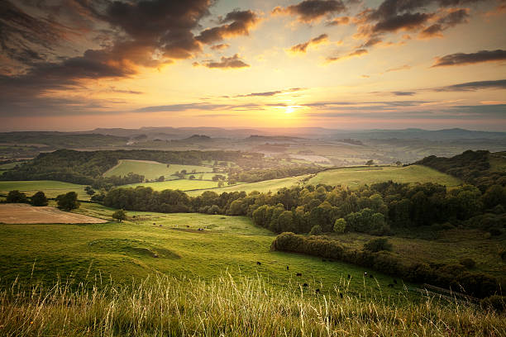
Countryside

Slide 8
Swing - A swing is something you sit on and move back and forth in a playground.
Pleasantest - It is the superlative form of“pleasant”.
Cattle - Cattle means cows, bulls, oxen, etc. kept on a farm.
Countryside - “Countryside” means the rural area outside towns and cities.

Slide 9
The Swing
Robert Louis Stevenson
How do you like to go up in a swing,
Up in the air so blue?
Oh, I do think it the pleasantest thing
Ever a child can do!
Up in the air and over the wall,
Till I can see so wide,
Rivers and trees and cattle and all
Over the countryside—
Till I look down on the garden green,
Down on the roof so brown—
Up in the air I go flying again,
Up in the air and down!
The Swing
Robert Louis Stevenson
How do you like to go up in a swing,
Up in the air so blue?
Oh, I do think it the pleasantest thing
Ever a child can do!
Up in the air and over the wall,
Till I can see so wide,
Rivers and trees and cattle and all
Over the countryside—
Till I look down on the garden green,
Down on the roof so brown—
Up in the air I go flying again,
Up in the air and down!

Slide 10
Summary of the session
What have we learnt today?
“We have read the poem and got the main ideas.”

Slide 11
Have a nice day. See you again in the next class.
Take Care.

