Slide 1

WELCOME

Slide 2
INTRODUCTION
INTRODUCTION OF TEACHER
JALI SHIL ASSISTANT TEACHER(ENGLISH)
PANCHASH HIGH SCHOOL AND COLLEGE
INTRODUCTION OF LESSON
UNIT:4
Lesson :5
Our Liberation War
TIME:45 Minutes
Date:23/06/2026

Slide 3


Slide 4
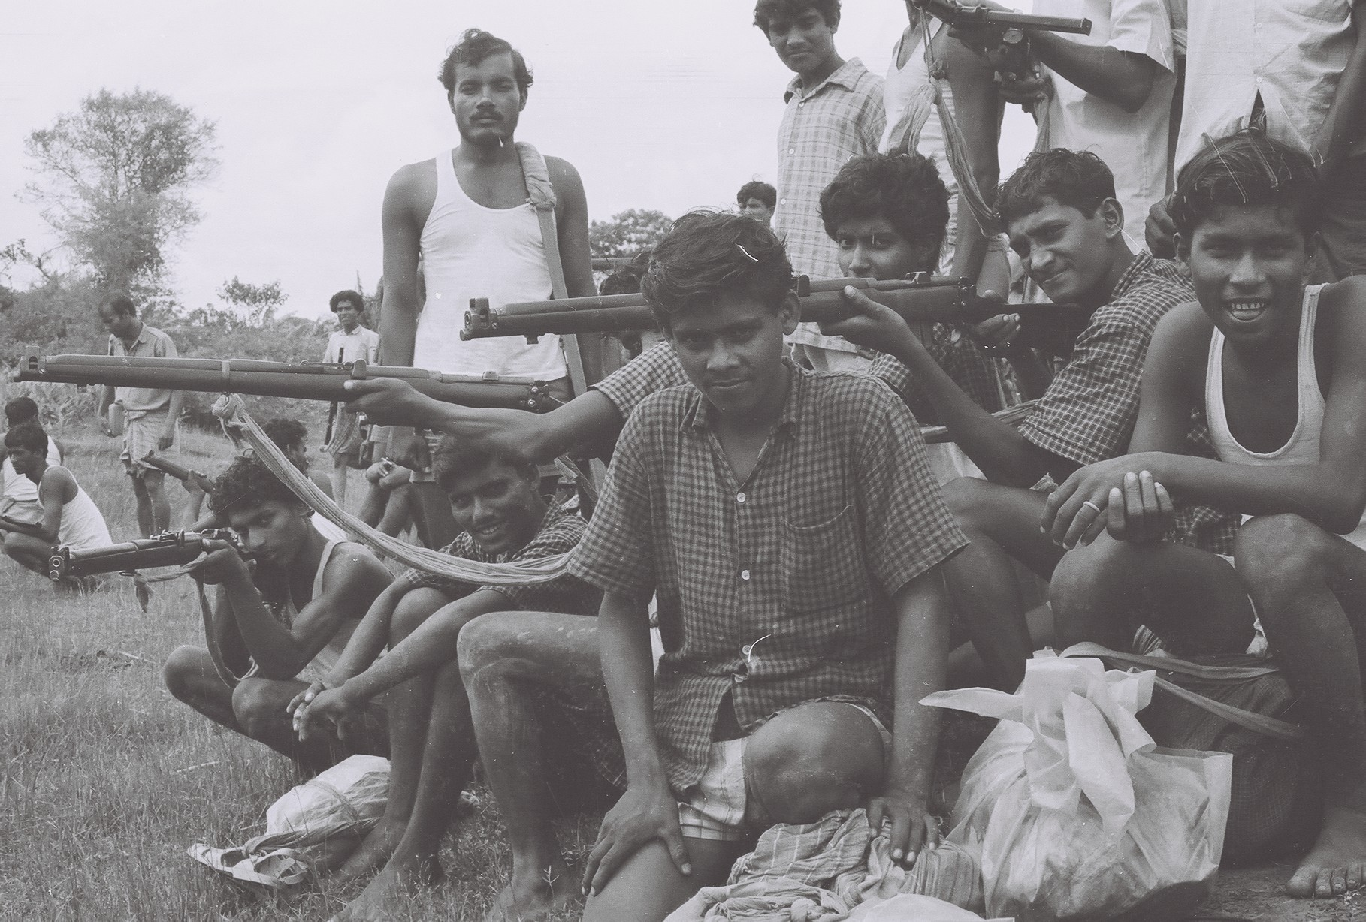
Our Liberation War

Slide 5
LEARNING OUTCOME
After we have studied this Lesson
We will learn be able to_--- 1)Our Liberation War
2)Our National conciousness
3)Our History of Patriotism

Slide 6
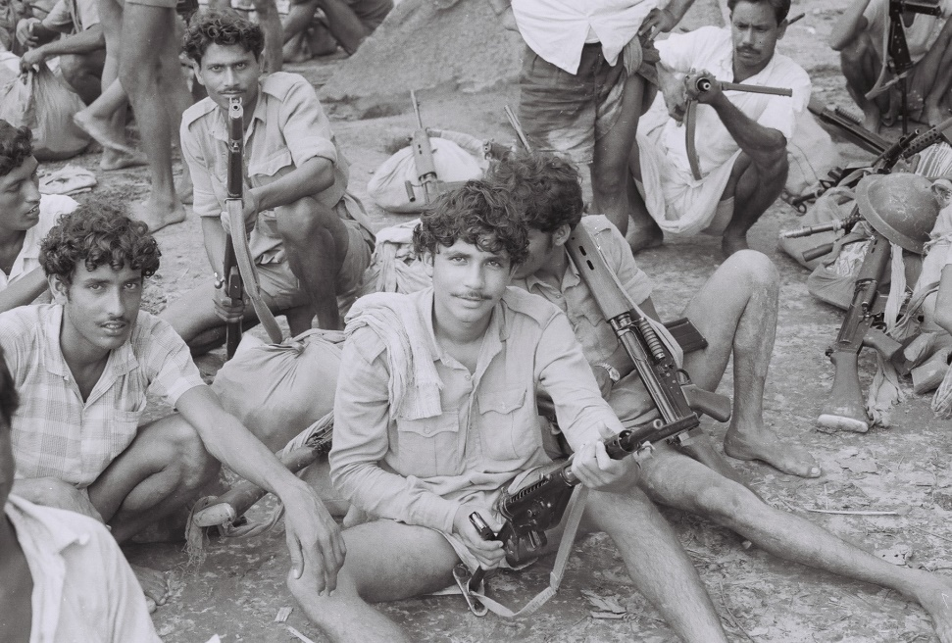

What Can We Understand by the Picture?

Slide 7
Group work:1)Discuss about the
topic2)Draw a picture on the topic of today`s lesson.

Slide 8
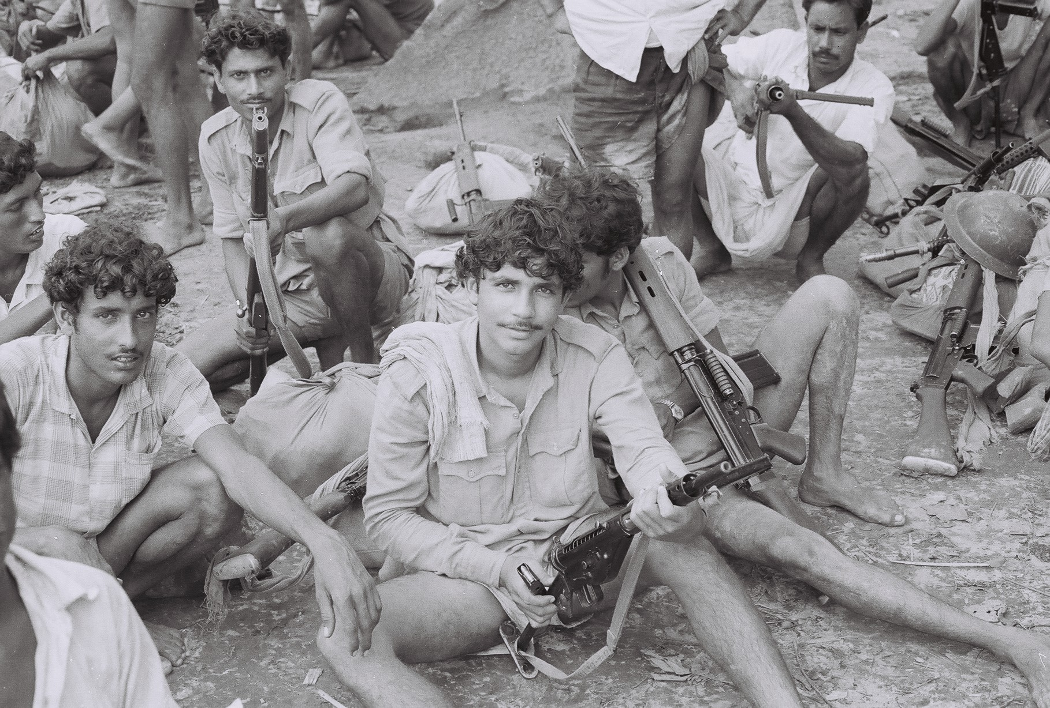
Evaluation:1)Say something about the Picture

Slide 9
Home Work:Write down Three Name of The Liberation Fighter.

Slide 10
Thank You
Our Lesson Is End

