Slide 2

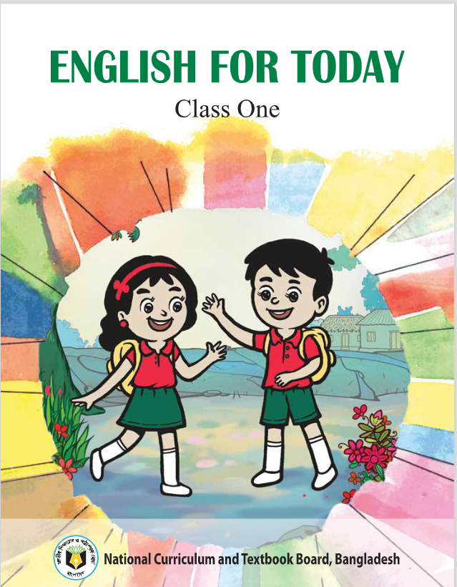
MD KOYES AHMED
Class: One
Sub: English
Unit: 2
Lesson: 14
Alphabet: mM nN
Session: 1
Assistant Teacher
Mohammadpur A. Gofur GPS
Dakshin Surma, Sylhet.
E-mail: koyesdsurma.syl@gmail.com
Mobile: 01710504502.

Slide 3
Greeting
How are you, my students?
Good morning, students.
Good morning, teacher.
Fine, thank you, teacher.

Slide 4
Warmup Activity
https://www.youtube.com/watch?v=X9C8D42jh0E

Slide 5
1.1.1 recognize the sounds of the alphabet in
familiar words
3.1.1 say proper sounds of the letters in
familiar words
4.1.1 read the pictures of familiar objects and
events

Slide 6
Lesson Declaration
mM nN
Alphabet (mM nN)

Slide 7
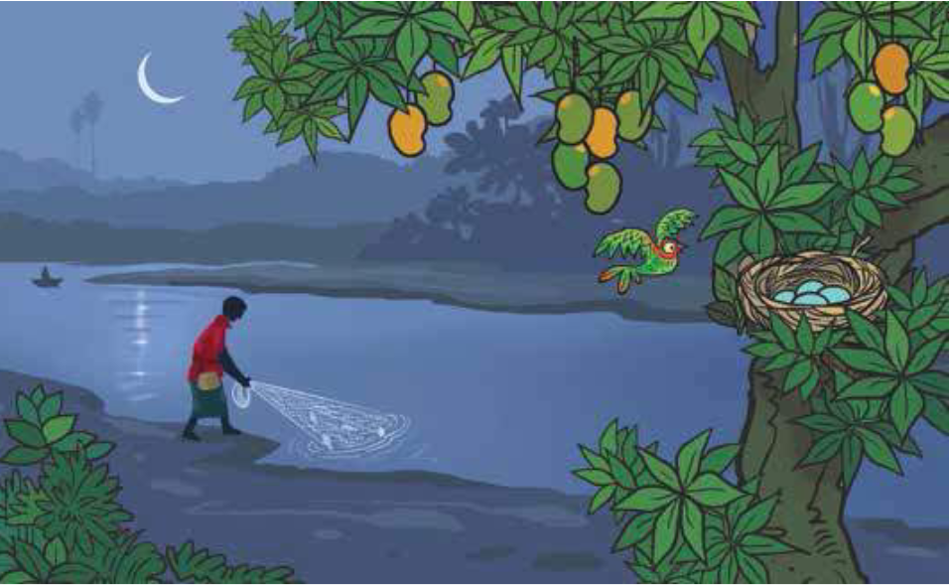
A Look at the picture. Say the names of the things and the objects
that you see.

Slide 8


Look, listen and say
moon m
Moon M
mango m
Mango M

Slide 9


net n
Net N
nest n
Nest N

Slide 10
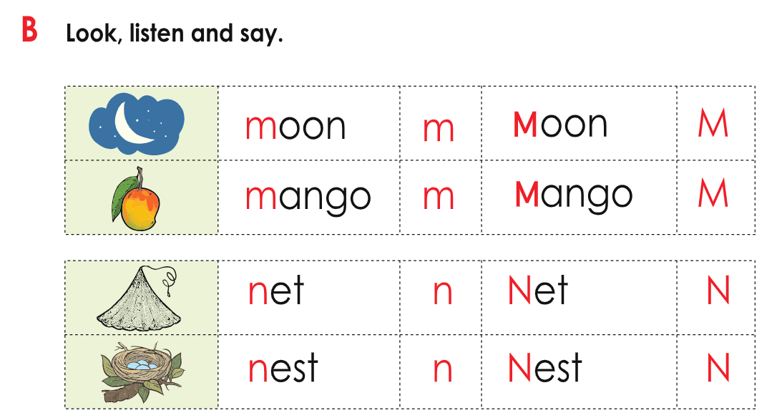
Open your book page 42

Slide 11
Read and match the small and capital Letters
M
N
n
m

Slide 12




m…..on
M…..ngo
n…….t
Ne…....t

Slide 13
write:
(Mm- Nn)

