Slide 1


Welcome

Slide 2
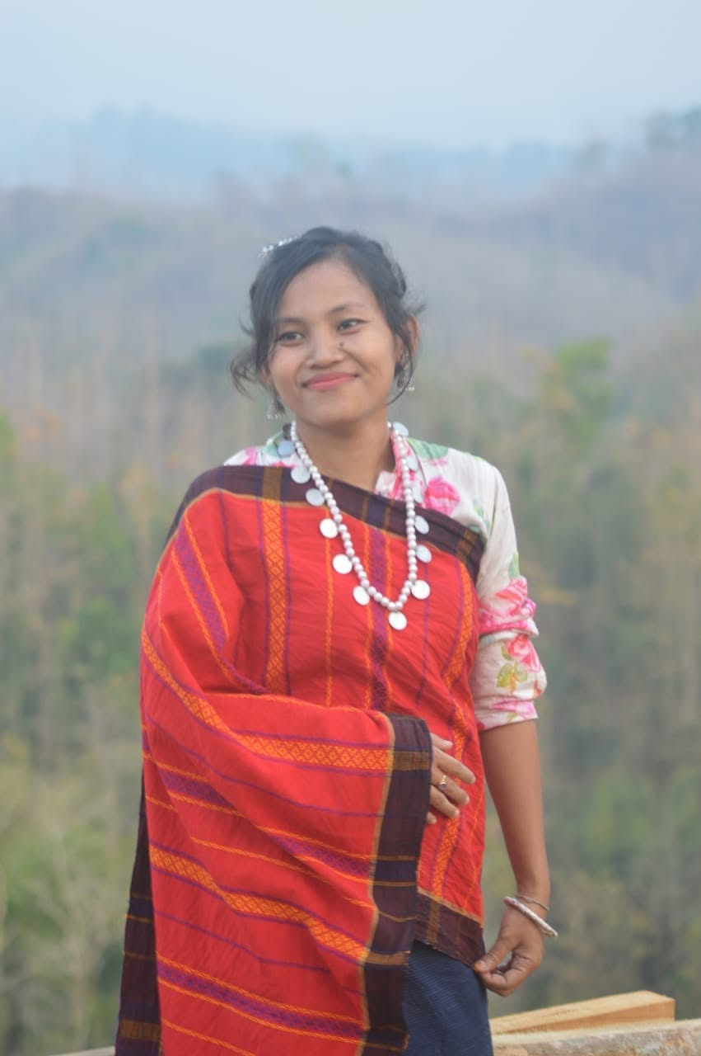
Teachers name:Dina Tanchangya
Designation:Assistant Teacher
School name:Nasalong Para GPS
Email:dinaict233@gmail.com

Slide 3

Class:Four
Subject:English
Unit:8
Session:34
Page:27-29
Activities:1.1,1.2,1.3
Date:24/06/2024
Time:40 minutes,

Slide 4
Learning Outcomes:
4.2.1 Read aloud short and simple texts with proper
stress and intonation
5.1.1 Get the specific information from simple texts.

Slide 5

What can you see in this picture?
Who are they?

Slide 6
Now,close your eyes and think
about your own family members.
How many members are there in your family?

Slide 7
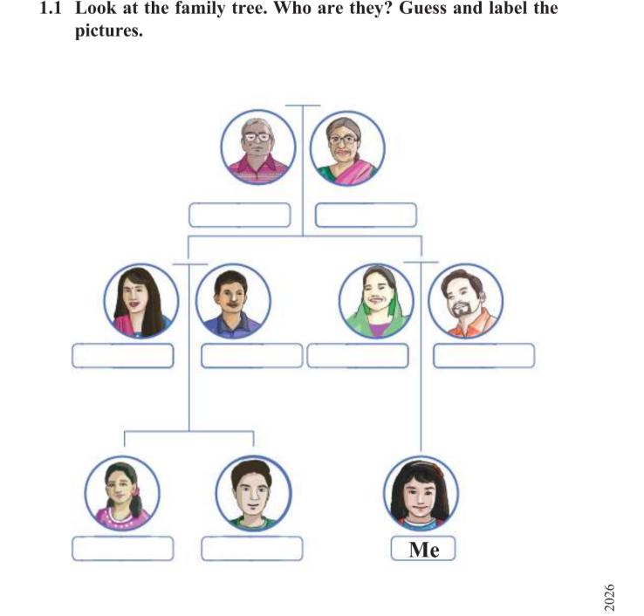
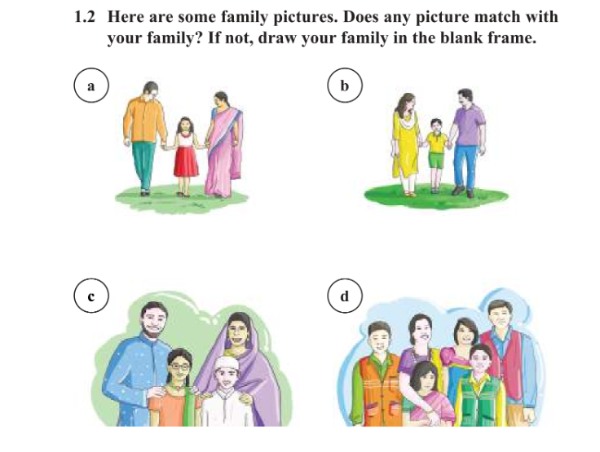
Today we will read a text about My family.
Please,open your book page no:27-29

Slide 8
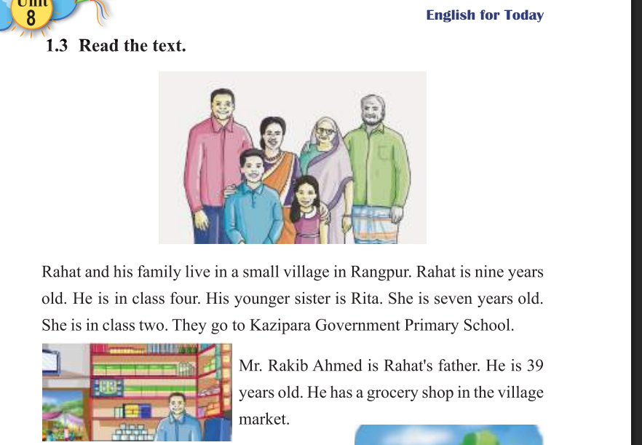
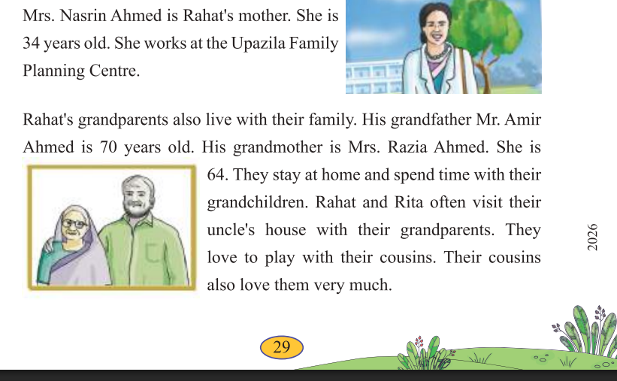

Slide 9
Practise: At first I will read out the Text with proper stress and intonation.
Then I will ask the students to read after me and trace the lines with finger.
I will divide 2 or 3 small groups. They will read the text by chain drill. I will observe the class and if anyone will unable to read proper pronunciation I will help him/her.

Slide 10
Assesmemt/Task:I will ask them some questions,,,,
Who is Rahat?
Who is Rahats father?
What does his father do?
Who is Rita?

Slide 11
What have we learnt today?
Thank you!
Notes:
Dina Tanchangya

