Slide 1



Slide 2

Introduction
Mst. Jahanara Begum
Assistant Teacher(English)
Kachua High School
Chunarughat,Habiganj
jahan359851@gmail.com
Mobile No:01706359851
Class:Nine
Subject:English 2nd paper
Unit:Four
Lesson:Verb
Time:50minutes
Date:24/06/2026

Slide 3
Let’s see some pictures & guess something.

Slide 4


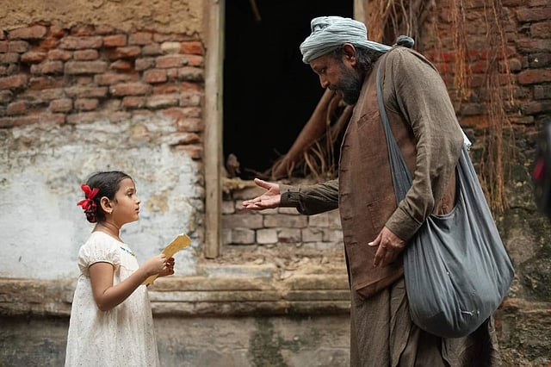



Here we see several people are working various kinds of works

Slide 5
These pictures are symbolizing today’s lesson.So,try to guess the lesson.
Yes,it is verb.So, my dear students, today’s lesson is verb.

Slide 6
Learning outcomes
After we have completed this lesson we will be able to
Define verb
Identify the classification of verb
Give example to different kinds of verbs.

Slide 7
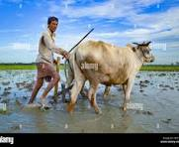
VERB
Verb is a word in a sentence that shows an action.

Slide 8

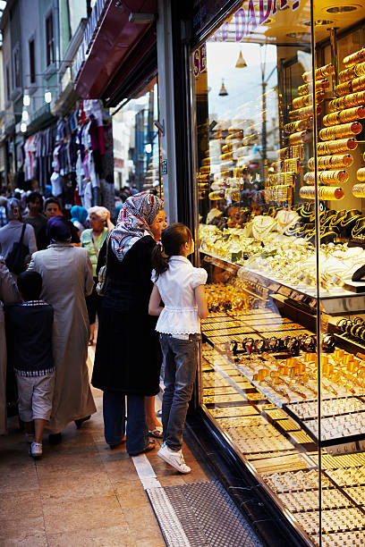

Write
Walk
Buy
Here we see some verbs with pictures like write,walk & buy.

Slide 9
There are various kinds of verbs.Let’s see them by a flowchart.

Slide 10
See the flowchart
VERB
Finite verb
Non-finite verb
Principal verb
Auxilary verb
Infinitive
Gerund
Participle
Transitive verb
Intransitive verb
To+verb
Verb+ing(Noun)
Primary auxilary verb
Model auxilary verb
Present participle
Past participle
Perfect participle
Verb+ing(Adjective)
V3
Having +V3

Slide 11

So,my dear students,I hope now you are all known about verb,definition of verb & classification of verb.

Slide 12
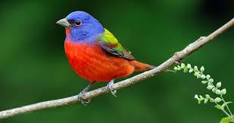
Group work
Group 1 & 3
Make a list of verbs & their meanings.
Group 2 & 4
Make a flowchart showing all kinds of verbs.

Slide 13
Home work
What is verb?
How many kinds of verbs are there?
Write the names of every kinds of verbs.
Write the names of some verbs.

Slide 14

ALLAH HAFEZ

